Slide 1

2018
Excellence in reclamation award
Presented at the
New Mexico Mining Association Annual Conference
Ruidoso Convention Center
September 6, 2018
Ken McQueen, Cabinet Secretary
Notes:
Good afternoon and thank you for being here.
This is the 23rd year that the Mining and Minerals Division of the Energy, Minerals and Natural Resources Department has presented the Excellence in Reclamation Award at the New Mexico Mining Association’s annual conference.
We thank the Mining Association for again hosting the presentation of these awards. And we also offer our appreciation of your dedication to protecting our environment, to providing education about the importance of our state’s minerals, and for establishing life-saving mine safety procedures.

Slide 2
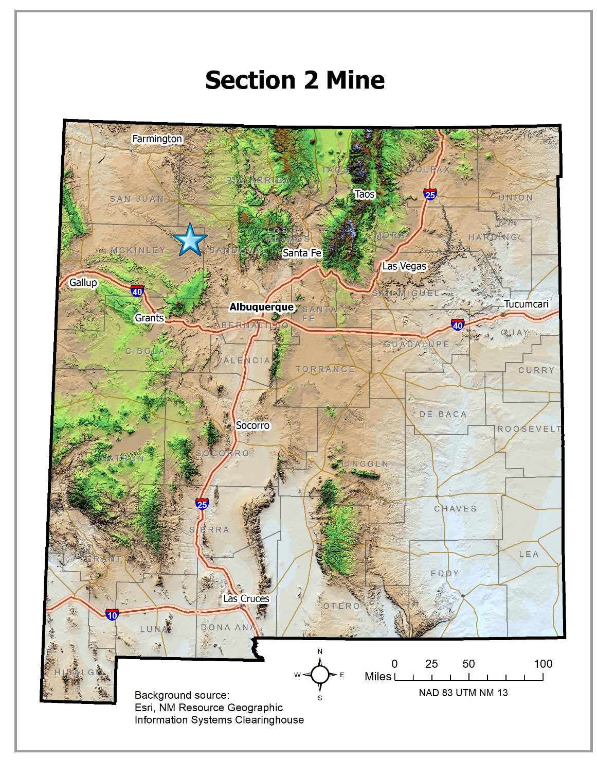

2018
Awarded
Reclamation
Site
Notes:
The nomination received this year is for reclamation at a small humate mining operation in McKinley County. The 2018 Excellence in Reclamation Award is presented to Miocene, LLC, for its reclamation work at a small mining operation.
This humate mine was known as the Section 2 Mine and was on state-owned lands in McKinley County under a lease granted by the State Land Office.

Slide 3
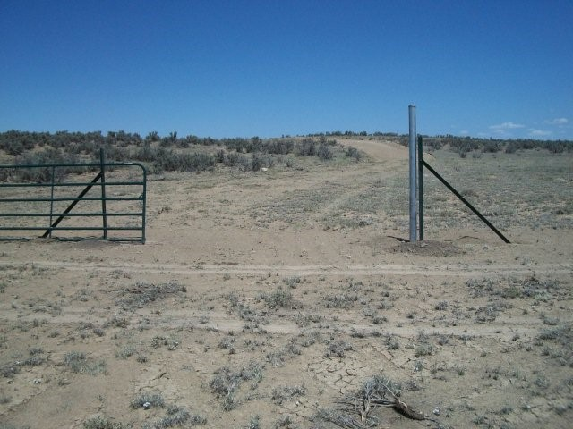
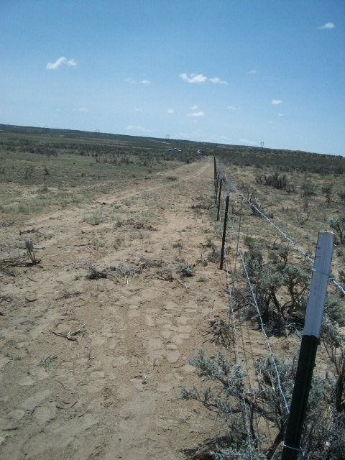
Pre-mining
Notes:
Reclamation concurrent with active mining operations was required as the legal disturbance area at any one time was limited to 10 acres in 2012 and 2013 when the mine was in operation.

Slide 4
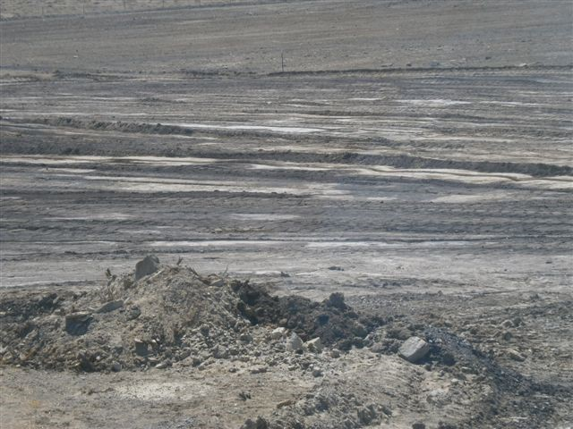
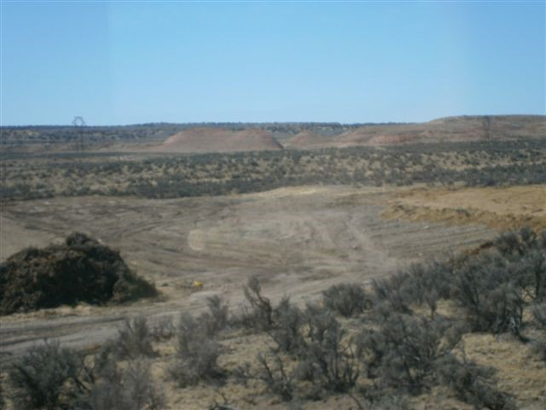
Post-mining
Notes:
To expand across the acreage that was to be mined in a timely fashion, reclamation efforts needed to occur alongside mining operations.

Slide 5
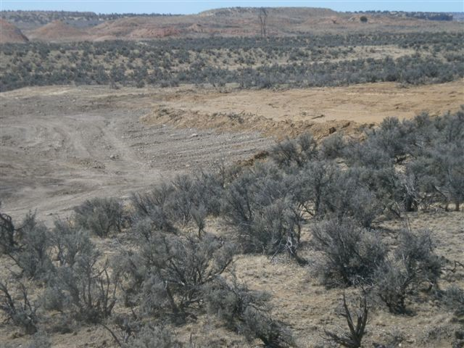
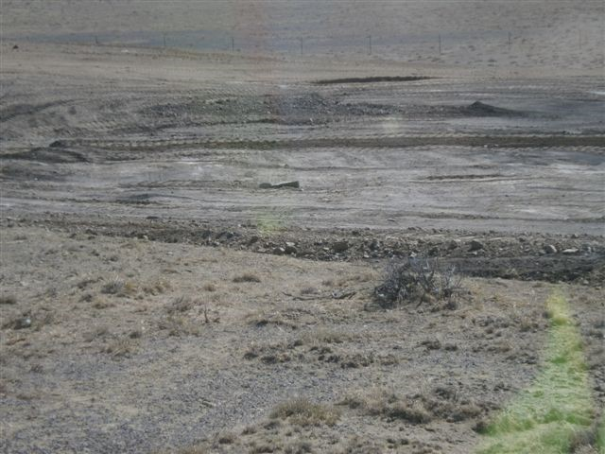
Contouring
Notes:
The native topsoil and vegetation was stockpiled/cleared and grubbed and then spread back across the mining disturbance area after earthwork was completed to recontour topography to appropriate slope and character.
Preservation of the original topsoil was a priority from the initial phases of mine planning and an absolute necessity to ensure proper revegetation success.
The re-application of vegetation that had been cleared and grubbed prior to operations and spread during reclamation acted to retain moisture and capture wind-blown seed.

Slide 6
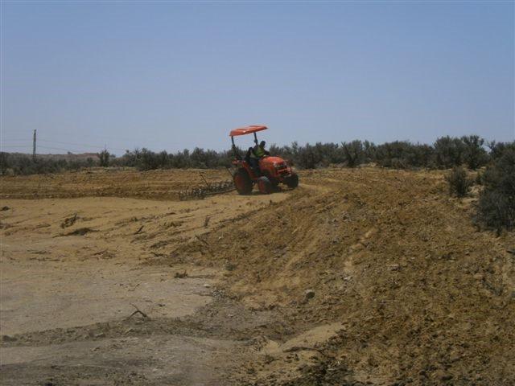
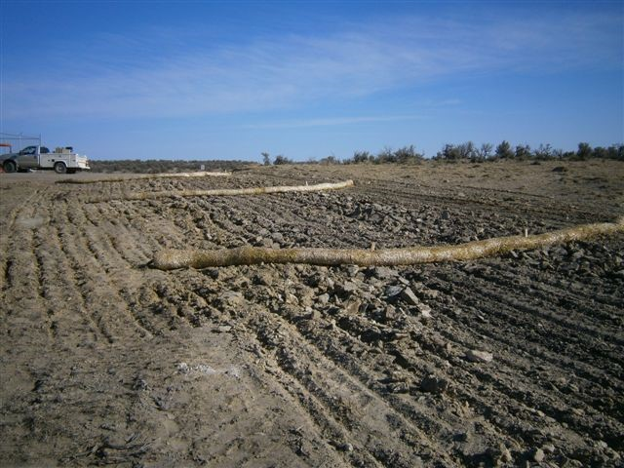
Reclamation
Notes:
Scarification or furrowing was done perpendicular to the prevailing winds while also acting as a barrier to surface water flow in areas where sloped surfaces were present. This resulted in the furrows running north-south and northwest-southeast. The furrows were 6 to 8 inches deep and, by design, captured naturally blowing seed and moisture in the area.
Miniature swales, no more than 12 inches from peak to trough, were graded into the landscape and provided small capture zones for moisture across the landscape. This further ensured runoff and soil character were ideal for re-establishing a peak vegetative community.

Slide 7
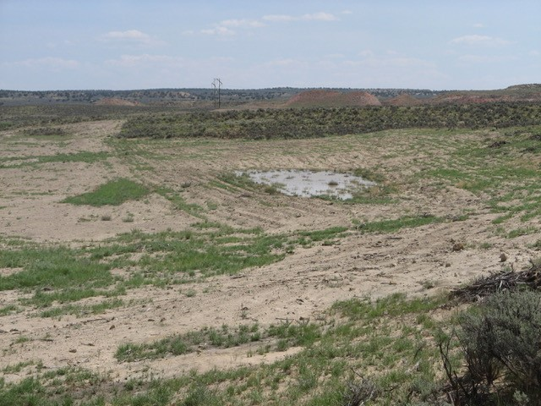
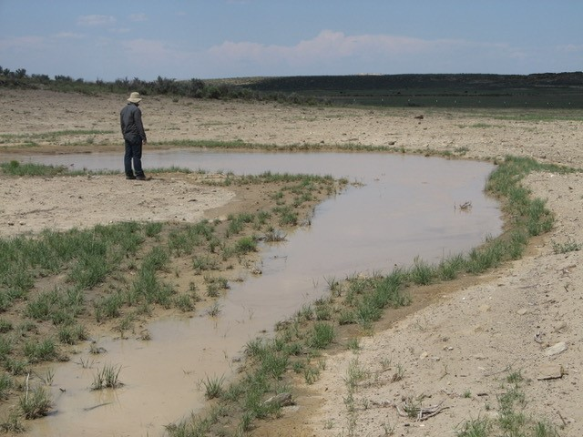
Approximately one year after reclamation
Notes:
The seed mixes were matched to the different soils. The area has two main soil types - dune sand and playa clay. Dropseed does well in sandy soils, and Blue grama does well in clays.

Slide 8
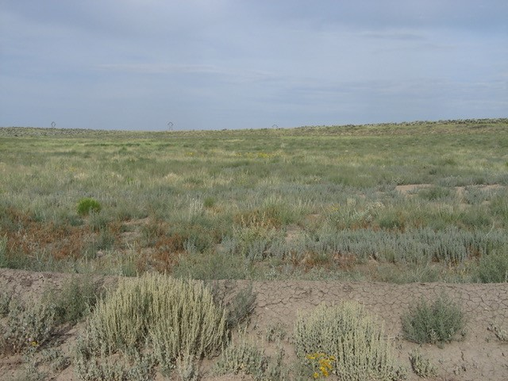
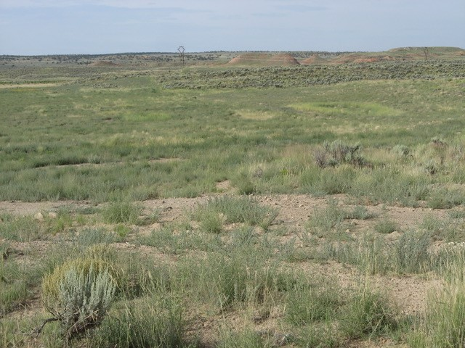
Approximately two years after reclamation
Notes:
The variation of seed within the applied mixes allowed for the ideal vegetative community to establish in a preferred soil type.

Slide 9
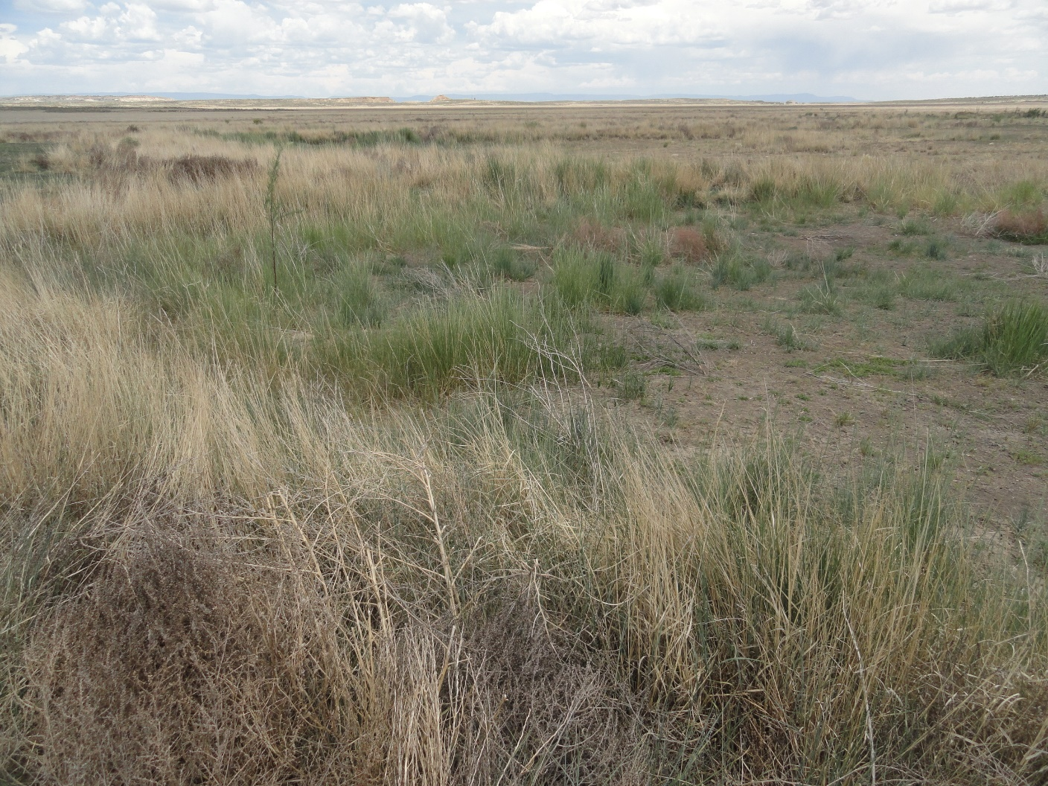
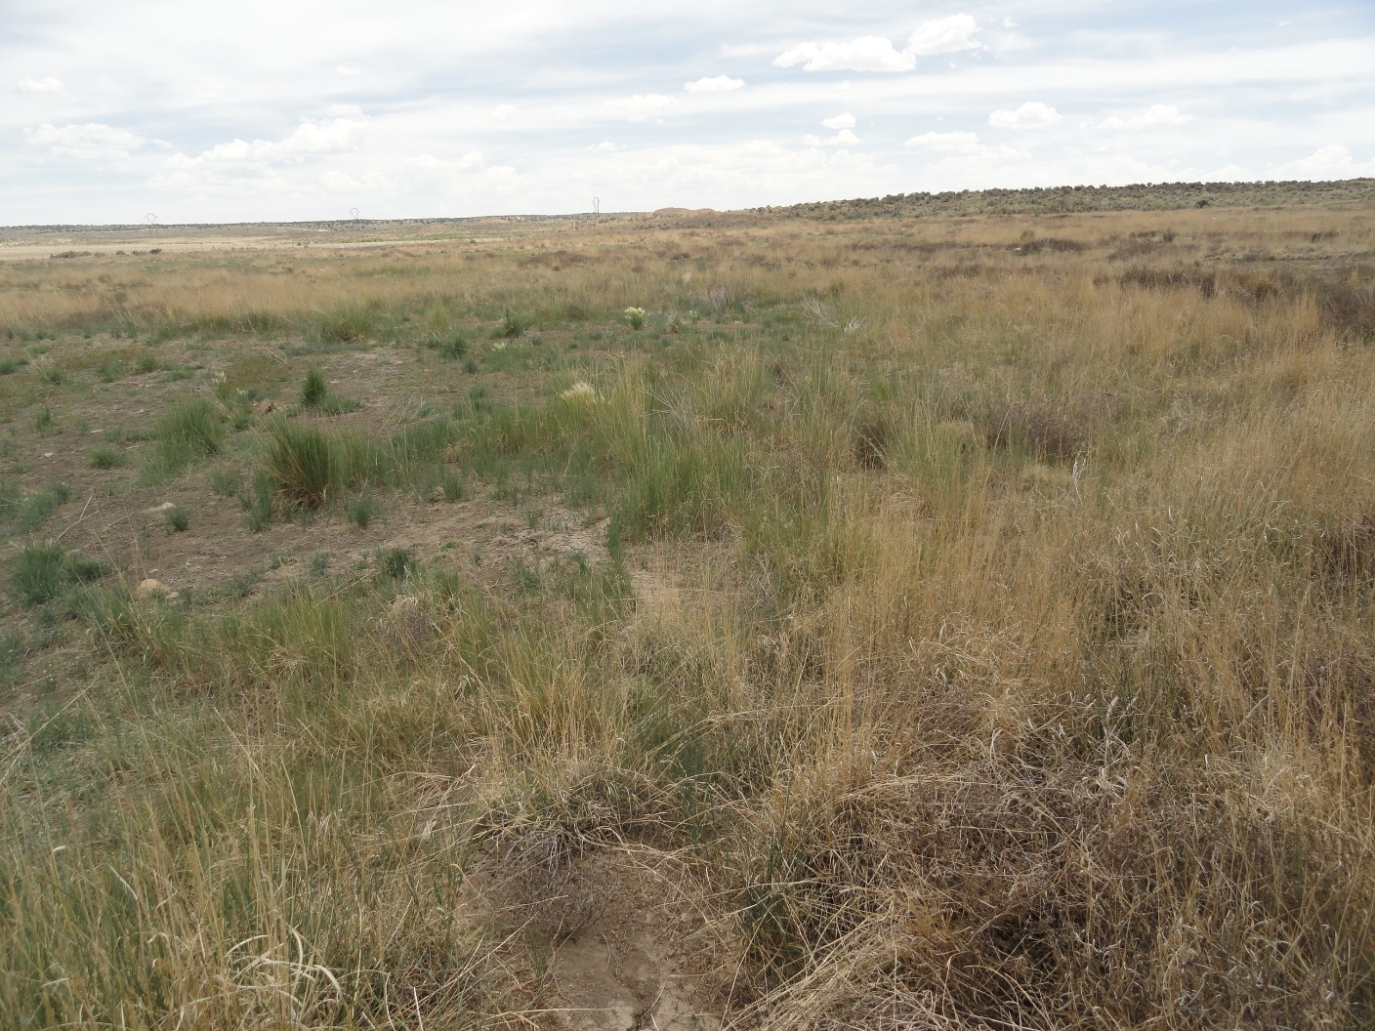
Approximately three years after reclamation
Notes:
The Miocene mining team, through their desire to return the land to an improved state, is responsible for the success of this reclamation project.

Slide 10
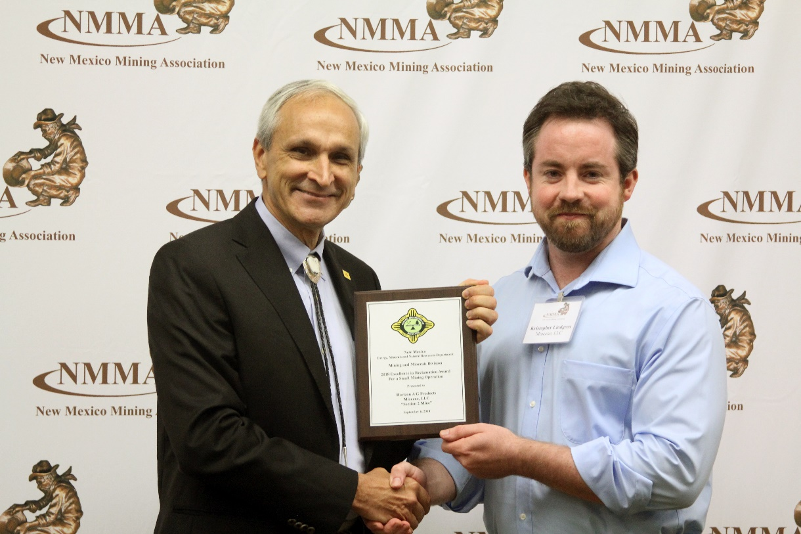
2018 Excellence in reclamation award is presented TO:
Miocene, LLC,
for successful reclamation of the Section 2 Mine,
a small mining operation,
in McKinley County, New Mexico
Secretary Ken McQueen with Kris Lindgren, Miocene
Notes:
The 2018 Excellence in Reclamation Award is presented to Miocene, LLC, for successful reclamation of the Section 2 Mine, a small mining operation in McKinley County.
Accepting the award today on behalf of the Miocene team is Kris Lindgren, the Mining and Product Improvement Manager for the company. Come on up, Kris.
Please say a few words, if you’d like.

