Slide 1


2019
Excellence in reclamation awards
Presented at the
New Mexico Mining Association Annual Convention
New Mexico Institute of Mining and Technology, Socorro
September 5, 2019
Todd Leahy, EMNRD Deputy Secretary
Notes:
Good afternoon and thank you for being here.
Our thanks to the Mining Association for again hosting the presentation of the Excellence in Reclamation Awards – the 24th year that the Mining and Minerals Division of the Energy, Minerals and Natural Resources Department has presented the awards at the Mining Association’s annual convention.
The awards program was initiated in 1996 to recognize excellence in coal, hard rock and aggregate mine reclamation, abandoned mine land reclamation, and other related efforts or initiatives deserving special recognition.

Slide 2

NAVAJO MINE – POWERING THE NAVAJO NATION THROUGH EDUCATION
Navajo Transitional Energy Company
North American Coal Corporation – Bisti Fuels Company
Notes:
The first project receiving the 2019 Excellence in Reclamation Award is one that positively impacts the Navajo Nation and surrounding communities through an educational and community outreach platform – an innovative effort that fits the award qualification of deserving special recognition:
Navajo Mine – Powering the Navajo Nation through Education.
We are pleased to present this award to:
Navajo Transitional Energy Company, and
North American Coal Corporation – Bisti Fuels Company

Slide 3


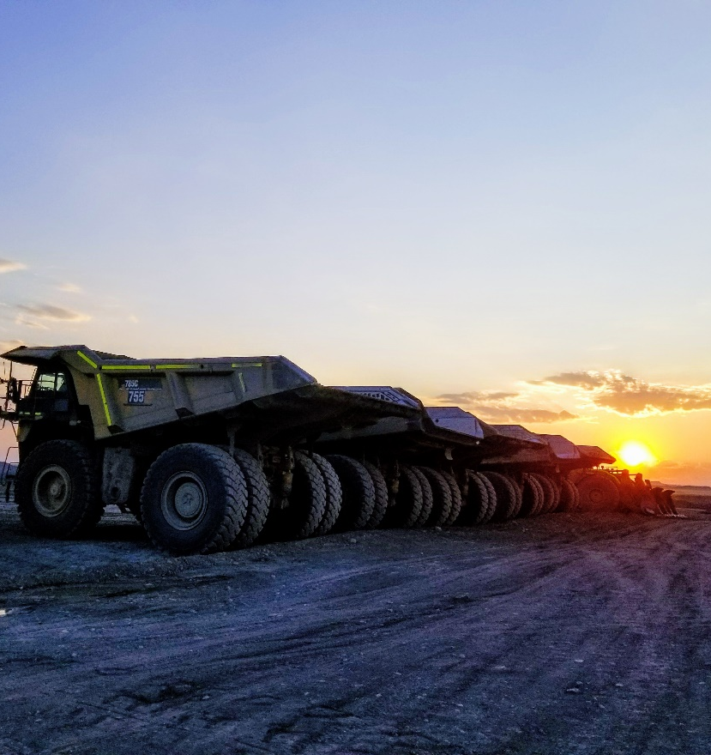
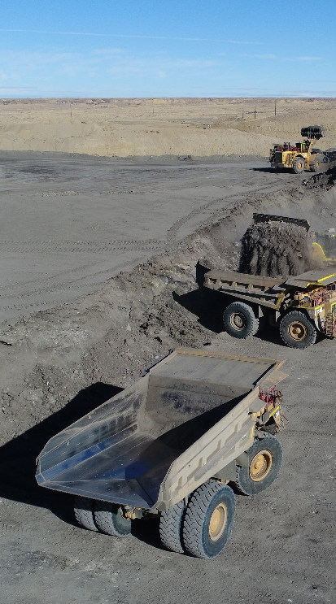
Notes:
NTEC’s mission is to be a reliable, safe producer of coal, while diversifying the Navajo Nation's energy resources to create economic and environmental sustainability for the Navajo people; and to develop and operate an energy company that values the Nation, its people, and its resources, now and in the future.
To help achieve this mission, NTEC contracted North American Coal Corporation – Bisti Fuels Company to run the day-to-day operations at Navajo Mine.

Slide 4
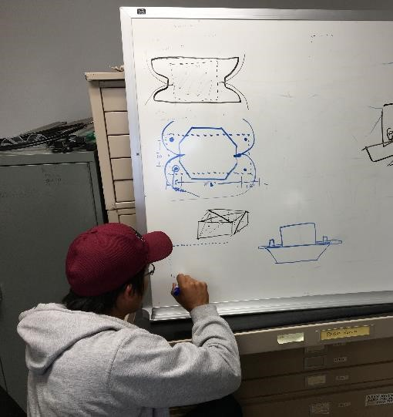
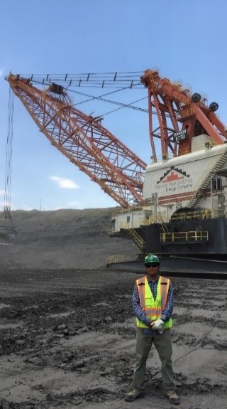
Notes:
With the high unemployment rate on the Navajo Nation, good-paying jobs are important. NTEC and Bisti Fuels not only provide jobs now, but they are also fostering hope for future generations of Navajo people by investing time and resources in educational programs for students and teachers.
Using education as a platform, NTEC and Bisti Fuels use reclamation practices as a catalyst to help students on the Navajo Nation explore careers related to mining. Reclamation principles fall in line with traditional Navajo values pertaining to the earth, while reclamation education is vital to learning about taking care of and restoring balance and harmony to the earth.

Slide 5
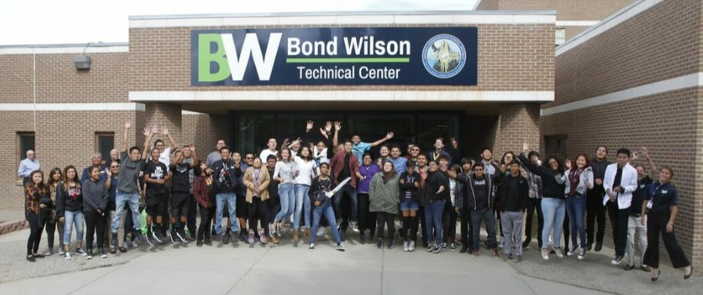
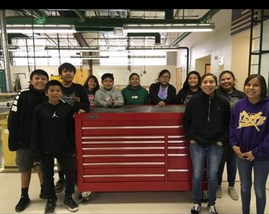
Notes:
NTEC and Bisti Fuels proudly support several educational programs in the belief that students deserve an opportunity for valuable skills training.
Bond Wilson Technical Center, in Kirtland, New Mexico, is the local school district’s newest initiative to provide alternative pathways to introduce high school students to desirable trade skills and gain a head start toward post-secondary education. The program is open to sophomores, juniors, and seniors, and offers five preparatory pathways including culinary arts, welding, construction, industrial maintenance operations, and mechatronics (pre-engineering/computer science). All BWTC students take foundational courses including technical writing, technical math, and interpersonal communication.
BWTC’s objective is to produce a new generation of competitive and skilled students who will support the evolving economic needs of the Navajo Nation and the surrounding communities.
NTEC and Bisti Fuels, as partners with BWTC, have donated time and materials, including flatbed trailers, tool boxes, and an excavator simulator to the school. Various NTEC and Bisti Fuels employees participated in helping BWTC get off the ground by providing input to develop the school’s curriculum.

Slide 6
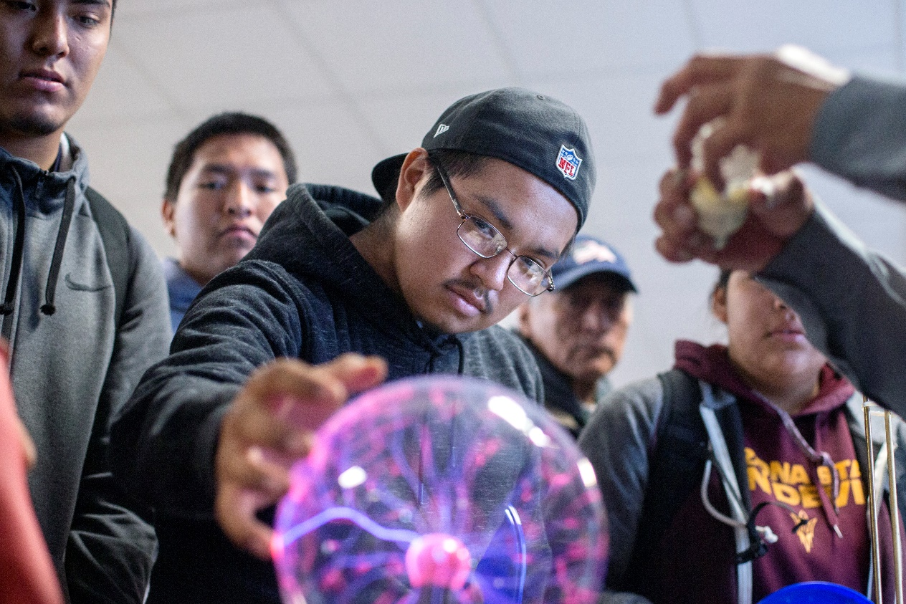

STEM-sation
Notes:
NTEC and Bisti Fuels enthusiastically support Science, Technology, Engineering, and Mathematics – STEM – activities on the Navajo Nation and in the surrounding communities. Like other school districts in the country, many Navajo area schools face budget constraints that limit students’ exposure to STEM opportunities in general and, more specifically, mining career opportunities. NTEC and Bisti Fuels brought STEM-sation, a STEM career event, to Navajo middle and high schools as a way to bring mining and STEM career pathways to the students without education administrations being burdened with the cost.
Company employees participated in 10 STEM-sation Days reaching more than 5,000 middle and high school students in the past 18 months. In February 2019, NTEC was selected as the Industry Partner of the Year for the New Mexico Excellence in STEM Awards, a.k.a. the STEMYS, presented by the Air Force Research Laboratory Tech Engagement Office in Albuquerque. Congratulations!

Slide 7
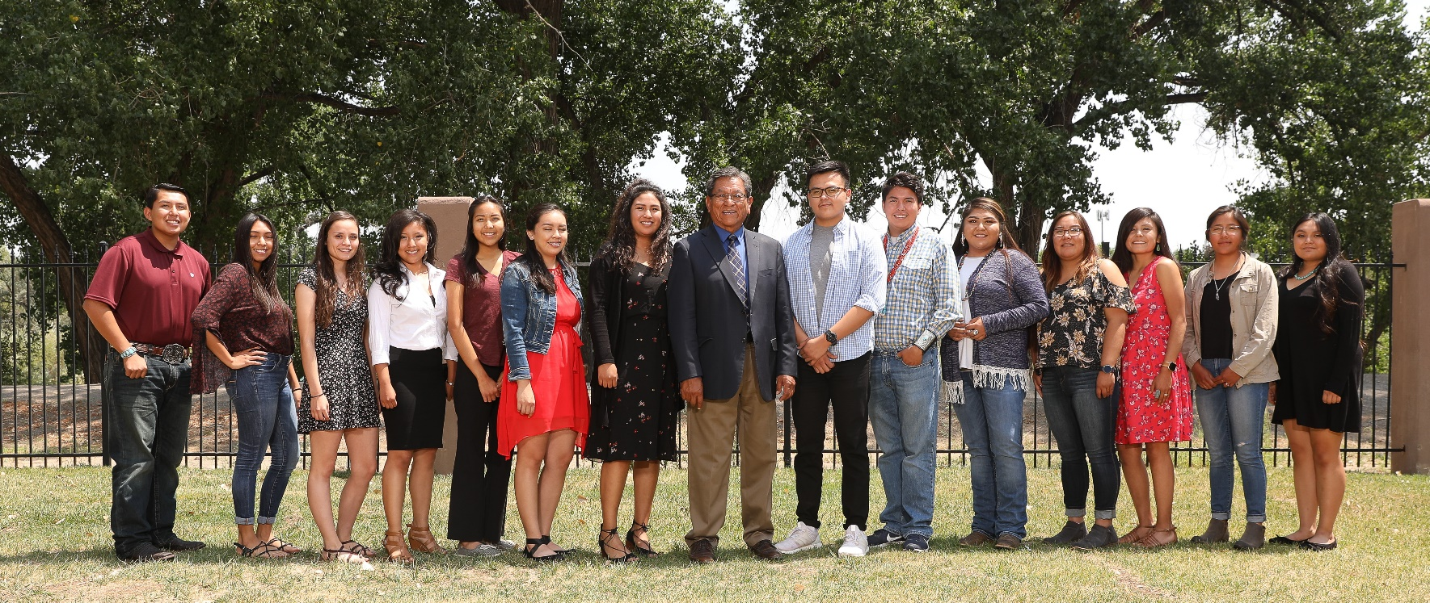
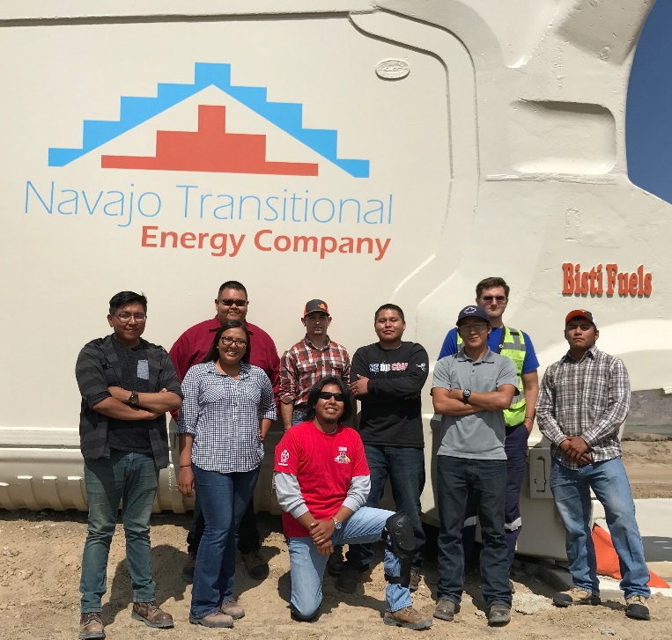
Scholarship Awardees
Teacher Workshops, and Internship and Scholarship Programs
Interns
Notes:
In 2018, NTEC and Bisti Fuels created “Carbon Rocks! Teachers Workshop on Coal” – a free workshop for middle school and high school STEM teachers. The workshop provides educators science-based information to help educate students about the role and benefits of natural resources. During the 3-day workshop, teachers visit a coal-fired power plant, tour the Navajo Mine facility and mining and reclamation areas, and receive professional instruction. The goal is for the teachers to return to their classroom to provide students with real-world, problem-solving activities, and an appreciation for coal, for mining, and for mining-related activities.
NTEC and Bisti Fuels believe that once students enter the track of STEM and/or mining careers, the students need financial help as well as exposure to day-to-day operational experience. By implementing internship and scholarship programs, the companies hope to strengthen the future workforce for Navajo Mine. NTEC and Bisti Fuels provide well-paid summer internships to students majoring in engineering, computer sciences, and environmental sciences. NTEC also provides scholarships: at-large scholarships to Navajo college students enrolled in at least their sophomore year in college; scholarships to students through their local governing Navajo chapter; and scholarship funding to three area colleges to selected recipients with STEM-related majors. In 2018, 90 scholarships were awarded totaling approximately $100,000.

Slide 8
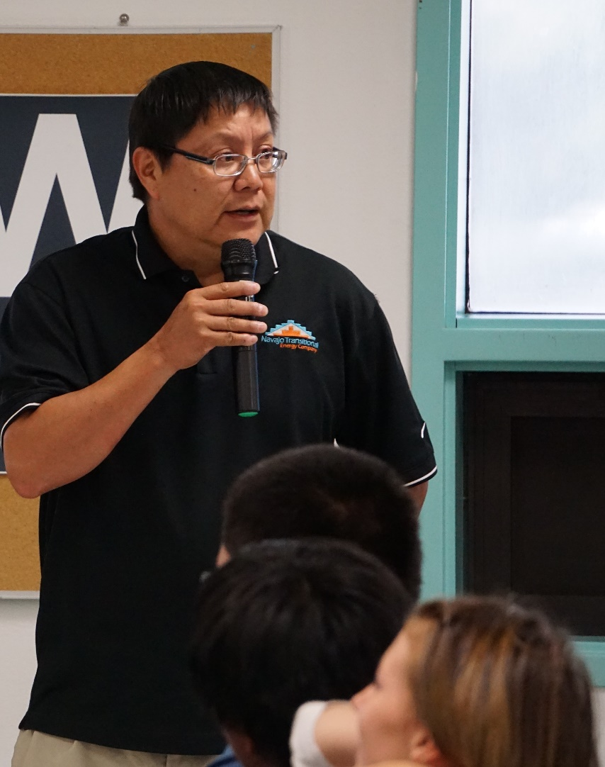
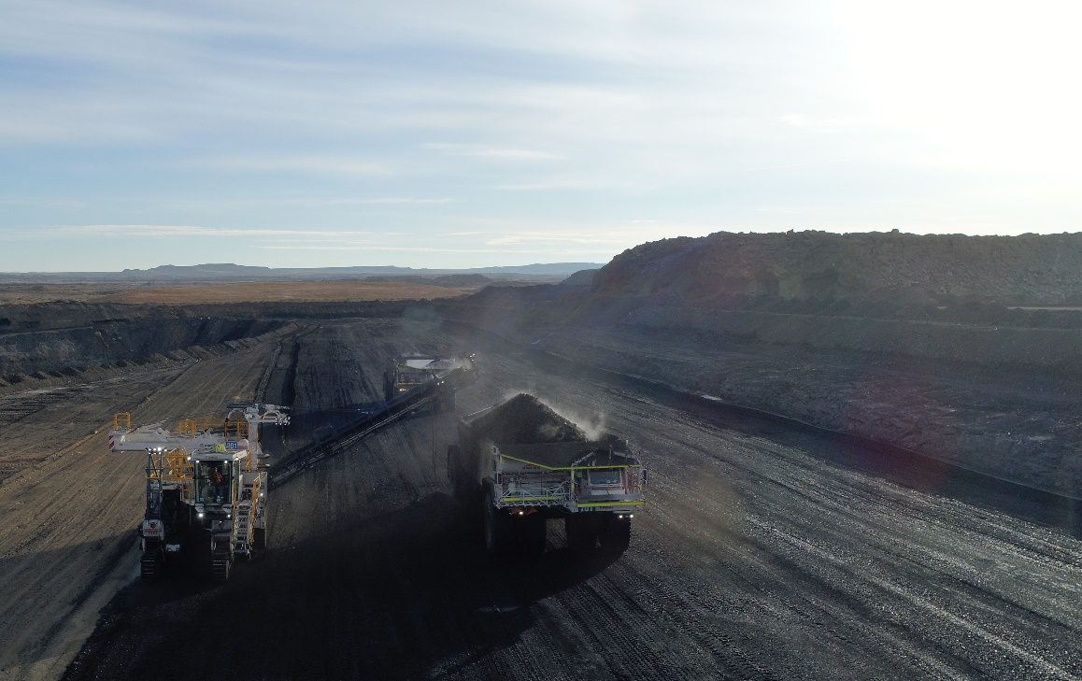
Volunteer Teaching, Tours, Other Educational Outreach, and Community Support
Notes:
Because of many tribes’ special relationships with federal, state and local governments, developing and maintaining energy projects can be a daunting task. To help address the task, NTEC and Bisti Fuels helped create the Tribal Energy Management Seminar Series and degree program held at San Juan College’s School of Energy in Farmington. The targeted students are tribal leaders who make decisions about energy resources, government officials wanting to understand tribal issues, and industry representatives who work on tribal lands.
Mine tours are a great way to educate the students and the general public, and Navajo Mine opened to tours in 2017 after NTEC assumed ownership of the operations. More than 800 people have toured the mine in nearly 60 tour groups in the past two years.
NTEC and Bisti Fuels employees have participated in science fairs, career fairs, and job fairs; donated school supplies to rural Navajo Nation schools and Christmas gifts to underprivileged Navajo elementary students; and, completed a coat drive to distribute coats to Navajo students and elders. NTEC and Bisti Fuels realize that, given the economic challenges of the Navajo Nation, community service is a gateway to further education about mining and reclamation.

Slide 9
2019 EXCELLENCE IN RECLAMATION AWARD
Presented to
Navajo Transitional Energy Company
North American Coal Corporation – Bisti Fuels Company
For their dedication to cultivate interest in mining, reclamation, and STEM-related careers through an education, outreach, and community service platform to help students and residents from the Navajo Nation and surrounding communities
Notes:
Our congratulations to Navajo Transitional Energy Company and North American Coal Corporation – Bisti Fuels Company for their dedication to cultivate interest in mining, reclamation, and STEM-related careers through an education, outreach, and community service platform to help students and residents from the Navajo Nation and surrounding communities.
Accepting the awards today are:
Tim Fagley, Chief Operating Officer, representing Navajo Transitional Energy Company, and
Andy Hawkins, Community Engagement Manager, and
Kay Nave-Mark, Community Engagement Specialist,
are representing Bisti Fuels Company.
If you would like to say a few words, please feel free – then we’ll gather for a picture.

Slide 10
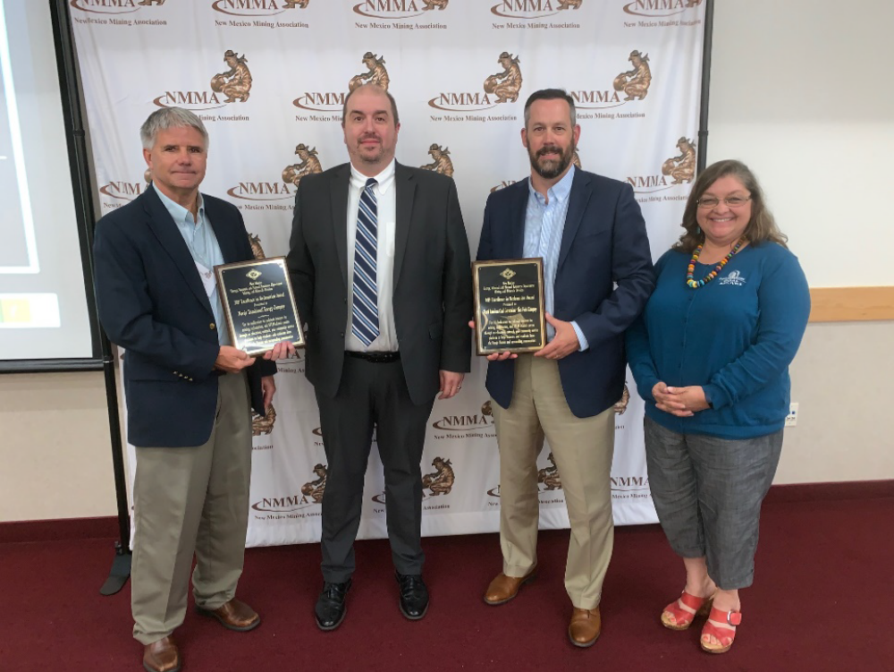
Notes:
EMNRD Deputy Secretary Todd Leahy presents the 2019 Excellence in Reclamation Award to Tim Fagley, Navajo Transitional Energy Company Chief Operating Officer; Andy Hawkins, Bisti Fuels Company Community Engagement Manager; and Kay Nave-Mark, Bisti Fuels Company Community Engagement Specialist.

Slide 11
AGAVE ROUNDUP IN GRANT COUNTY
Freeport McMoRan Chino Mines Company
Borderlands Restoration Network
Gila Watershed Partnership
Bat Conservation International
Notes:
Our second award today goes to a group of staff and volunteers from four organizations who carried out, perhaps the first ever, “Agave Roundup” that salvaged agave plants for use in mine reclamation areas and non-mining areas for the benefit of improved bat habitat and environmental awareness. Another initiative fitting the award qualification of deserving special recognition.
The Agave Roundup in Grant County project was spearheaded by:
Freeport McMoRan Chino Mines Company
and supported by the assistance and expertise of three non-profit organizations:
Borderlands Restoration Network,
Gila Watershed Partnership, and
Bat Conservation International.

Slide 12
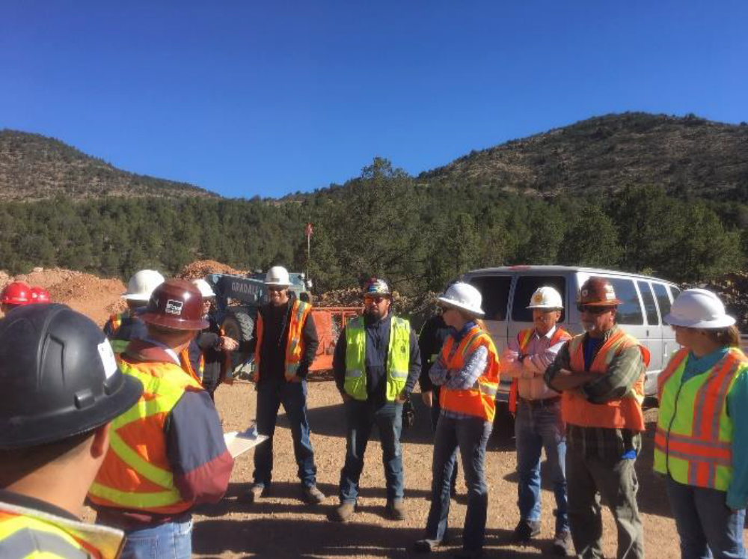
Notes:
FMI Chino Mines Company owns and operates Continental Mine and Hanover Mountain as active mining projects regulated under the New Mexico Mining Act and Rules. The permitted area extends to include the North Overburden Stockpile which expands as Hanover Mountain is mined, and eventually will be entirely reclaimed. FMI and the non-profit groups assembled 20 staff and volunteers north of Hanover, in Grant County, to round up the agaves in an innovative effort that went above and beyond the conditions of the permit.

Slide 13
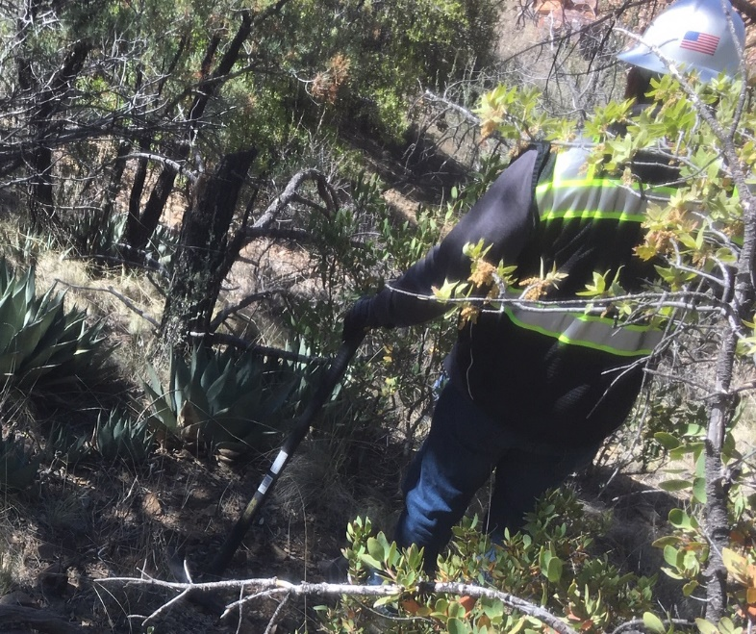
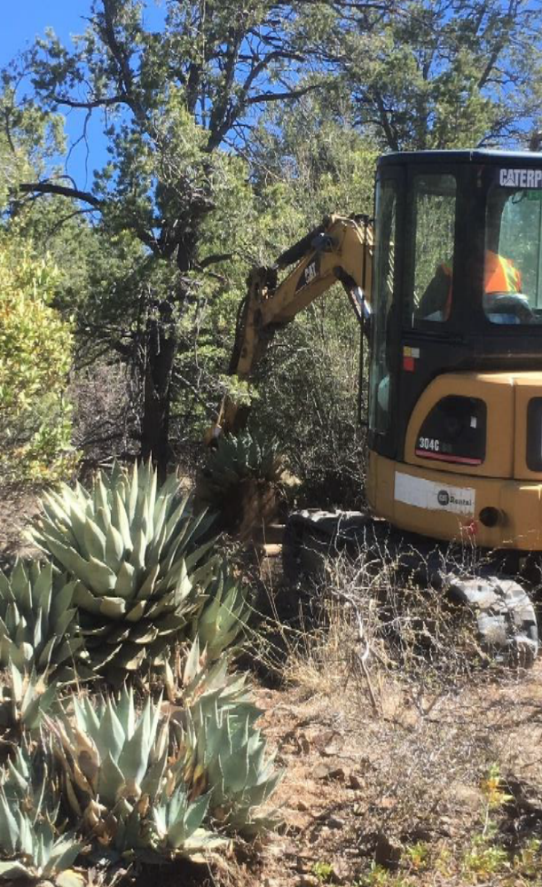
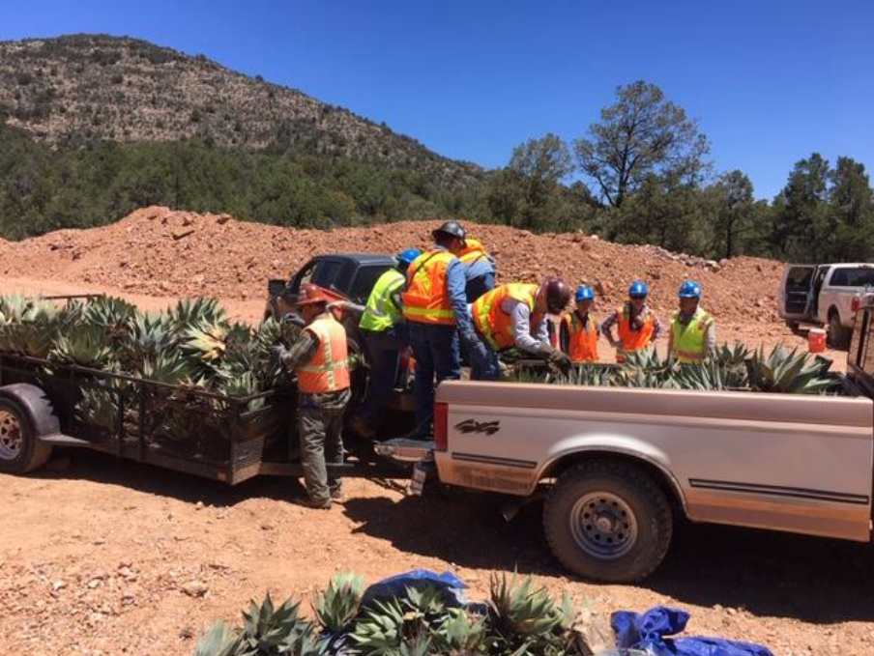
Notes:
This project to proactively salvage and transplant more than 750 agave plants helped jump start reclamation and bat habitat improvements in numerous locations. FMI coordinated a work day with its employees and partnered with these non-profit groups with the requisite greenhouses, expertise and labor. The crew dug up agave plants using hand tools and a mini excavator, and manually loaded hundreds of plants on trailers and trucks.

Slide 14
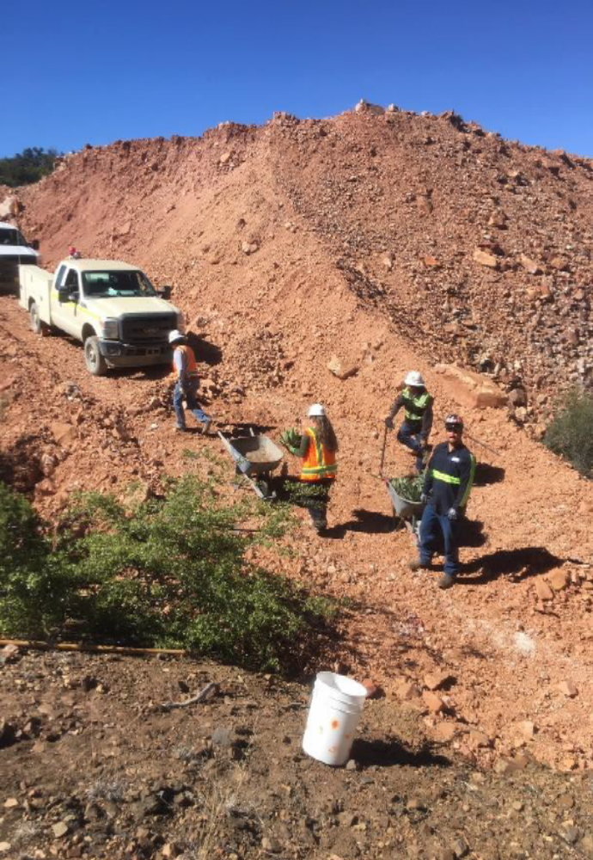
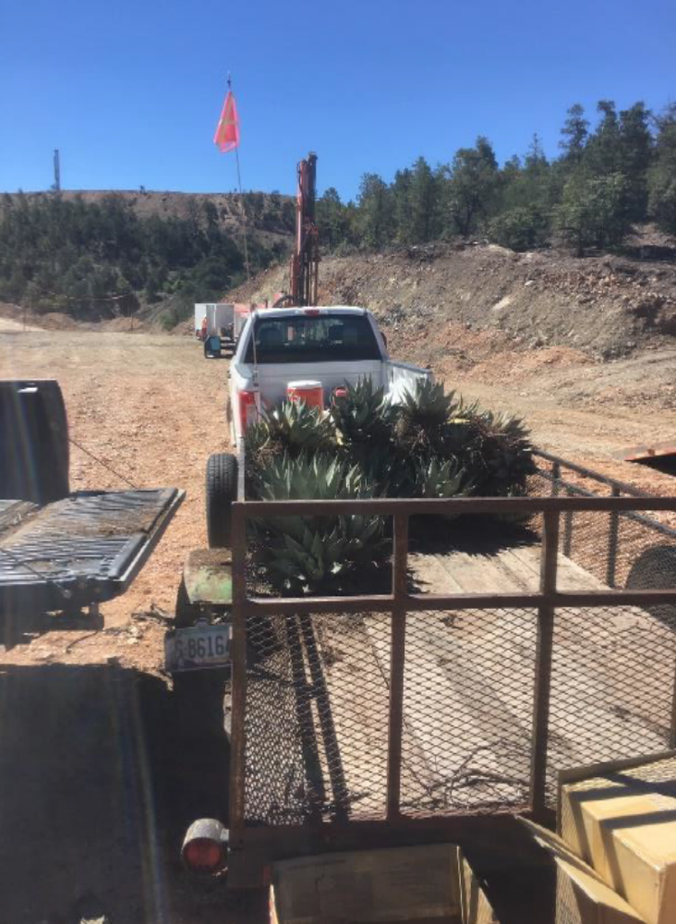
Notes:
Some of the salvaged plants were transplanted to Chino and Tyrone mine sites in Grant County, and others were moved to nurseries for eventual planting at other mining and non-mining sites in New Mexico and Arizona.
FMI is dedicated to responsible mining and reclamation, and the non-profit groups focus on raising environmental awareness in the southwest about plants and bat habitat. The “Agave Roundup” project certainly was in line with their goals.

Slide 15
2019 EXCELLENCE IN RECLAMATION AWARD
Presented to
Freeport McMoRan Chino Mines Company
Borderlands Restoration Network
Gila Watershed Partnership
Bat Conservation International
For their successful “Agave Roundup in Grant County” project that salvaged more than 750 agave plants for use in mine reclamation areas and non-mining areas for the benefit of improved bat habitat and environmental awareness
Notes:
Our congratulations to Freeport McMoRan, Borderlands Restoration Network, Gila Watershed Partnership, and Bat Conservation International for their successful “Agave Roundup in Grant County” project that salvaged more than 750 agave plants for use in mine reclamation areas and non-mining areas for the benefit of improved bat habitat and environmental awareness.
Accepting the award for Freeport McMoRan is:
Tom Shelley, Reclamation Manager, New Mexico Operations.
The non-profits were unable to have representatives here today. Plaques will be mailed to:
Borderlands Restoration Network
Gila Watershed Partnership, and
Bat Conservation International.
If you would like to say a few words, Tom, please feel free – then we’ll take a picture.

Slide 16
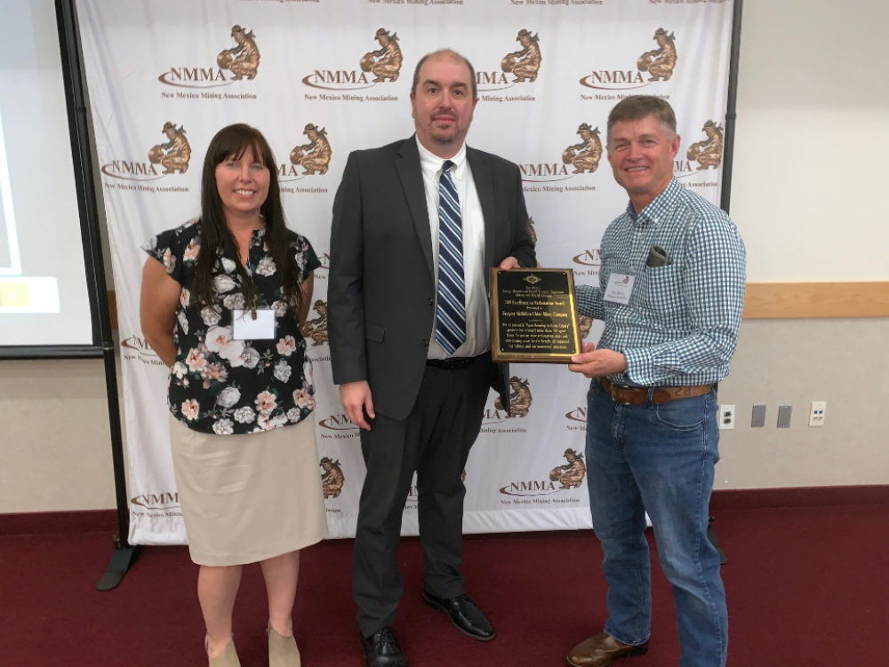
Notes:
EMNRD Deputy Secretary Todd Leahy presents the 2019 Excellence in Reclamation Award to Sherry Burt-Kested, FMI Chino Mines Company Environmental Services Manager; and Tom Shelley, Freeport McMoRan Reclamation Manager, New Mexico Operations.

Slide 17
Notes:
Again, our congratulations to all the recipients, and our thanks for their conscientious work and their successful efforts on behalf of reclamation, preservation, education, and environmental awareness. We anticipate receiving another round of worthy entries for the 2020 awards.
In an important update on the Mining and Minerals Division, Fernando Martinez, MMD director for many years, has retired after 26 years in state government and has taken on the role of Executive Director of the New Mexico Renewable Energy Transmission Authority. We congratulate Fernando on this new opportunity, and commend and thank him for the expertise and leadership he provided to the division.
MMD’s Interim Director is Mike Tompson, manager of the Abandoned Mine Land Program. EMNRD will conduct a search for the next MMD Director, which will be advertised as a governor’s exempt position, and all interested, qualified candidates are encouraged to apply. In the near future, we look forward to announcing the new director who will continue to lead the division, as Fernando has done, in fulfilling its mission to ensure the responsible utilization, conservation, reclamation and safeguarding of land and resources affected by mining.
Thank you.

