Slide 1
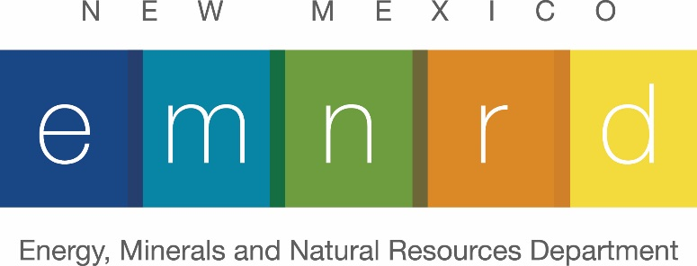

2020 and 2021
Excellence in reclamation awards
( The Mining Association Convention was cancelled again due to health concerns)
New Mexico Mining Association Annual Convention
Sandia Casino & Resort, Albuquerque
August 26, 2021
Sarah Cottrell Propst, EMNRD Cabinet Secretary
Notes:
This is the 26th year that the Mining and Minerals Division of the Energy, Minerals and Natural Resources Department has presented the Excellence in Reclamation Awards.
The awards program was initiated in 1996 to recognize excellence in coal, hard rock, and aggregate mine reclamation, abandoned mine land reclamation, and other related efforts or initiatives deserving special recognition. You find the complete history of award winners posted on our website.

Slide 2
THE ESPAÑOLA MERCANTILE COMPANY
and
MATT LANE
in recognition of their innovative efforts to correct erosion features at El Cajete and
Las Conchas pumice mines
Notes:
The first project receiving a 2020 Excellence in Reclamation Award is for innovative efforts initiated by a company and led by its environmental compliance specialist to correct erosion features at El Cajete and Las Conchas pumice mines.
We are pleased to present this award to:
The Española Mercantile Company and to Matt Lane.

Slide 3

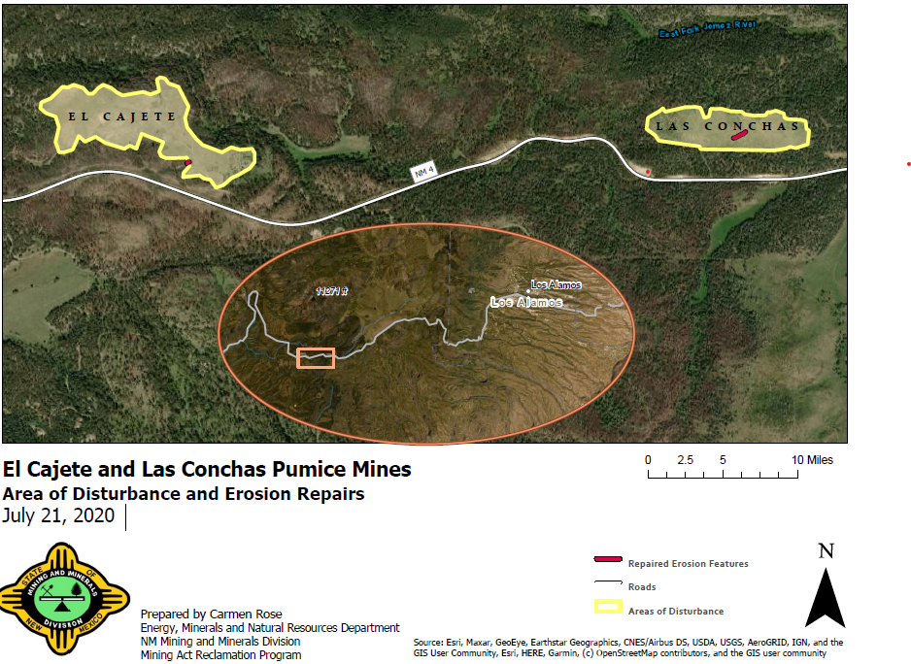

Notes:
El Cajete and Las Conchas pumice mines are approximately 2 miles apart and just west of Los Alamos in Sandoval County. Reclamation of the two mining units concluded separately with Las Conchas completed in 1998 and El Cajete completed in 2014 after The Española Mercantile Company purchased the mines from Copar Pumice Company, Inc.

Slide 4
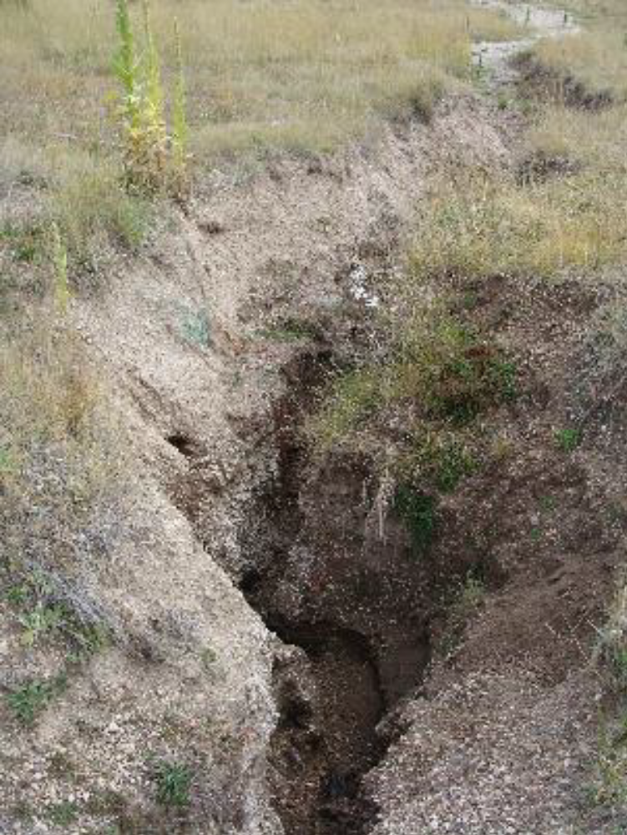
Exposed unconsolidated pumice at
Las Conchas, 2015
Notes:
The history of these mine sites is complex with reclamation challenges presenting themselves along the way, including loose, erodible pumice under the topsoil cover material, livestock trespassing onto the fenced reclamation sites, and the 2011 Las Conchas wildfire burning the southwest edge of the El Cajete site.
Despite these factors, Española Mercantile Company addressed the erosion features at these reclaimed sites in an innovative and permanent fashion. Matt Lane led a team to implement a variety of Best Management Practices to stabilize the below-the-surface erosion of material that was creating a series of headcuts at these sites.

Slide 5
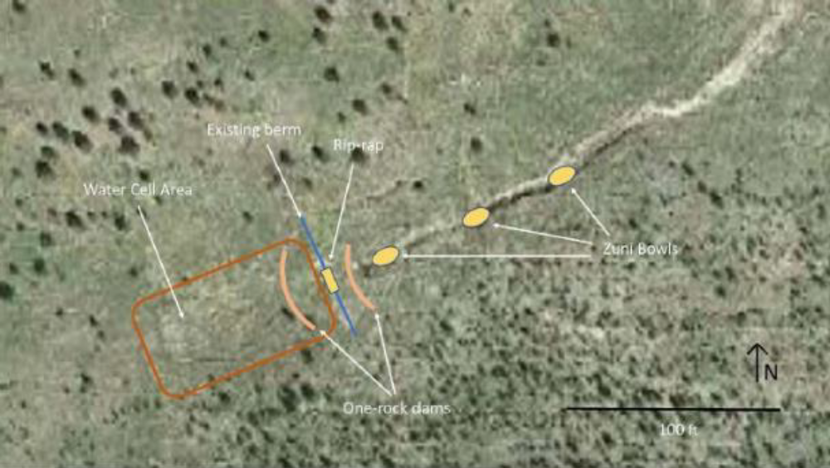
Schematic developed by Española Mercantile Company
outlining the erosion repair work at Las Conchas
Notes:
An example of the erosion control layout is seen here in this schematic for Las Conchas. The Zuni Bowl technique allow for the in-channel capture of stormwater into an armored pool with a pour-over wall at the inlet and outlet to slow water flow along an existing erosion feature and prevent the growth of the headcut.

Slide 6
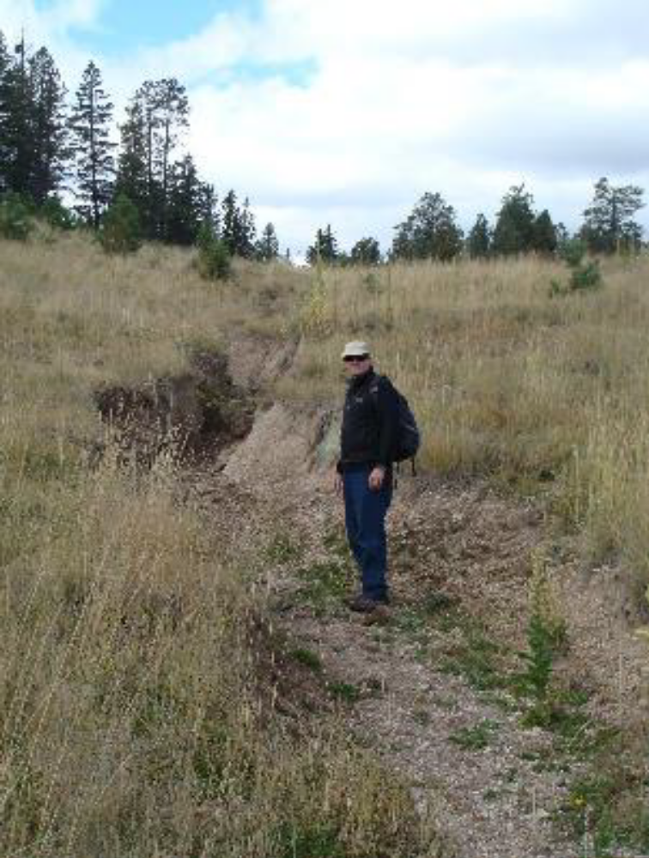
Headcut at
Las Conchas, 2015
Notes:
Two persistent areas of erosion were identified, one at each mine site. The gully at Las Conchas was quite severe at 200 feet long, 5 to10 feet wide, and 1 to 4 feet deep. This feature continued to develop despite previous efforts of staking in straw bales and straw wattles. The erosion feature at Las Conchas was corrected in June 2019 using a series of One Rock Dams, Zuni Bowls, and supporting rip-rap in the gully and along existing berms to disperse and slow the flow of water. In addition, Water Cells were incorporated at this site to roughen the surface and create a sort of pothole to slow overland flow, increase water infiltration, and provide a microclimate for vegetation.

Slide 7
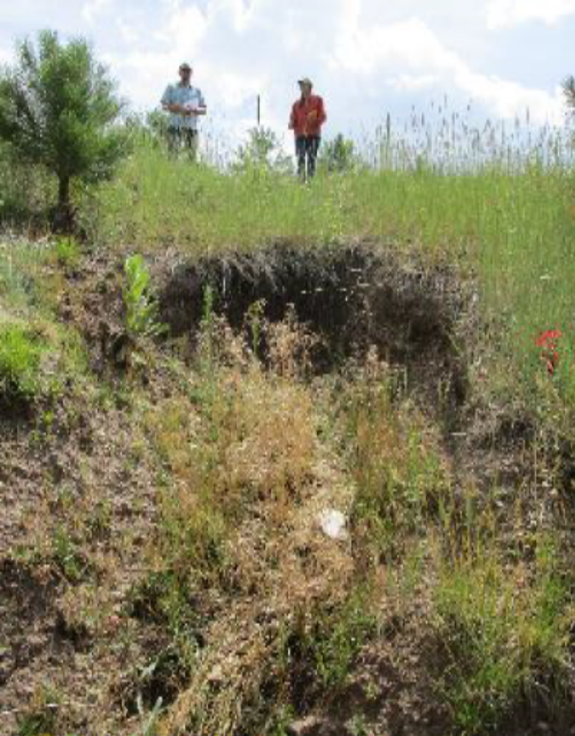
Headcut at El Cajete, July 2019
Notes:
The erosion feature at El Cajete was smaller, but the headcut had the potential to become severe as it was on a steeper slope and adjacent to the area that had burned in 2011. The El Cajete erosion feature was corrected in October 2019 using similar methods as those at Las Conchas.

Slide 8
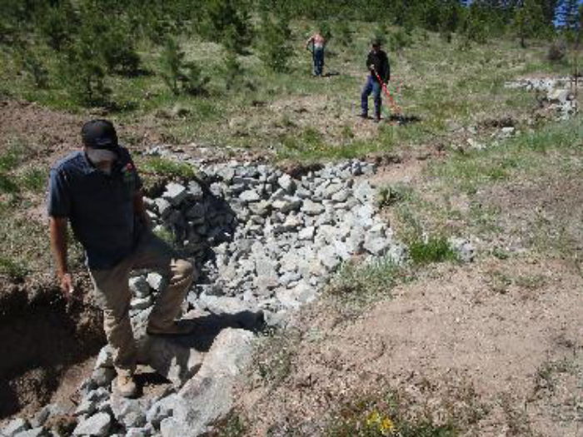
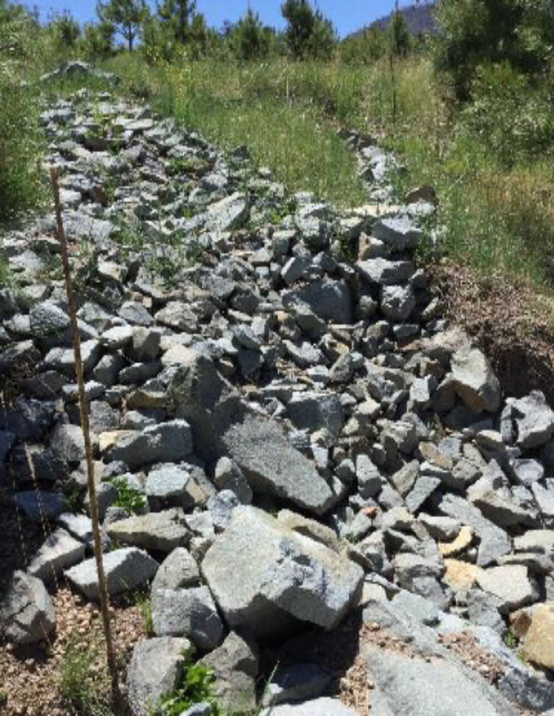
Above: Zuni Bowl construction at Las Conchas, June 2019
Right: Zuni Bowl construction at El Cajete and associated
fishbone style berm, June 2020
Notes:
The Zuni Bowls were armored with 18-inch boulders along the upper and lower pour-overs, and 4 to 12 inches of rip-rap within the Zuni Bowls themselves. Zuni Bowls are often paired with One Rock Dams, or ORDs, as they are a less intensive erosion mitigation technique that assist in roughening the surface, increasing water retention and infiltration, and encouraging the slow reparation and filling in of the channel over time with sediment and vegetation. In this case, ORDs were applied traditionally and then adapted to a fishbone style design to ensure that the unconsolidated pumice would remain stable around the Zuni Bowl construction sites.

Slide 9
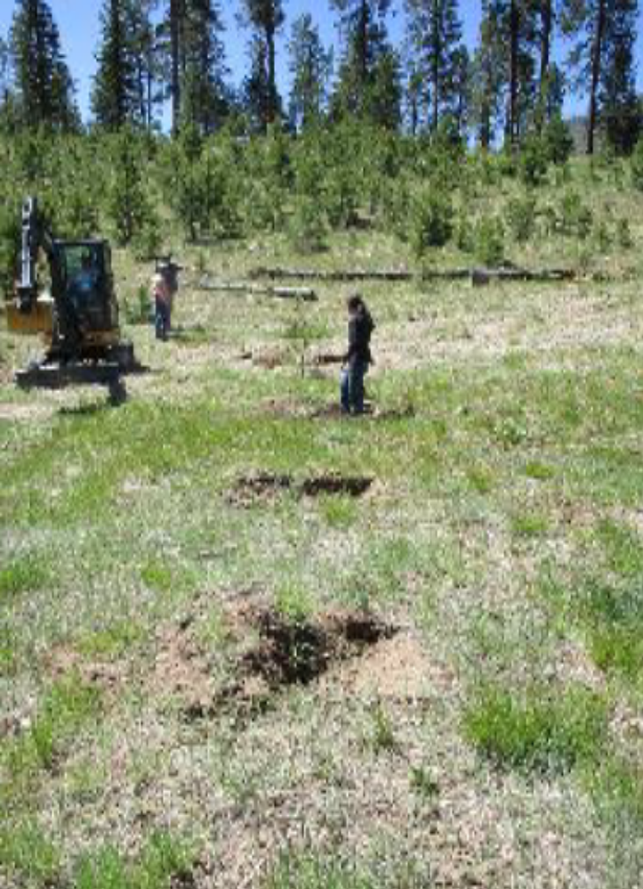
Water Cell construction at Las Conchas,
June 2019
Notes:
After years of seeing headcuts and gullies form in the unconsolidated pumice material at the Las Conchas and El Cajete Mines, The Española Mercantile Company put forth a great effort to correct these erosion features in more permanent ways. They went above and beyond the bare minimum of treating the surface symptoms and have successfully incorporated innovative and experimental techniques to bring about permanent correction.

Slide 10
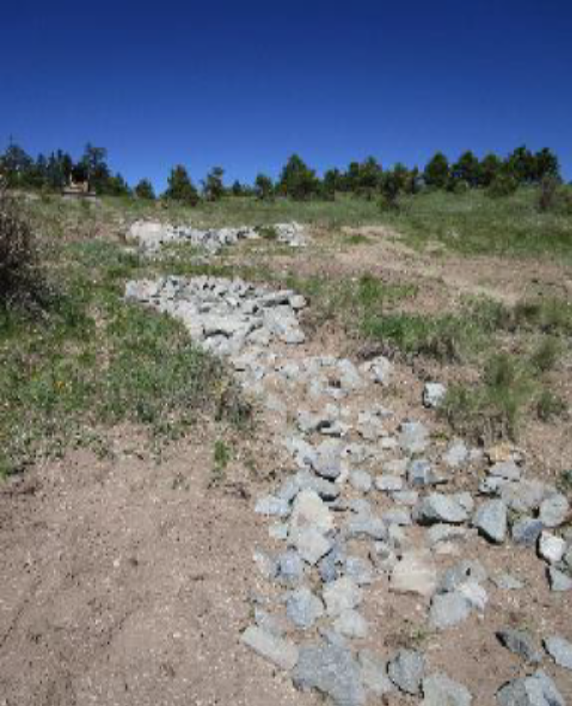
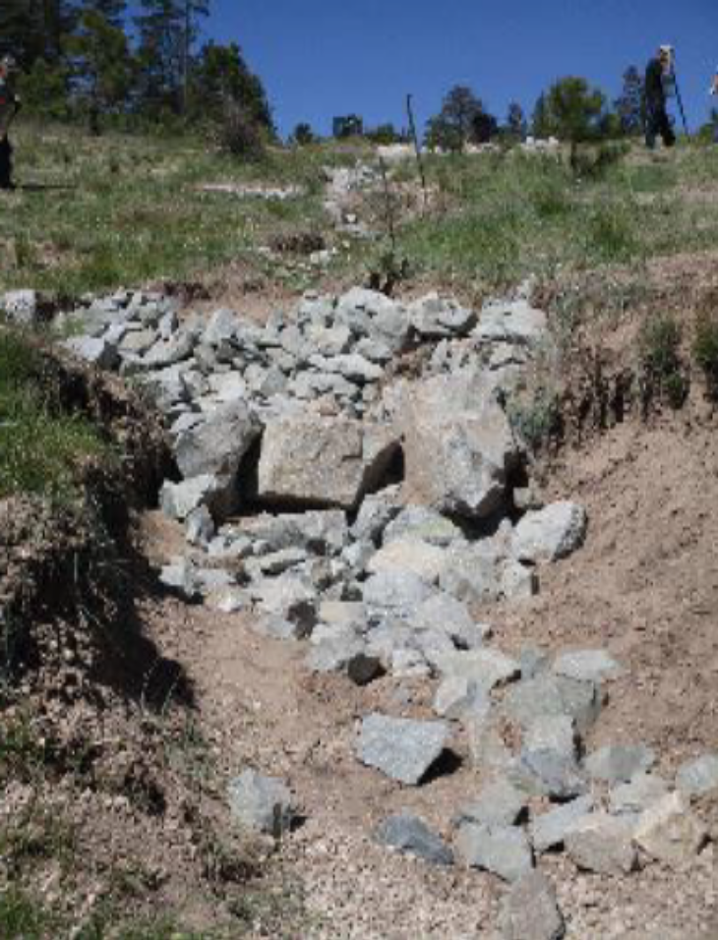
Armored gully at Las Conchas (left) and view of
lower pour-over in one of the Zuni Bowls (right), June 2019
Notes:
On behalf of the company, Matt Lane has demonstrated an adaptive and creative approach in the reclamation of these particularly challenging sites.

Slide 11
THE ESPAÑOLA MERCANTILE COMPANY
In recognition of its successful work using innovative and experimental techniques to permanently correct challenging erosion features at El Cajete and Las Conchas pumice mines
MATT LANE
The Española Mercantile Company
In recognition of his adaptive and creative approach to reclamation to permanently correct challenging erosion features at
El Cajete and Las Conchas pumice mines
Notes:
Our congratulations to The Española Mercantile Company in recognition of its successful work using innovative and experimental techniques to permanently correct challenging erosion features at El Cajete and Las Conchas pumice mines.
And to Matt Lane in recognition of his adaptive and creative approach to reclamation to permanently correct challenging erosion features at El Cajete and Las Conchas pumice mines.

Slide 12
PICURIS PUEBLO –
U.S. Hill Mine Reclamation
Restoring a natural state to the land, securing tribal access to spiritual sites and traditional sources of pottery-making materials,
and protecting the land in perpetuity
Notes:
The second project receiving a 2020 Excellence in Reclamation Award is for a mica mine acquired by a Pueblo for reclamation to a more natural state, and to secure access to important spiritual sites and traditional sources of micaceous materials that have been collected by generations of Pueblo pot makers. The reclaimed land will soon be integrated into Tribal Trust Land for protection in perpetuity.
We are pleased to present this award to:
Picuris Pueblo for its reclamation work at the U.S. Hill Mine site.

Slide 13
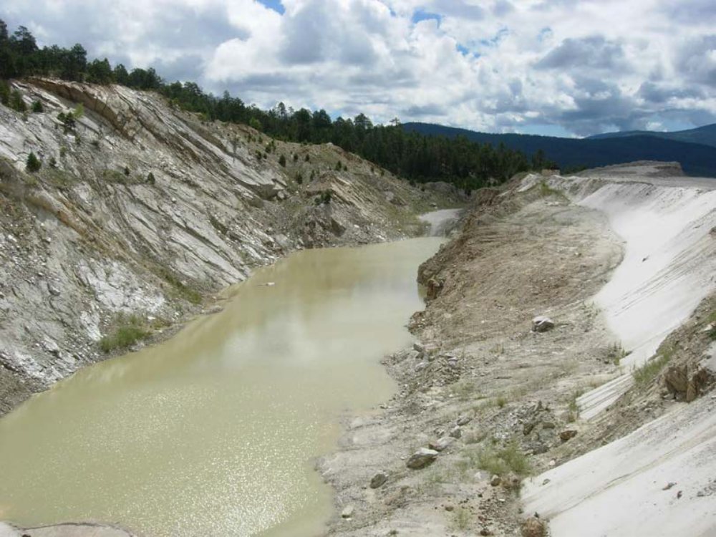
Old pit and highwall before reclamation, August 2005
Notes:
Before reclamation and prior to 2006, the 200-acre mine site included two large water-filled pits; eroding vertical mine benches; several waste and process ore piles; and unstable land surfaces, destabilized in part due to the “light” micaceous nature of the mine waste products. The local watershed was most heavily impacted by excess sedimentation during the run-off seasons following winter months.

Slide 14
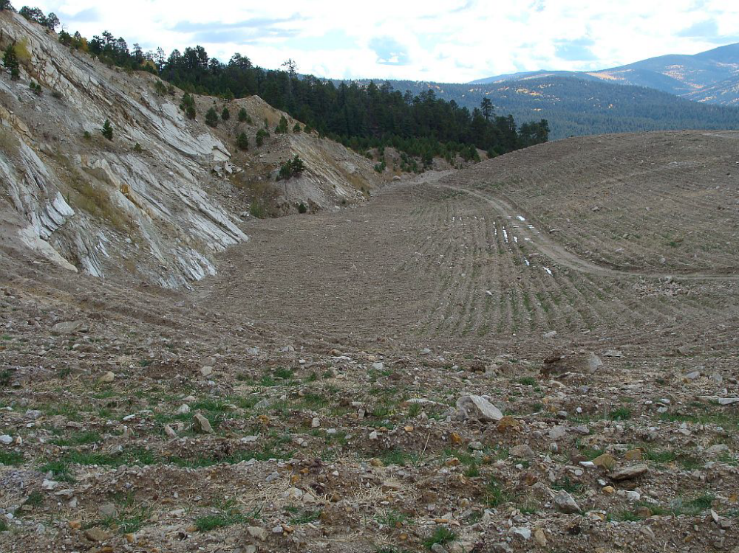
Old pit and highwall after reclamation, October 2008
Notes:
In 2006, private contractors and Picuris field crews drained and backfilled the old mine pits; buried tens of thousands of tons of mica ore; regraded more than 75 acres of severely disturbed ground; recovered a large volume of topsoil from stockpiles and hauled it to cover regraded areas; and revegetated the site utilizing carefully selected native and non-native seed mixes.

Slide 15
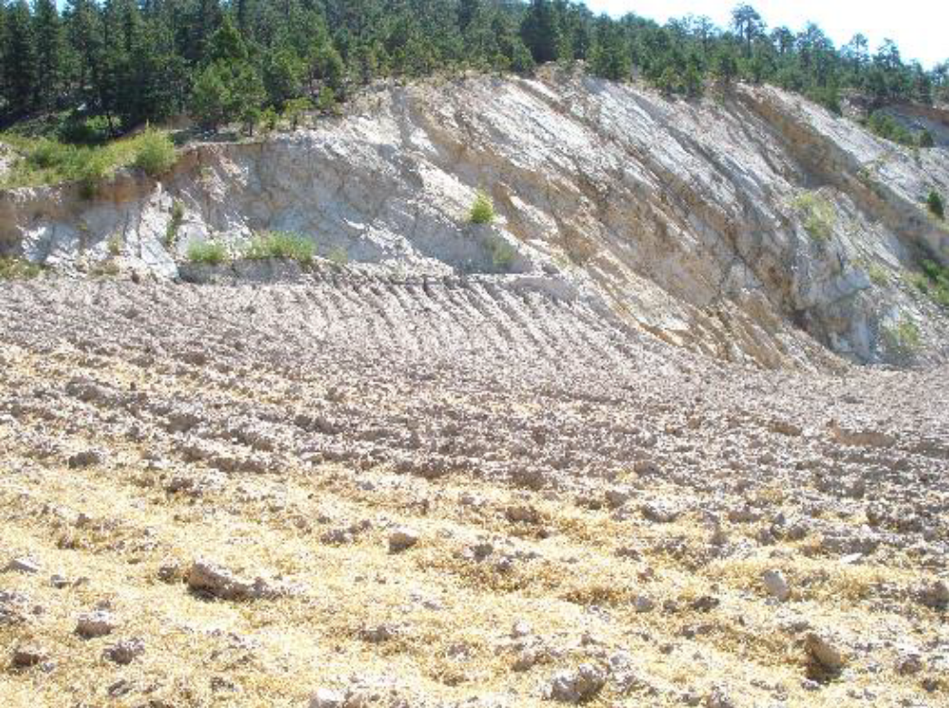
Steep slope contour furrows showing the depth of furrows
and distribution of the straw mulch, July 2008
Notes:
An aggressive and highly effective technique of contour furrowing followed by a straw mulch topdressing application was used to stabilize topsoiled surfaces.

Slide 16
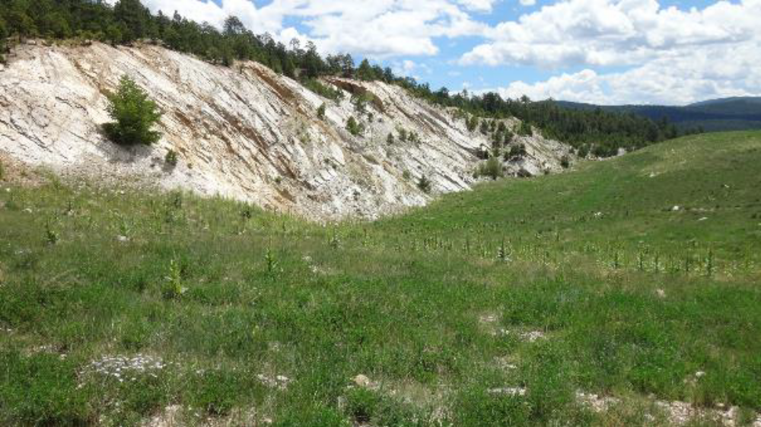
Steep slope contour furrows showing vegetation establishment, August 2017
Notes:
The effectiveness of this technique was realized following two 100-year storm events that occurred within 60 days of final grading and before seeding had been completed. The remnants of these furrows are still be seen today with much of the vegetation growing along the depressions of the furrows where water is caught and retained in a sheltered microenvironment.

Slide 17
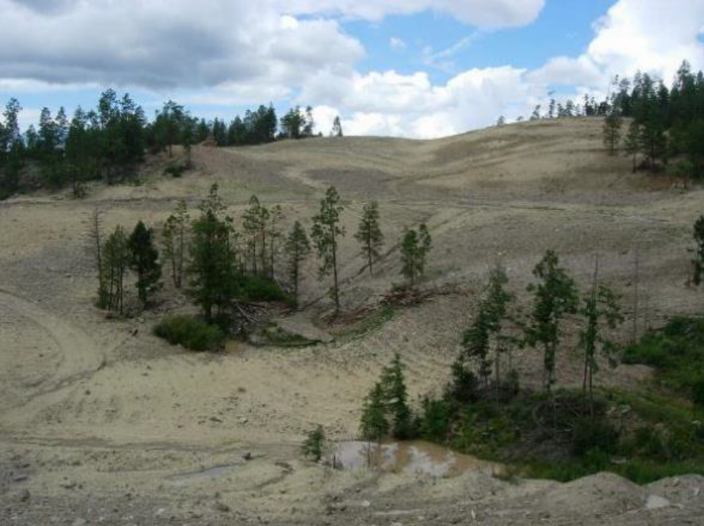
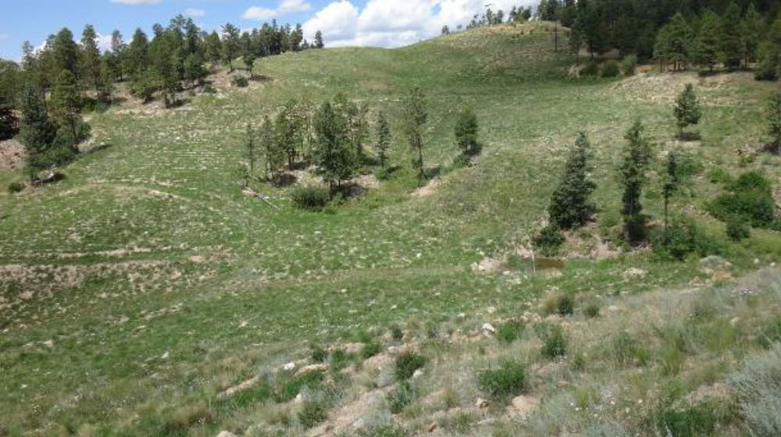
Looking northwest at reclamation, August 2006 vs August 2017
Notes:
The hard work and dedication from many professional resources contributed to this successful reclamation outcome, including those that provided day-to-day guidance and project management; the Picuris Pueblo ground crew who performed the seeding, detailed reclamation tasks and site maintenance; and construction work that brought the site to completion in 2008 with exceptional efforts in backfilling, grading, topsoil placement, and project design.

Slide 18
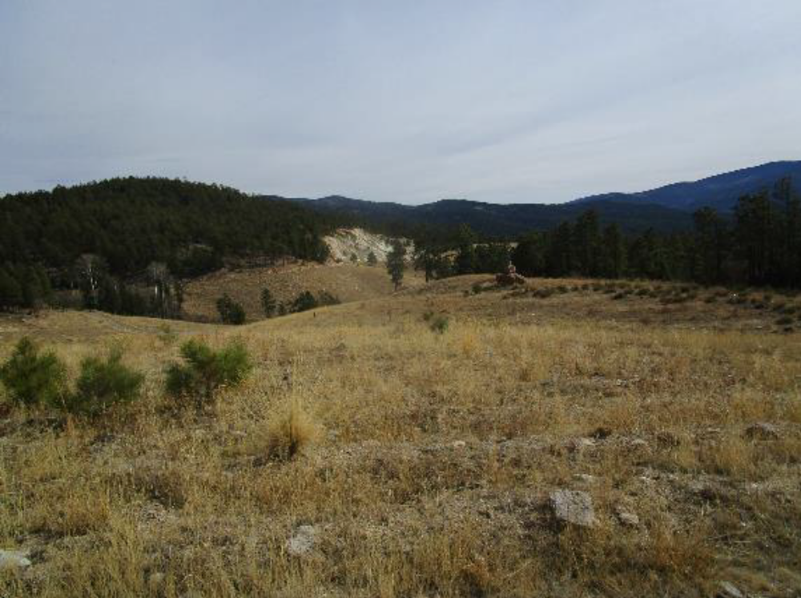
Looking southeast back at the highwall with natural ponderosa pine regeneration in the foreground, November 2019
Notes:
This nearly two-decade-long project came to fruition thanks to these dedicated contractors and Picuris Pueblo members, and to the primary financial support of the Lannan Foundation, of Santa Fe, New Mexico.

Slide 19
2020 EXCELLENCE IN RECLAMATION AWARD
Presented to
PICURIS PUEBLO
For its reclamation of the U.S. Hill Mica Mine to a more natural state, soon to be integrated into Tribal Trust Land for protection in perpetuity, securing access to spiritual sites and traditional sources of micaceous materials collected by generations of Picuris pottery makers
Notes:
Our congratulations to Picuris Pueblo for its reclamation of the U.S. Hill Mica Mine to a more natural state, soon to be integrated into Tribal Trust Land for protection in perpetuity, securing access to spiritual sites and traditional sources of micaceous materials collected by generations of Picuris pottery makers.

Slide 20
NAVAJO TRANSITIONAL ENERGY COMPANY, LLC and
BISTI FUELS COMPANY, LLC
For its project:
“Navajo Mine - Restoring the Land, One Watershed at a Time”
that utilized geomorphic reclamation principles to reclaim an entire watershed; replace an old terrace; and improve a community road
Notes:
The first project receiving a 2021 Excellence in Reclamation Award is for two companies whose project utilized geomorphic reclamation principles to reclaim an entire watershed, the South Barber Watershed at Navajo Mine; replace an old terrace, which was originally released from regulatory jurisdiction; and improve a community road.
We are pleased to present this award to:
Navajo Transitional Energy Company, LLC and Bisti Fuels Company, LLC

Slide 21
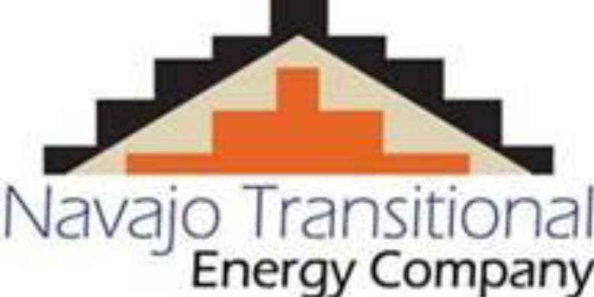
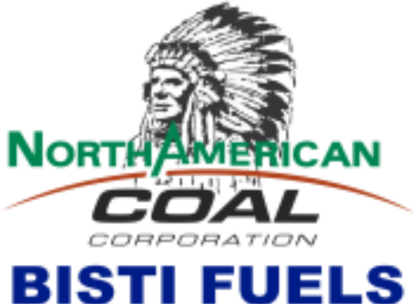
“We have an obligation to our
shareholders to make it right and this was an opportunity to step up, do the right thing, at the right time, and create a better landform than what was currently planned.”
Clark Moseley, NTEC CEO
Notes:
The Navajo Nation granted a 24,000-acre coal lease in 1957 to Utah Construction and Mining Company, and surface coal mining operations began in 1963. This was several years prior to the promulgation of the 1977 Surface Mining Control Reclamation Act (SMCRA). Over the years, through a series of lease revisions and amendments, the lease increased to approximately 33,000 acres.
Since inception, ownership of the mine has changed hands with all the owners being non-Navajo companies. That changed in 2013 when Navajo-owned Navajo Transitional Energy Company, or NTEC, purchased the mine, making it the first time a tribe has owned a coal mine on its own reservation. NTEC’s mission is to be a reliable, safe producer of coal, while diversifying the Nation’s energy resources to create economic and environmental sustainability for the Navajo people, and to develop and operate an energy company that values the Navajo Nation, its people, and its resources, now and in the future. To help achieve this mission, NTEC contracted North American Coal Bisti Fuels, LLC, to run the day-to-day operations at Navajo Mine.
Realizing that reclamation is not “one-size fits all,” NTEC’s and Bisti Fuels’ reclamation practice is driven by the natural pre-mine land features and the post-mine land use. At Navajo Mine, with a post mining land use of grazing, the traditional reclamation approach was reassessed and tailored to the environment of the Southwest. After 40 years of monitoring Navajo Mine reclamation, the best results were when the designs mimic the mature surrounding landscape.

Slide 22
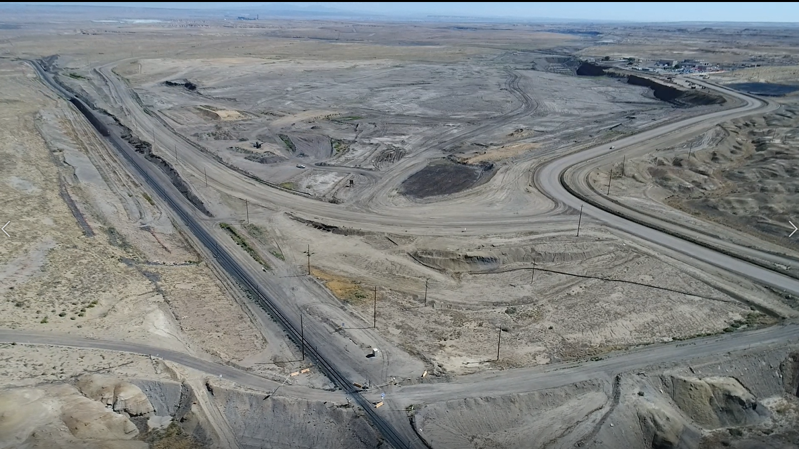
SOUTH BARBER WATERSHED – August 2017
(image from drone video)
Notes:
Historically, reclamation was done piece by piece until the entire watershed was complete. When NTEC took over, the reclamation approach changed to a more holistic approach of completing an entire watershed using geomorphic reclamation principles, ignoring jurisdictional boundaries. This design principle uses fewer hard-engineered structures such as drop structures and terraces for erosion control. The new design uses principles that mimic the natural erosion process. The method of reclaiming the entire watershed and going beyond jurisdictional boundaries allowed the pre-mine drainages to be reestablished.
The South Barber Watershed was the first of eight watersheds scheduled for completion and encompasses 455 acres. South Barber is split into two main working areas, Mason Pit and South Barber Pit, that are separated by a rail system.

Slide 23
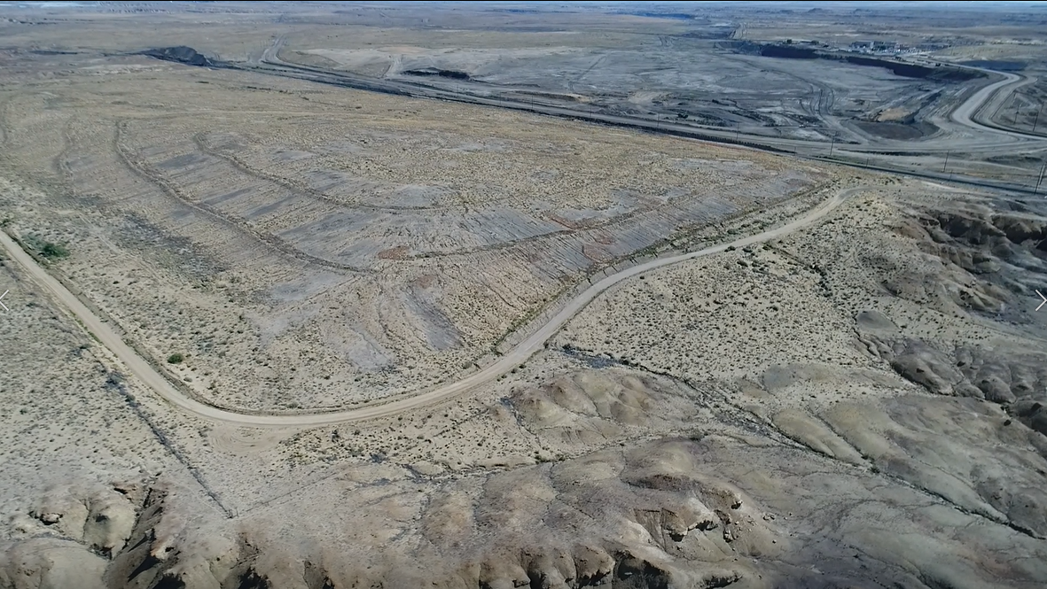
MASON PIT– August 2017
(image from drone video)
Notes:
Mason Pit was mined in 1980 and is along the western side of the rail system surrounded by permit boundary on the remaining three sides. Due to the limited life of the pit, there was more spoil material than room in the final pit. Traditional reclamation practices included rounding off excess material and adding water control features, such as terraces. This meant the pre-mining topography could not be restored without exporting a significant amount of the spoil material.

Slide 24
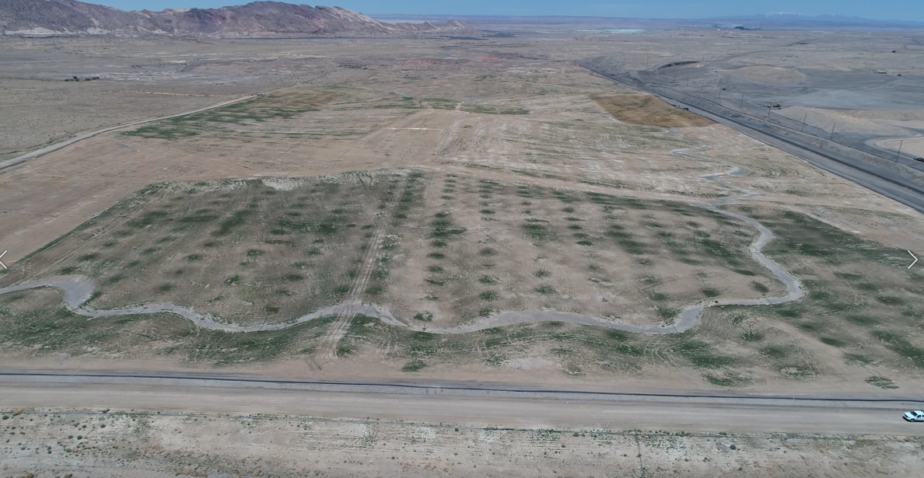
MASON PIT – May 2020
(image from drone video)
Notes:
Mason Pit was redesigned to a more natural landform with 6.8 million cubic yards of excess material going to the South Barber Pit. The excess material from the Mason Pit was removed in strategically designed lifts and controlled using high precision GPS to maintain accurate cuts.

Slide 25
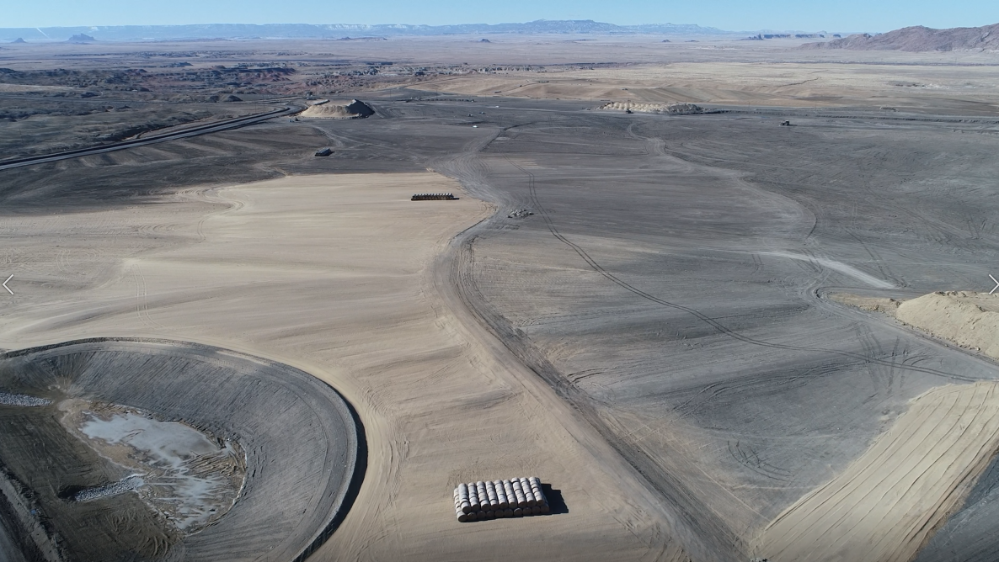
SOUTH BARBER PIT along the highwall – January 2020
(image from drone video)
Notes:
South Barber Pit is on the east side of the rail system and was mined west to east with the final pit on the east side of the watershed. The original reclamation plan for South Barber Pit was to backfill it with over 8 million cubic yards of Coal Combustible Byproducts (CCBs); however, in 2007, Navajo Mine was informed that CCBs could no longer be used for that purpose. Since South Barber was left open to accommodate those CCBs, this left the pit deficient by at least 8 million yards of material to allow proper drainage.
As previously mentioned, 6.8 million cubic yards of excess material were moved from the Mason Pit to the South Barber Pit to fill the void. The fill was placed in a manner that allowed water to continually flow to a pond by working inwards, or from highest elevation down. Dozers used high precision GPS so underfilling or overfilling was not an issue. Having the GPS dozers at the site also sped up the final regrading process.

Slide 26
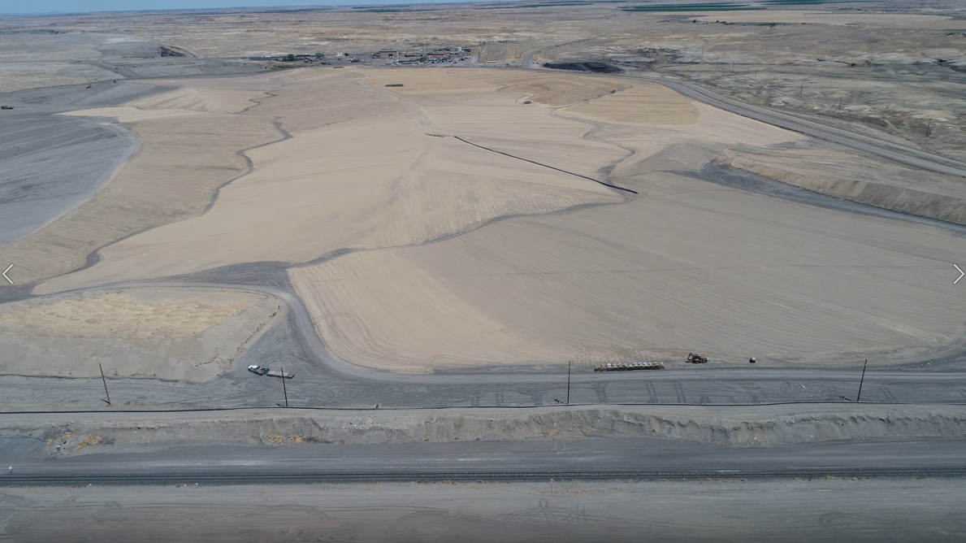
SOUTH BARBER PIT topsoil area – May 2020
(image from drone video)
Notes:
Topdressing was unexpectedly, and pleasantly, discovered as the Mason area became closer to grade. Through the reclamation process it became apparent that, in the 1980’s, mining spoil was placed on top of deep topsoil-suitable material, also defined as regolith (sandy material below the topsoil horizon that has the potential to be used as topsoil). Navajo Mine has a negligible amount of topsoil for reclamation, as the pre-mine area was 60% badlands that had little to no topsoil.
With this discovery of a potential topsoil substitute, the plan was to salvage as much of the newly discovered regolith as possible. The loader operators and supervisors worked together to find the best approach to uncover the regolith for sampling. Once the soil analysis results came in as suitable for topdressing, the regolith was then extracted. The deposit was large, ranging between 5 feet and 30 feet deep, which meant backfilling over excavated areas afterward. Overall, more than 325,000 cubic yards of regolith was salvaged from Mason, enough to sufficiently cover 393 acres of reclamation.

Slide 27
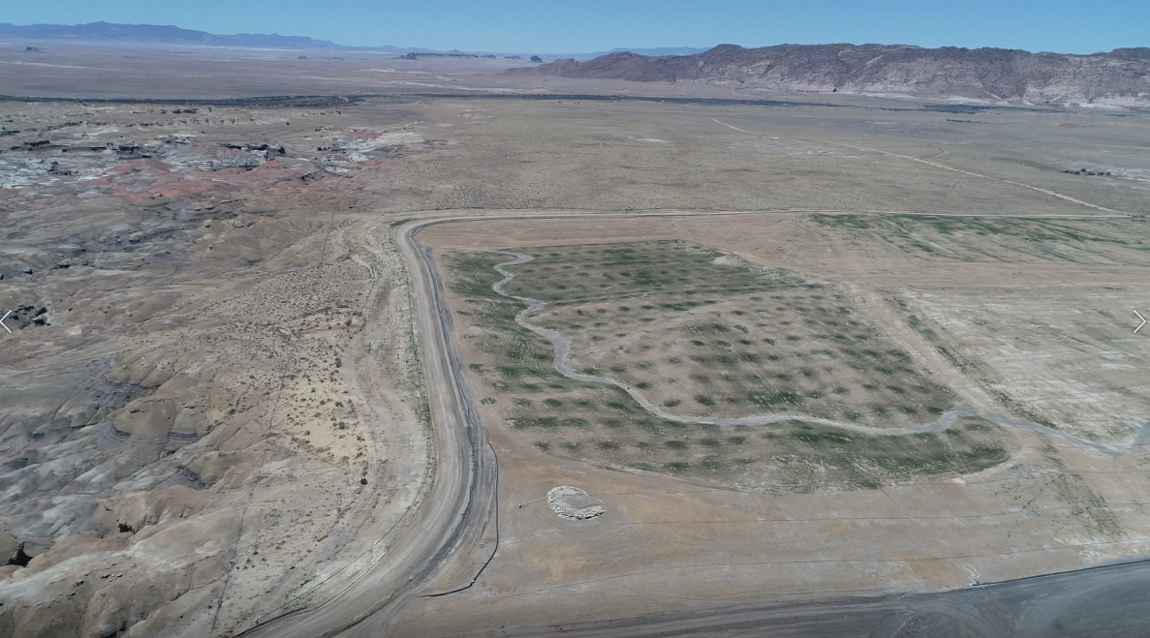
TABLE MESA COMMUNITY ROAD, finished – May 2020
(image from drone video)
Notes:
As another bonus, while constructing the southern ridgeline in the Mason Pit area, the scraper crew saw an opportunity to upgrade the Table Mesa Community Road which provides public access through the mine site to the residents on the west side of the mine lease. Although the road upgrade was not in the original plan, NTEC decided to pursue this opportunity. The road is along the south and west perimeter of the Mason Pit and was unstable during rain events. The cost of upgrading the road was minimal due to the top of the redesigned south ridge being the perfect slope and width. The upgraded community road has improved visibility and safety and added a beautiful view of the Mason Pit reclamation area.

Slide 28
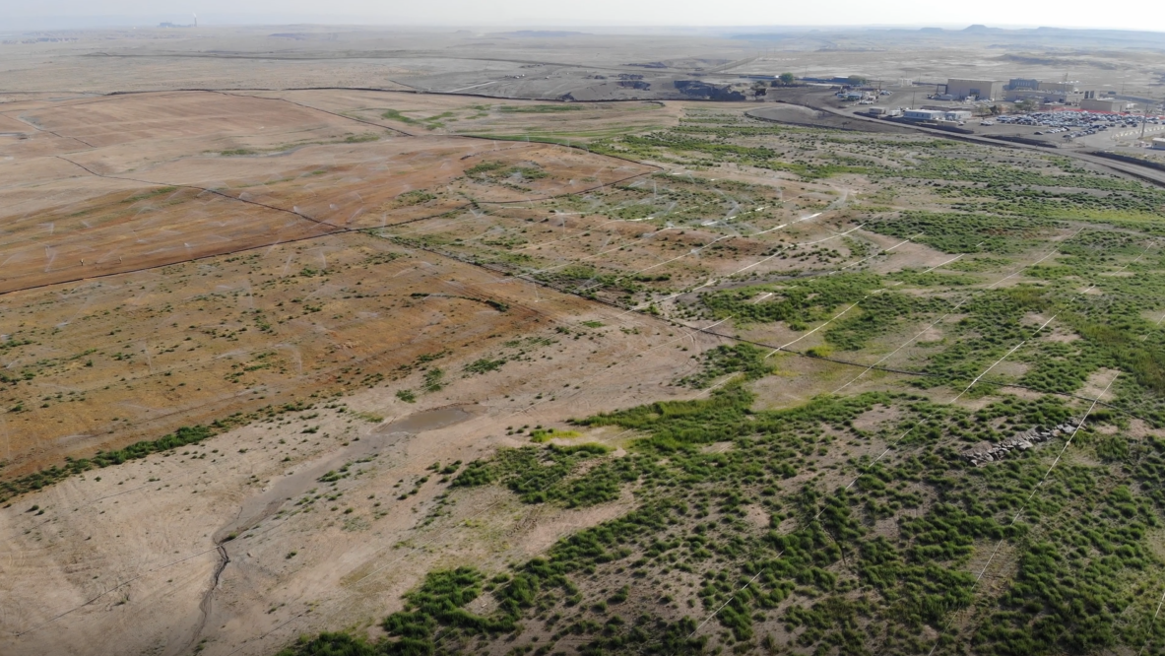
SOUTH BARBER WATERSHED RECLAMATION – 2020
(image from drone video)
Notes:
This two-year project began in 2018 with an overall cost of $13,657,170 or $1.69 per cubic yard. Keeping the elevation controlled was necessary to controlling the overall cost of the project because every rise of one-foot per acre equals 1,610 cubic yards – meaning each additional foot of elevation costs $2,720 per acre. In the South Barber Watershed this would have been an additional $761,852 of cost.
Another metric was the yards per acre when completing a watershed. In the past, when backfilling from July 2014 to December 2017, the average cubic yards per acre was 36,595. This project used about 18,341 cubic yards per acre. Completing the entire South Barber Watershed was 200% more efficient than previous projects while also restoring the natural drainages.

Slide 29
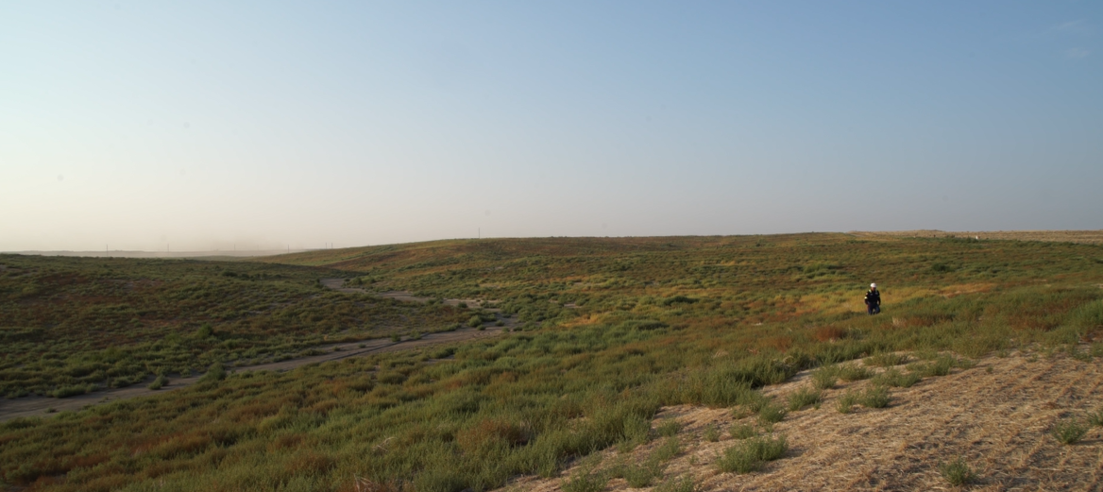
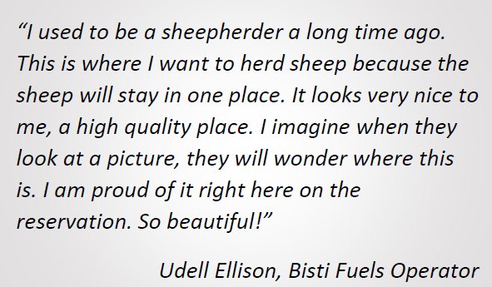
SOUTH BARBER WATERSHED RECLAMATION – 2020
(image from drone video)
Notes:
Navajo employees say this is the type of area they envision raising livestock. Replacing the terraces, creating natural regrade, and restoring the previous drainages ensure the area will support the post mine land use of grazing.
Restoring a healthy watershed benefits the grazing permittee the most because they will see more of the natural runoff that has not been seen since the 1980s. Breaking out of the past reclamation mold has allowed for the development of better methods, from implementing newer technology, such as geomorphic reclamation, to the operational methods of cutting and filling the material to mimic the mature surrounding landscape – building a self-sustaining landscape that will last lifetimes.
The South Barber Watershed is something that all parties are extremely proud of and is a showcase on tours – visitors get to see what the reclamation artists created at Navajo Mine. NTEC plans to continue employing this artistic reclamation practice and the lessons learned on the rest of the mine site – one watershed at a time.

Slide 30
2021 EXCELLENCE IN RECLAMATION AWARD
Presented to
NAVAJO TRANSITIONAL ENERGY COMPANY, LLC
and
BISTI FUELS COMPANY, LLC
For their project:
“Navajo Mine - Restoring the Land, One Watershed at a Time”
that holistically applies geomorphic principles and other innovative methods to return thousands of acres of Navajo Nation land to a
self-sustaining post mine land grazing use
Notes:
While this presentation can only present a brief overview of this amazing project, we offer our sincere congratulations to Navajo Transitional Energy Company, LLC and Bisti Fuels Company, LLC for their project:
“Navajo Mine - Restoring the Land, One Watershed at a Time” that holistically applies geomorphic principles and other innovative methods to return thousands of acres of Navajo Nation land to a self-sustaining post mine land grazing use.

Slide 31
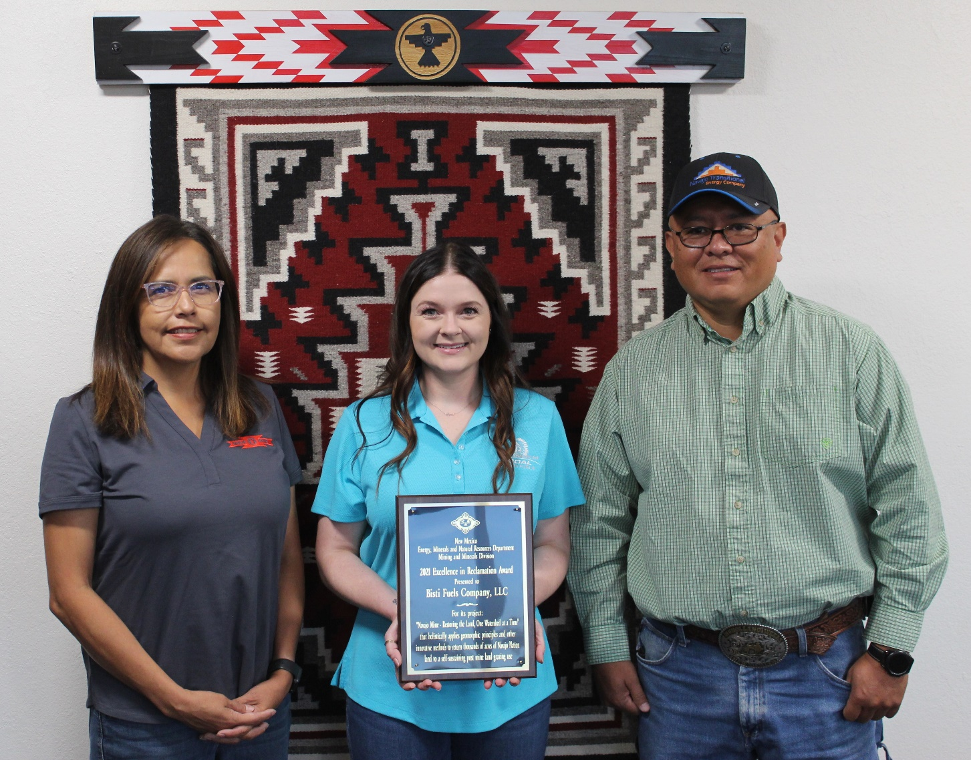
Pictured from left to right (all Bisti Fuels employees) are
Vivie Melendez, Environmental Manager; Deanna Resmini, Reclamation Engineer; and Shawn Smith, Reclamation Manager
Notes:
Photo provided by Bisti Fuels

Slide 32
PEABODY NATURAL RESOURCES COMPANY
For its project:
At El Segundo Mine, implementing geomorphic principals into contemporaneous reclamation that improved material handling and reclamation outcomes
Notes:
The second project receiving a 2021 Excellence in Reclamation Award is for another coal mine reclamation project at a mine that was one of the first mines to incorporate geomorphic reclamation as part of the mining sequence.
We are pleased to present this award to:
Peabody Natural Resources Company for its reclamation work at El Segundo Mine implementing geomorphic principals into contemporaneous reclamation that improved material handling and reclamation outcomes.
.

Slide 33
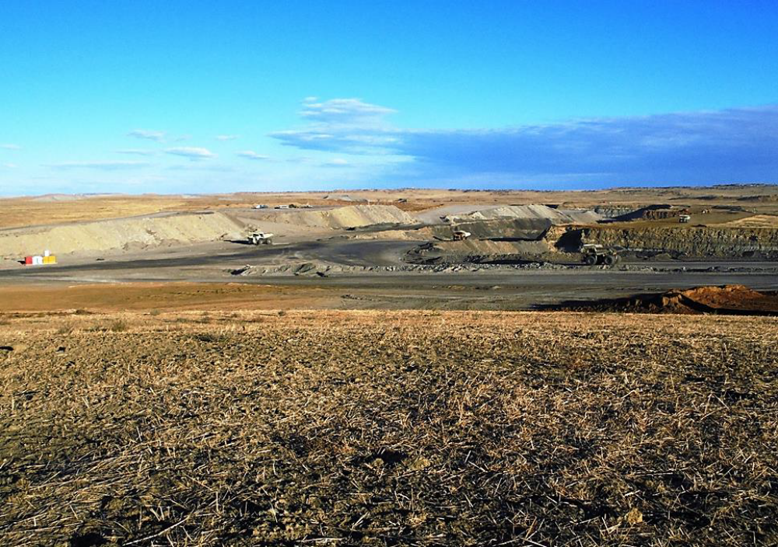
Notes:
El Segundo Mine has been in operation since 2008, producing 4-8 million tons of coal per year.
Residing on the center of the Continental Divide, 22 miles north of Milan, the mine permit area comprises 16,000 acres in an arid desert basin, with elevations ranging from 6,800 to 7,100 feet above sea level. The east portion of the permit area drains into the Inditos Arroyo that flows into the Rio Grande, and the west portion of the permit area drains into unidentified arroyos that flow into the Colorado River.

Slide 34
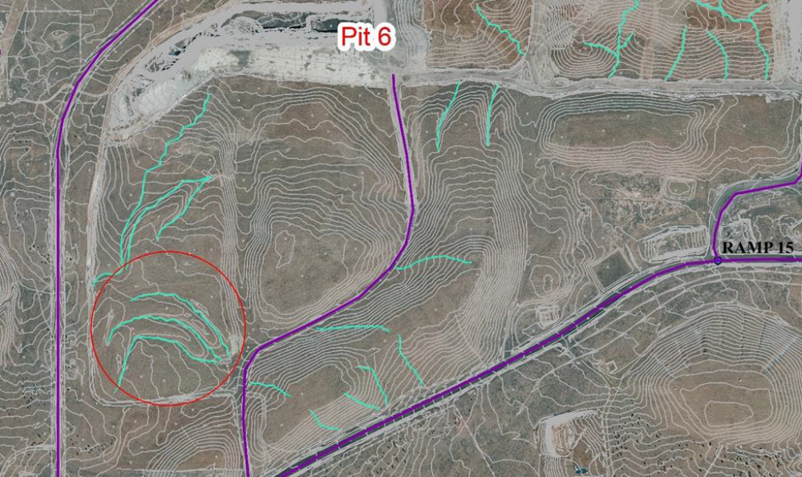
Pit 6 West’s design implemented three secondary drainages with small ridges separating the drains that eventually flow into a
primary drainage toward the east.
Notes:
The advances in the new geomorphic reclamation technology and philosophy – that reclamation is part of the mine cycle – promote minimal material handling, creation of a stable landform, and regrowth of native vegetation. In Pit 6 West, removal of topsoil, overburden, inter-burden material, and coal recovery took place from 2010 to 2018. The regrading of the final post mine topography (PMT) and reclamation took place from 2013 to 2019 incorporating topsoil and mulch placement, and drill seeding of the permitted seed mix.
The Pit 6 West area is the most successful example at the facility for geomorphic grading, topsoiling and revegetation as reclamation was conducted contemporaneously with the mining process. The previously defined PMT contours for this area were as a flat terrace with no planned drainages to carry water to the main channel. Instead, the new geomorphic designs were incorporated, replacing the slope and terrace reclamation process for drainages designed with long and uniform side slopes.

Slide 35
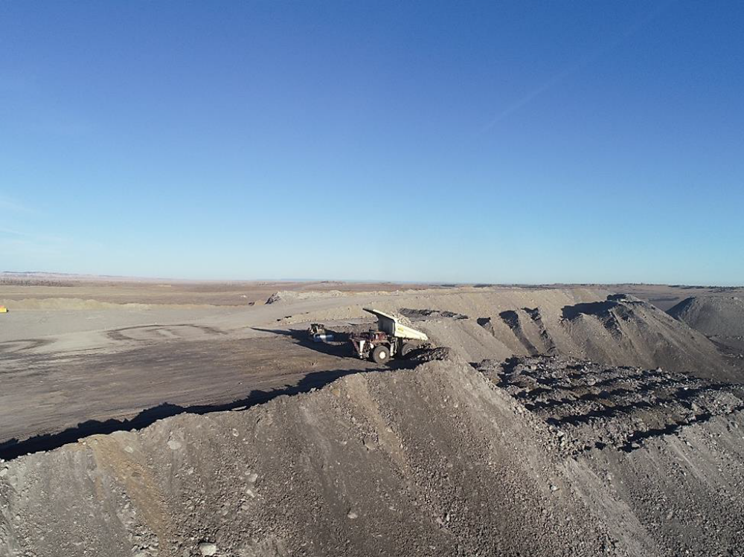
Example of the shovel and truck operation
Notes:
To further improve the process, engineering and production teams developed a plan for the placement of fill material incorporating a balance of material to fill and construct the ridges, maintain drain separation, and prevent crowding of the drains. Dozers cut drains (arroyos) to the appropriate grade in the backfill area. As each drain is developed the dozer pushes the material up and out of the drain into what will become a ridge, the next step of the reclamation process.
Once the drains are outlined and boundaries are established by the dozer crew, the electric shovel and truck operation dumps material between the drains which is then graded by a dozer to the constrains of the design. Opportunities to use overburden from an active cut as the material to fill and develop the ridges during the mining process enables dumping in the ridges and shaping the material as it is placed without re-handle or increasing additional costs.
This process allows completion of the ridges by the time the shovel finishes digging the overburden to uncover the mineable coal with no additional work necessary for each ridge.

Slide 36
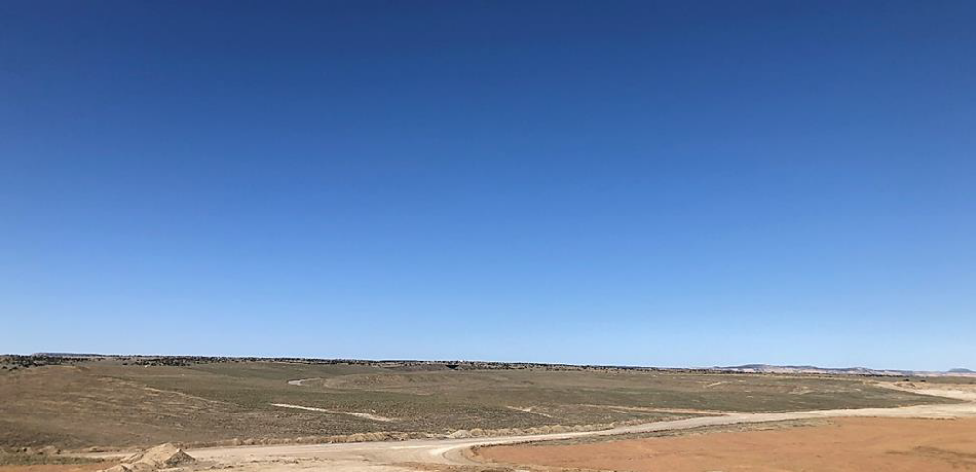
Stable natural looking landform, one year post-seeding
Notes:
Scrapers were used to define the final channel sinuosity and blend the channel to the topography of the ridges. The lower gradient of the drains allowed for even more effective implementation of sinuosity by the scraper crew and produced a very stable and natural landform. The process saved time and money while successfully achieving final reclamation topography with limited effort.
As Pit 6 West is one of the oldest and best reclaimed areas, Peabody is confident that this reclamation approach is the best way to move forward with reclaiming the entirety of the mine. Though there is not considerable relief with the topography of this reclaimed area, wind erosion does not appear to have an impact on the soil. The surface of the topsoil has subtle ridges and valleys which allow moisture to collect and seep into the ground. In the reclaimed area, minimizing spoil material and topsoil handling provided improved landform and seedbed conditions which are instrumental in establishing a strong vegetative growth.
One year after the initial seeding in Pit 6 West, diverse vegetative growth was largely established on slopes and in drainages.

Slide 37
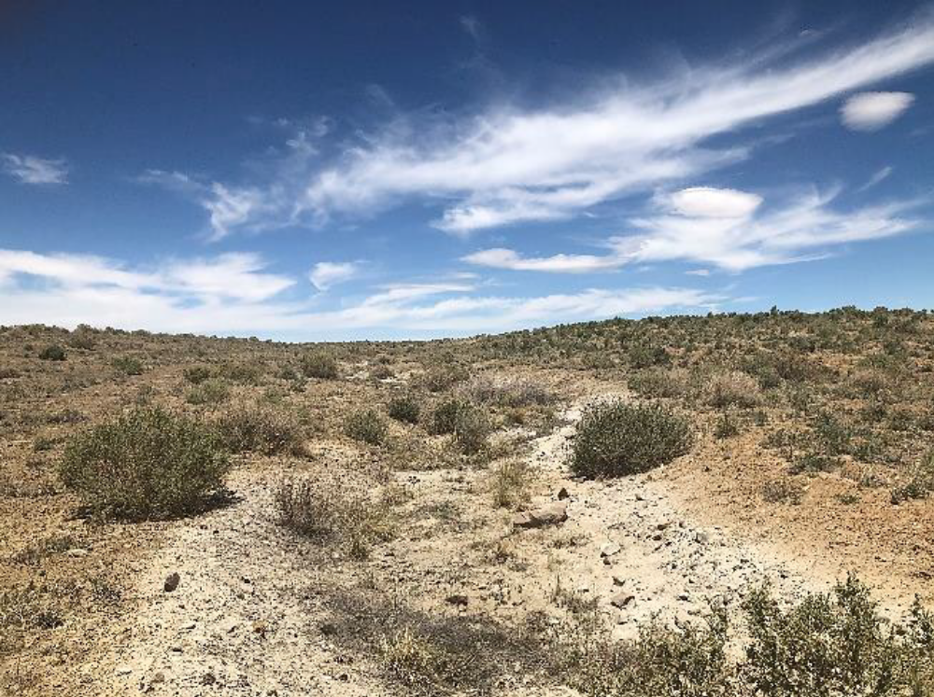
Pit 6 West Drainage
Notes:
Pit 6 West demonstrates exceptional vegetative success through high infiltration rate, surface roughness, and low gradient slopes. During precipitation events, it has been noted that soil erosion from runoff is minimal due to the high density of vegetation on the slopes and in the drainages.
The drainages have remained stable through eight monsoon seasons without need for repair because of the designed concave profile and site-appropriate sinuosity. The shorter slopes and different shapes of the reclamation allowed for more water to be held in the topsoil, promoting better vegetative germination establishment in the growing seasons.

Slide 38
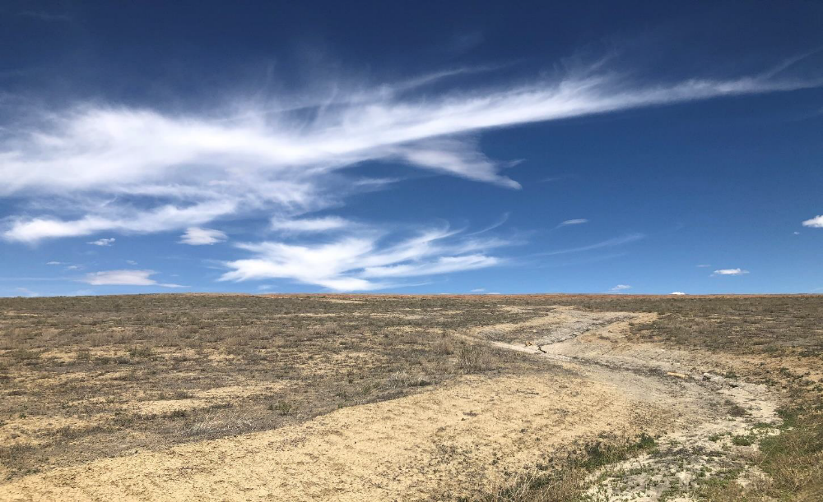
Sinuous drainage with no erosion
Notes:
El Segundo has perfected the ability to establish a cost-effective and sustainable ecosystem through approximate original contouring designs, minimal handling of material, sinuous drainage practices, erosion control, and successful vegetative growth. Peabody Energy strives to restore the mined area to its original contours or better by designing the reclamation plan so that the contours are as close to original landscape as possible.
El Segundo has surpassed the goal to plant and restore a healthy foliage in a challenging arid desert environment and will continue to improve the geomorphic reclamation process with added benefits to landform stability and overall reclamation success. The process is reviewed continuously to determine what could be done better and how future reclamation can be developed in a more natural and cost-effective means while active mine operations are ongoing.
The El Segundo team takes pride in the ability to take cutting edge technology and apply it effectively to the mining activities today. The culture around reclamation has changed for the better; where in the past it was seen as a task, now it is a mission integrated into the overall mining operation.

Slide 39
2021 EXCELLENCE IN RECLAMATION AWARD
Presented to
PEABODY NATURAL RESOURCES COMPANY
For its goal-surpassing efforts at El Segundo Mine, successfully implementing new geomorphic reclamation technology principals
into contemporaneous reclamation that greatly improved
material handling and reclamation outcomes
Notes:
Please join us in congratulating Peabody Natural Resources Company for its goal-surpassing efforts at El Segundo Mine, successfully implementing new geomorphic reclamation technology principals into contemporaneous reclamation that greatly improved material handling and reclamation outcomes.

Slide 40

www.emnrd.nm.gov
Notes:
Again, our congratulations to all the recipients, and our thanks for their conscientious work and their successful efforts on behalf of reclamation, preservation, education, and environmental awareness. We anticipate receiving another round of worthy entries for the 2022 awards.
For those who may not know him, Jerry Schoeppner is MMD’s new Division Director following the retirement of long-time director Fernando Martinez. With the cancellation of last year’s convention, we didn’t have the opportunity to introduce Jerry but are pleased to do so this year. He is doing a great job leading the division in fulfilling its mission to ensure the responsible utilization, conservation, reclamation and safeguarding of land and resources affected by mining.
We look forward to seeing you again next year.
Thank you.

