Slide 1

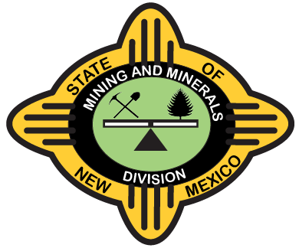
2026 EXCELLENCE IN RECLAMATION AWARDS
New Mexico Mining Association
87th Annual Convention and Tradeshow
Drury Plaza Hotel, Santa Fe, NM
Energy, Minerals, and Natural Resources Department (EMNRD)
Mining and Minerals Division (MMD)
Erin Taylor
Acting Cabinet Secretary
Anna Aguilera
Mining and Minerals Division Director
September 15, 2026

Slide 2
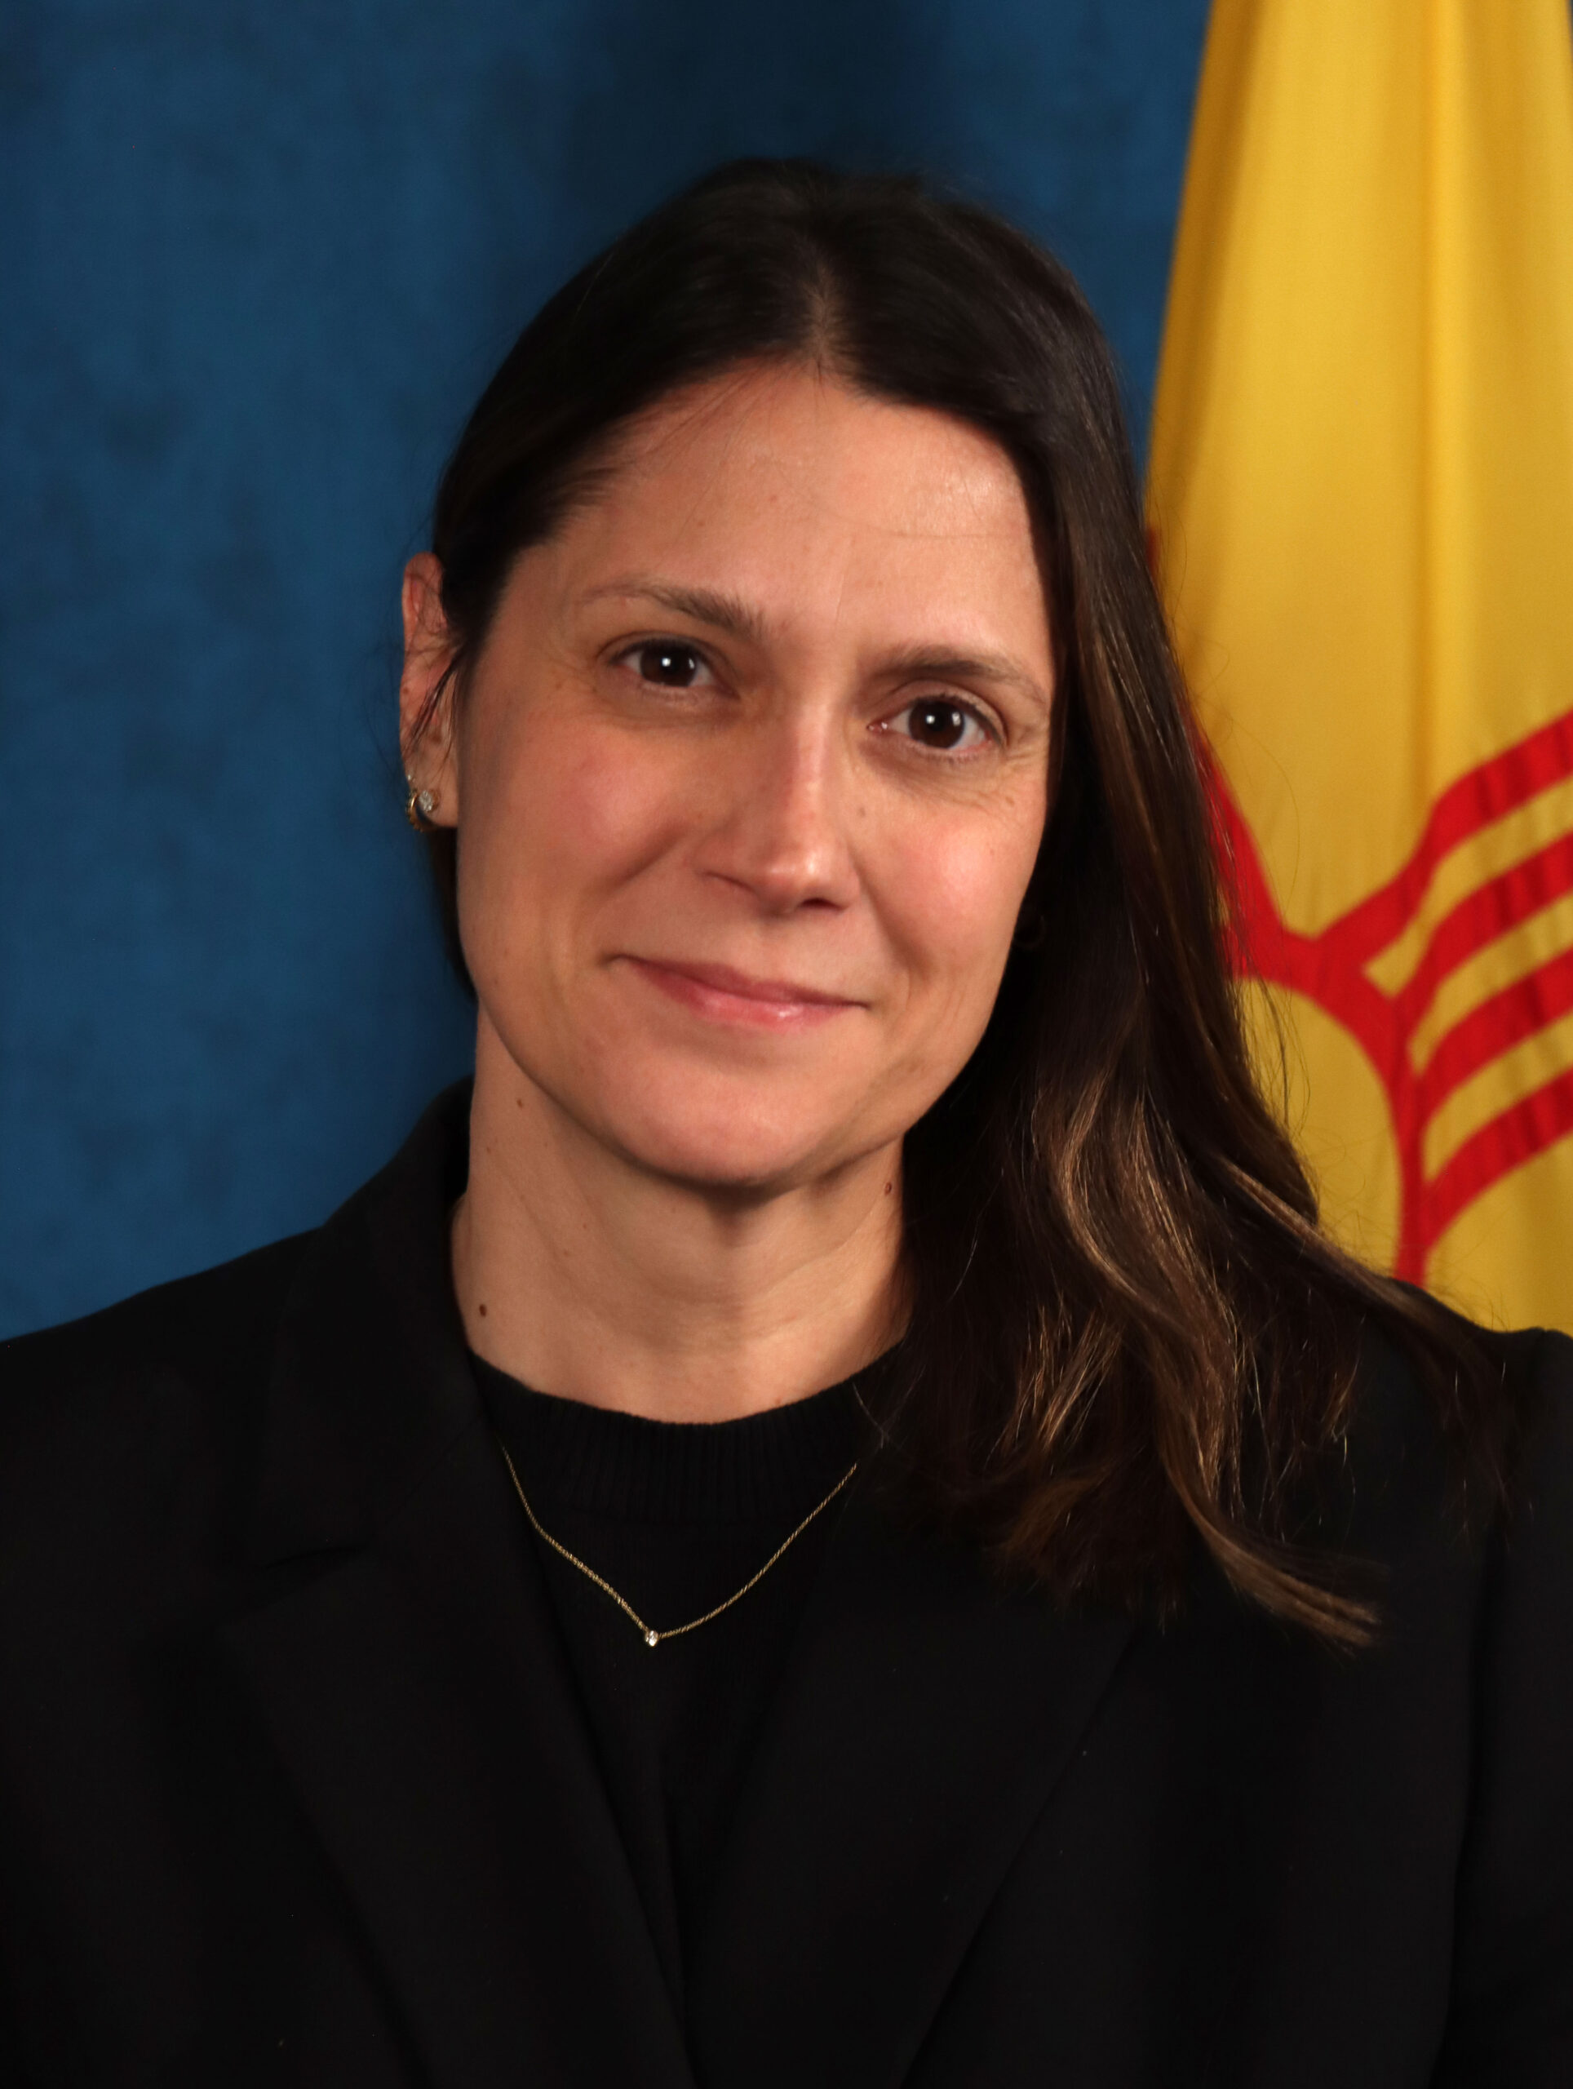
Thank you for joining us today to recognize outstanding achievements in mine safeguarding and land reclamation and honor those who restore New Mexico’s legacy mining sites.
Erin Taylor
Acting Cabinet Secretary

Slide 3
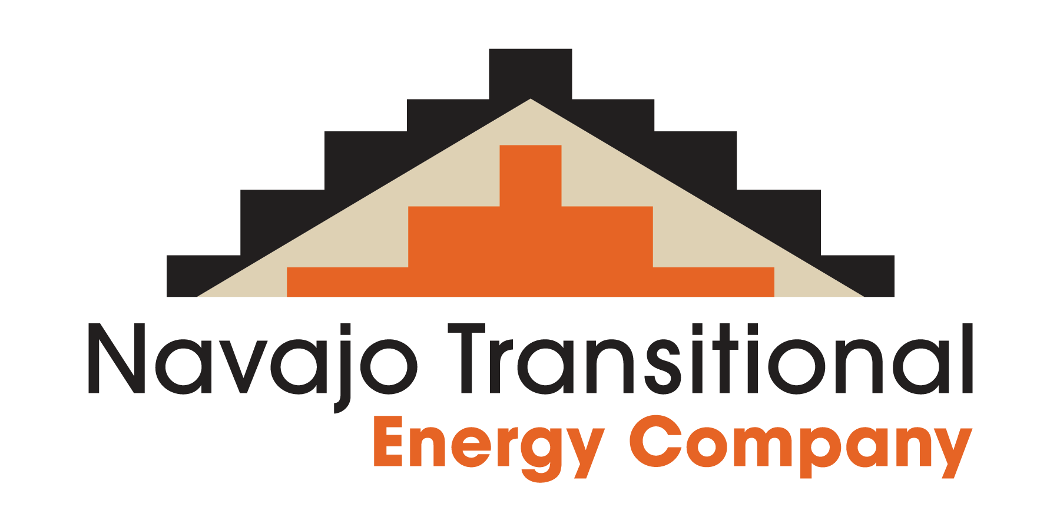
NAVAJO TRANSITIONAL ENERGY COMPANY
For its project:
Cottonwood Wash North Fork Restoration
Notes:
This year, MMD is presenting two awards for Excellence in Reclamation. The first award is going to Navajo Transitional Energy Company for the “Cottonwood Wash North Fork Restoration” Project.

Slide 4
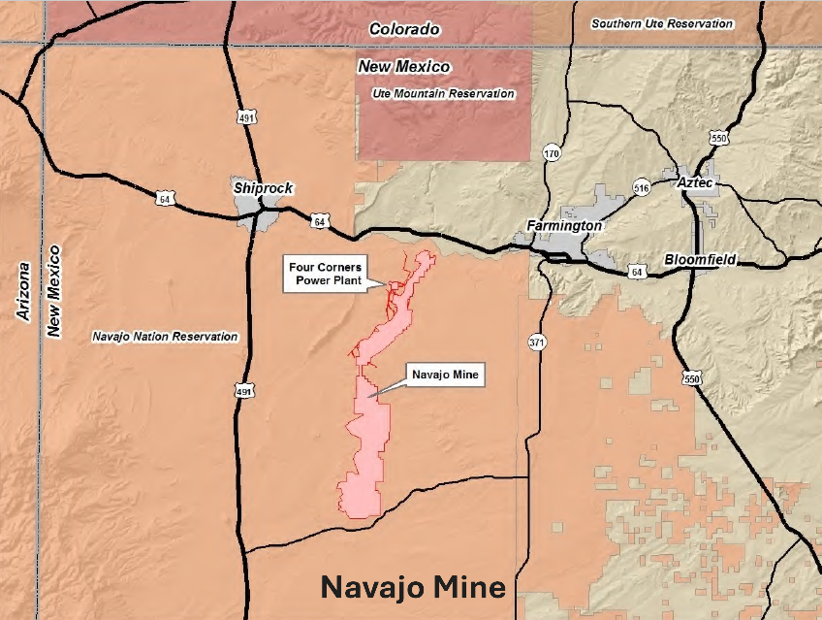
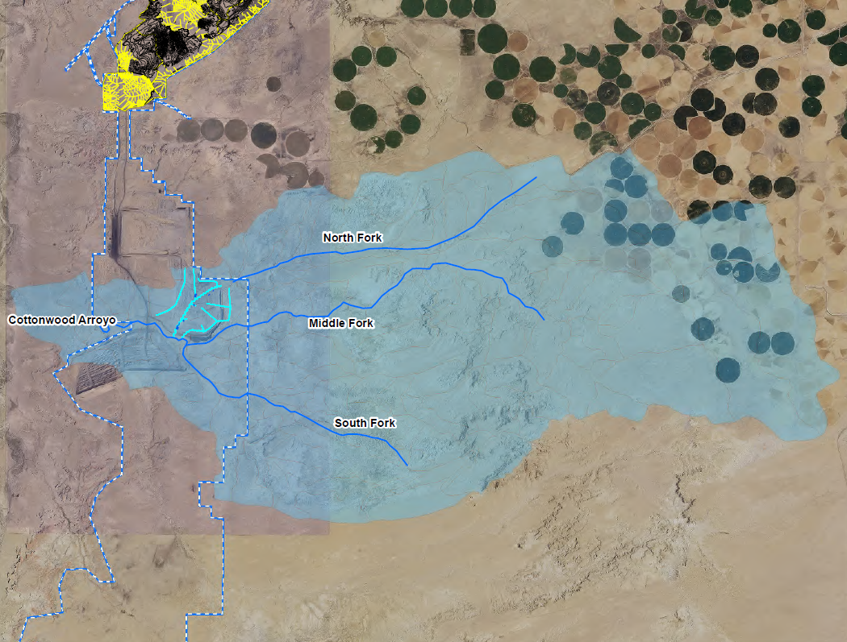
Project Location
Notes:
The Navajo Mine is located approximately 19 miles southwest of Farmington, New Mexico. Cottonwood Arroyo flows through the permit area and consists of the North Fork, Middle Fork and South Fork and The Cottonwood North Fork. The North Fork Diversion was constructed in 2002 to isolate freshwater from mining activities. As mining operations advanced, the diversion constrained access to recoverable coal. This restoration project began in 2024 and was completed by 2025 by Navajo Transitional Energy Company

Slide 5
Project Overview - Cottonwood Wash North Fork Restoration
9.2 M
Cubic Yards Moved
6.5 M
Tons Total Coal Unlocked
100-yr, 6-hr
Storm Event Design Across
Geomorphic Steam Design – channel functions as a natural stream, conserving soil moisture and suppressing evaporation.
Overcoming Challenges – sediment control challenges, sodic spoil remediation and field conditions.
Creative, Transferable Techniques – sediment and topdressing salvaging, sediment pond sequencing, and subsurface water harvesting.
End Result – stable, reclaimed drainage capable of conveying upstream sediment-laden runoff, supporting vegetation and improving habitat in a difficult setting.

Slide 6
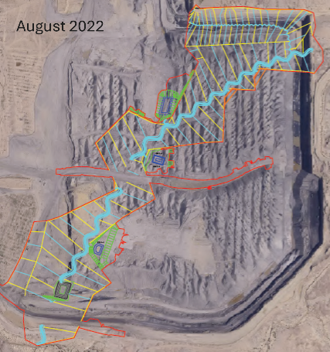
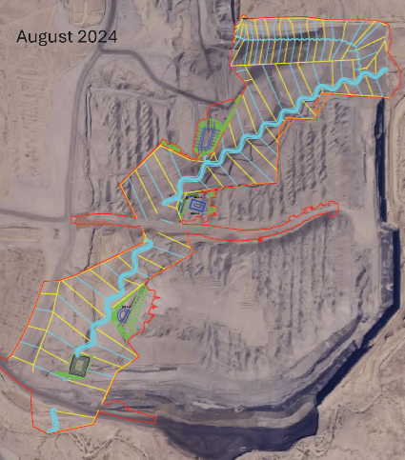
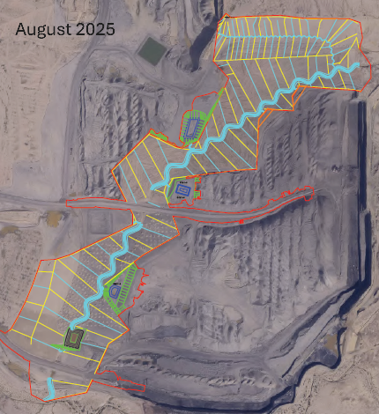
Aerial Photos of Project Progress over 3 years
Notes:
Over time, you can see the progress of the reclamation in these arial photos. The area becomes smoother and uniform reflecting all the earthwork/regrading done.

Slide 7
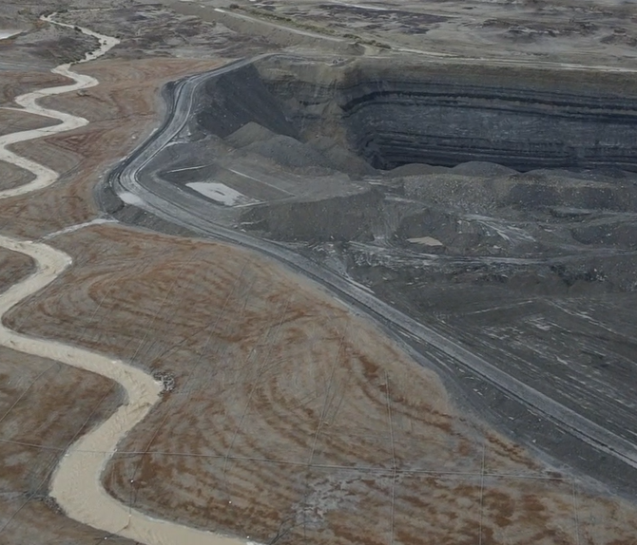
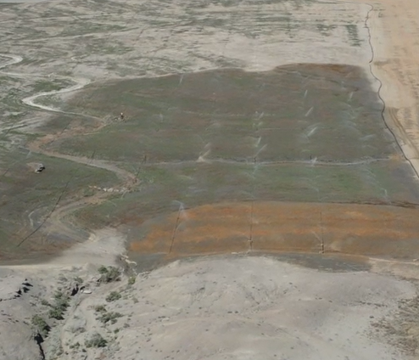
OCTOBER 2025
APRIL 2026
Notes:
Geomorphic reclamation before and after – erosion issues are reduced and it blends better with its surroundings. Grass is growing, you can see it with the irrigation.

Slide 8
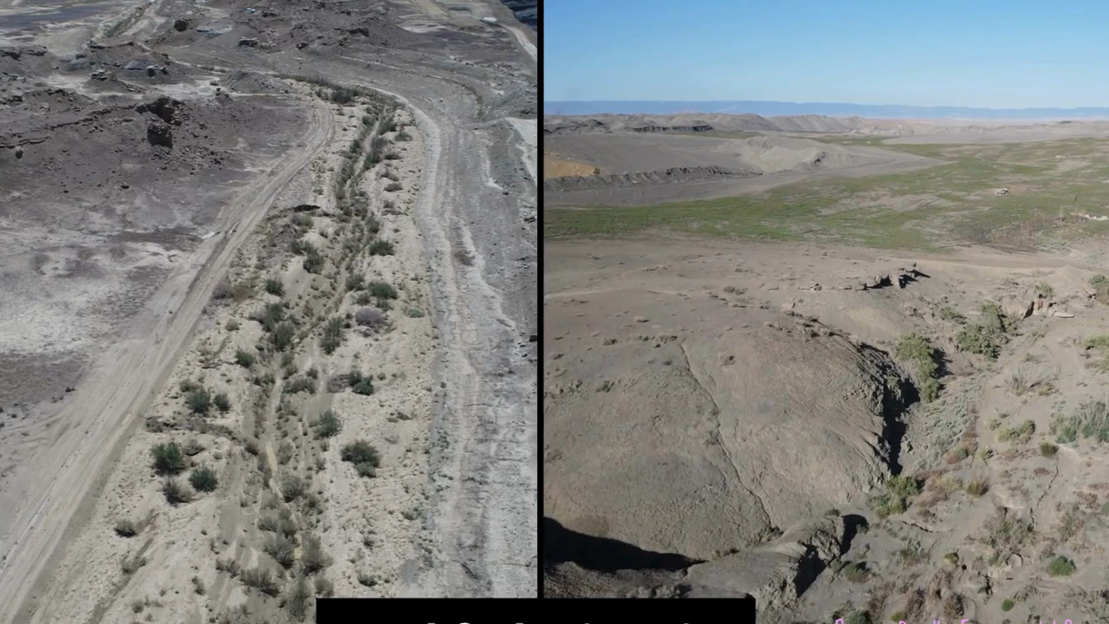
Notes:
NOTE TO PRESENTER: This is a video.
This is the Northfork Diversion. Pole plantings were planted - cottonwoods and willows, including some harvested from the area, that had already established and hopefully they would have an easier time getting established since they were already surviving with minimal runoff. The goal is to restore the land as close to its original state as possible, brining the community additional economic benefits and making the land usable in different ways.

Slide 9
2026 EXCELLENCE IN RECLAMATION AWARD
Presented to
NAVAJO TRANSITIONAL ENERGY COMPANY
For its project:
“Cottonwood Wash North Fork Restoration”
which went beyond the minimum reclamation requirements and utilized innovative techniques for geomorphic channel design and revegetation, enabling advanced coal recovery and storm resilience while maintaining an exceptional safety record.

Slide 10
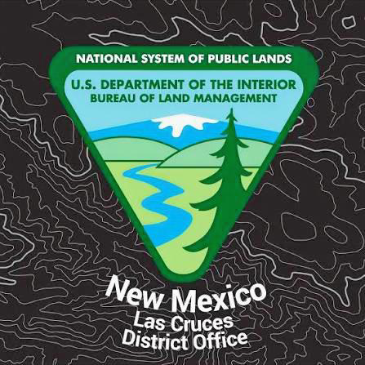
Bureau of Land Management
Las Cruces District Office
For its project:
Fluorite Ridge Mine Safeguard Project
Notes:
This year, MMD is presenting two awards for Excellence in Reclamation. The first award is going to Navajo Transitional Energy Company for the “Cottonwood Wash North Fork Restoration” Project.

Slide 11
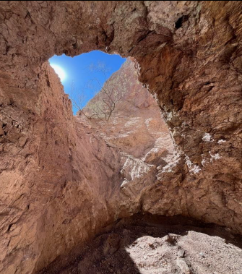
Project Overview – Fluorite Ridge Mine Safeguarding Project
History
Located approximately 10 miles NE of Deming
Operating from late 1800s until 1955
The Problem
Abandoned open shafts, adits and woodworking posed serious risk of injury or death to federal personnel, grazing livestock and recreational visitors
Contractor
Mountain State Restoration
Notes:
Project is located 10 miles northeast of Deming. Mining flourpar from 1800’s until 1955. Fluorite is the only mineral that has been produced on this district.

Slide 12
Project Overview – Fluorite Ridge Mine Safeguarding Project
68 mining features safeguarded
Closure Method | Quantity | Key Materials & Features
Backfills | 43 | Earth/rock material
Bat Gates | 17 | Custom steel bars, rebar pins, preserves bat passage
Cupolas | 3 | Steel structures over vertical openings
PUF Plugs | 3 | Polyurethane foam
Shaft Grate | 1 | Horizontal steel grate
Fencing | 1 | Barbed-wire perimeter security

Slide 13
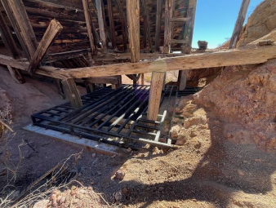
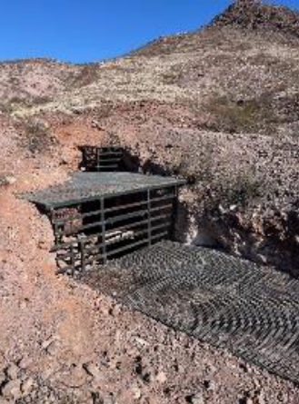
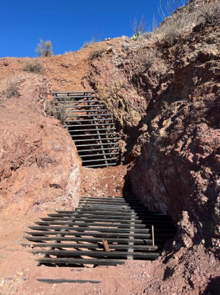
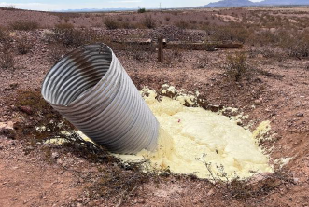
Notes:
Each closure had to be fitted without disturbing any cultural features while still providing the structural integrity necessary to protect the public.

Slide 14
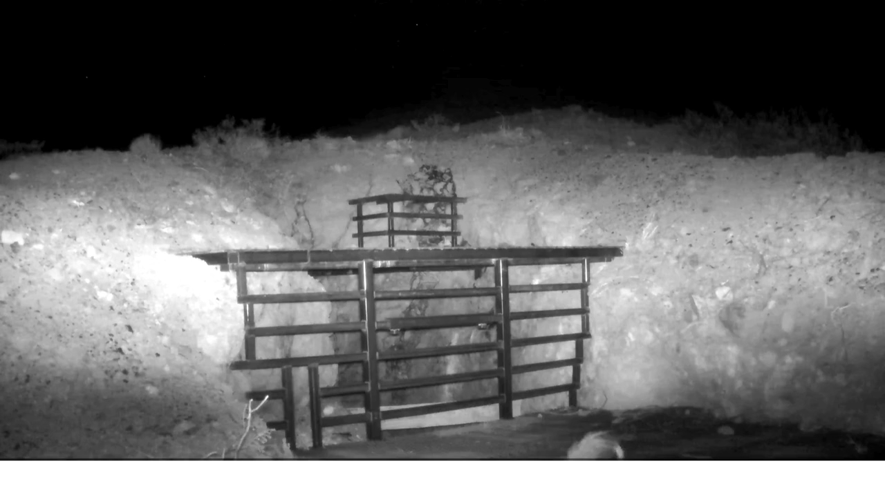
Notes:
NOTE TO PRESENTER: This is a video. Click it to play.
Example of the wildlife using the enclosures, showing they are working as designed: keeping people out of the openings but still allowing wildlife to enter them. The first one is a skunk. The second animal is a fox. The last one is a bobcat on top of a cupola. These videos were taking with carefully placed wildlife cameras throughout the project area.

Slide 15
2026 EXCELLENCE IN RECLAMATION AWARD
Presented to
BUREAU OF LAND MANAGEMENT – LAS CRUCES DISTRICT OFFICE
For its project:
“Fluorite Ridge Mine Safeguard Project ”
which demonstrated outstanding effort and technical innovation in safeguarding the public across 68 mining features near Deming, establishing structural integrity without disturbing cultural resources.

Slide 16
Thank you!

