Slide 1



Madrid Stormwater and Erosion Control Project
public information meeting
Thursday, August 15th, 2024
Madrid Firehouse – Madrid, NM
Notes:
Welcome

Slide 2
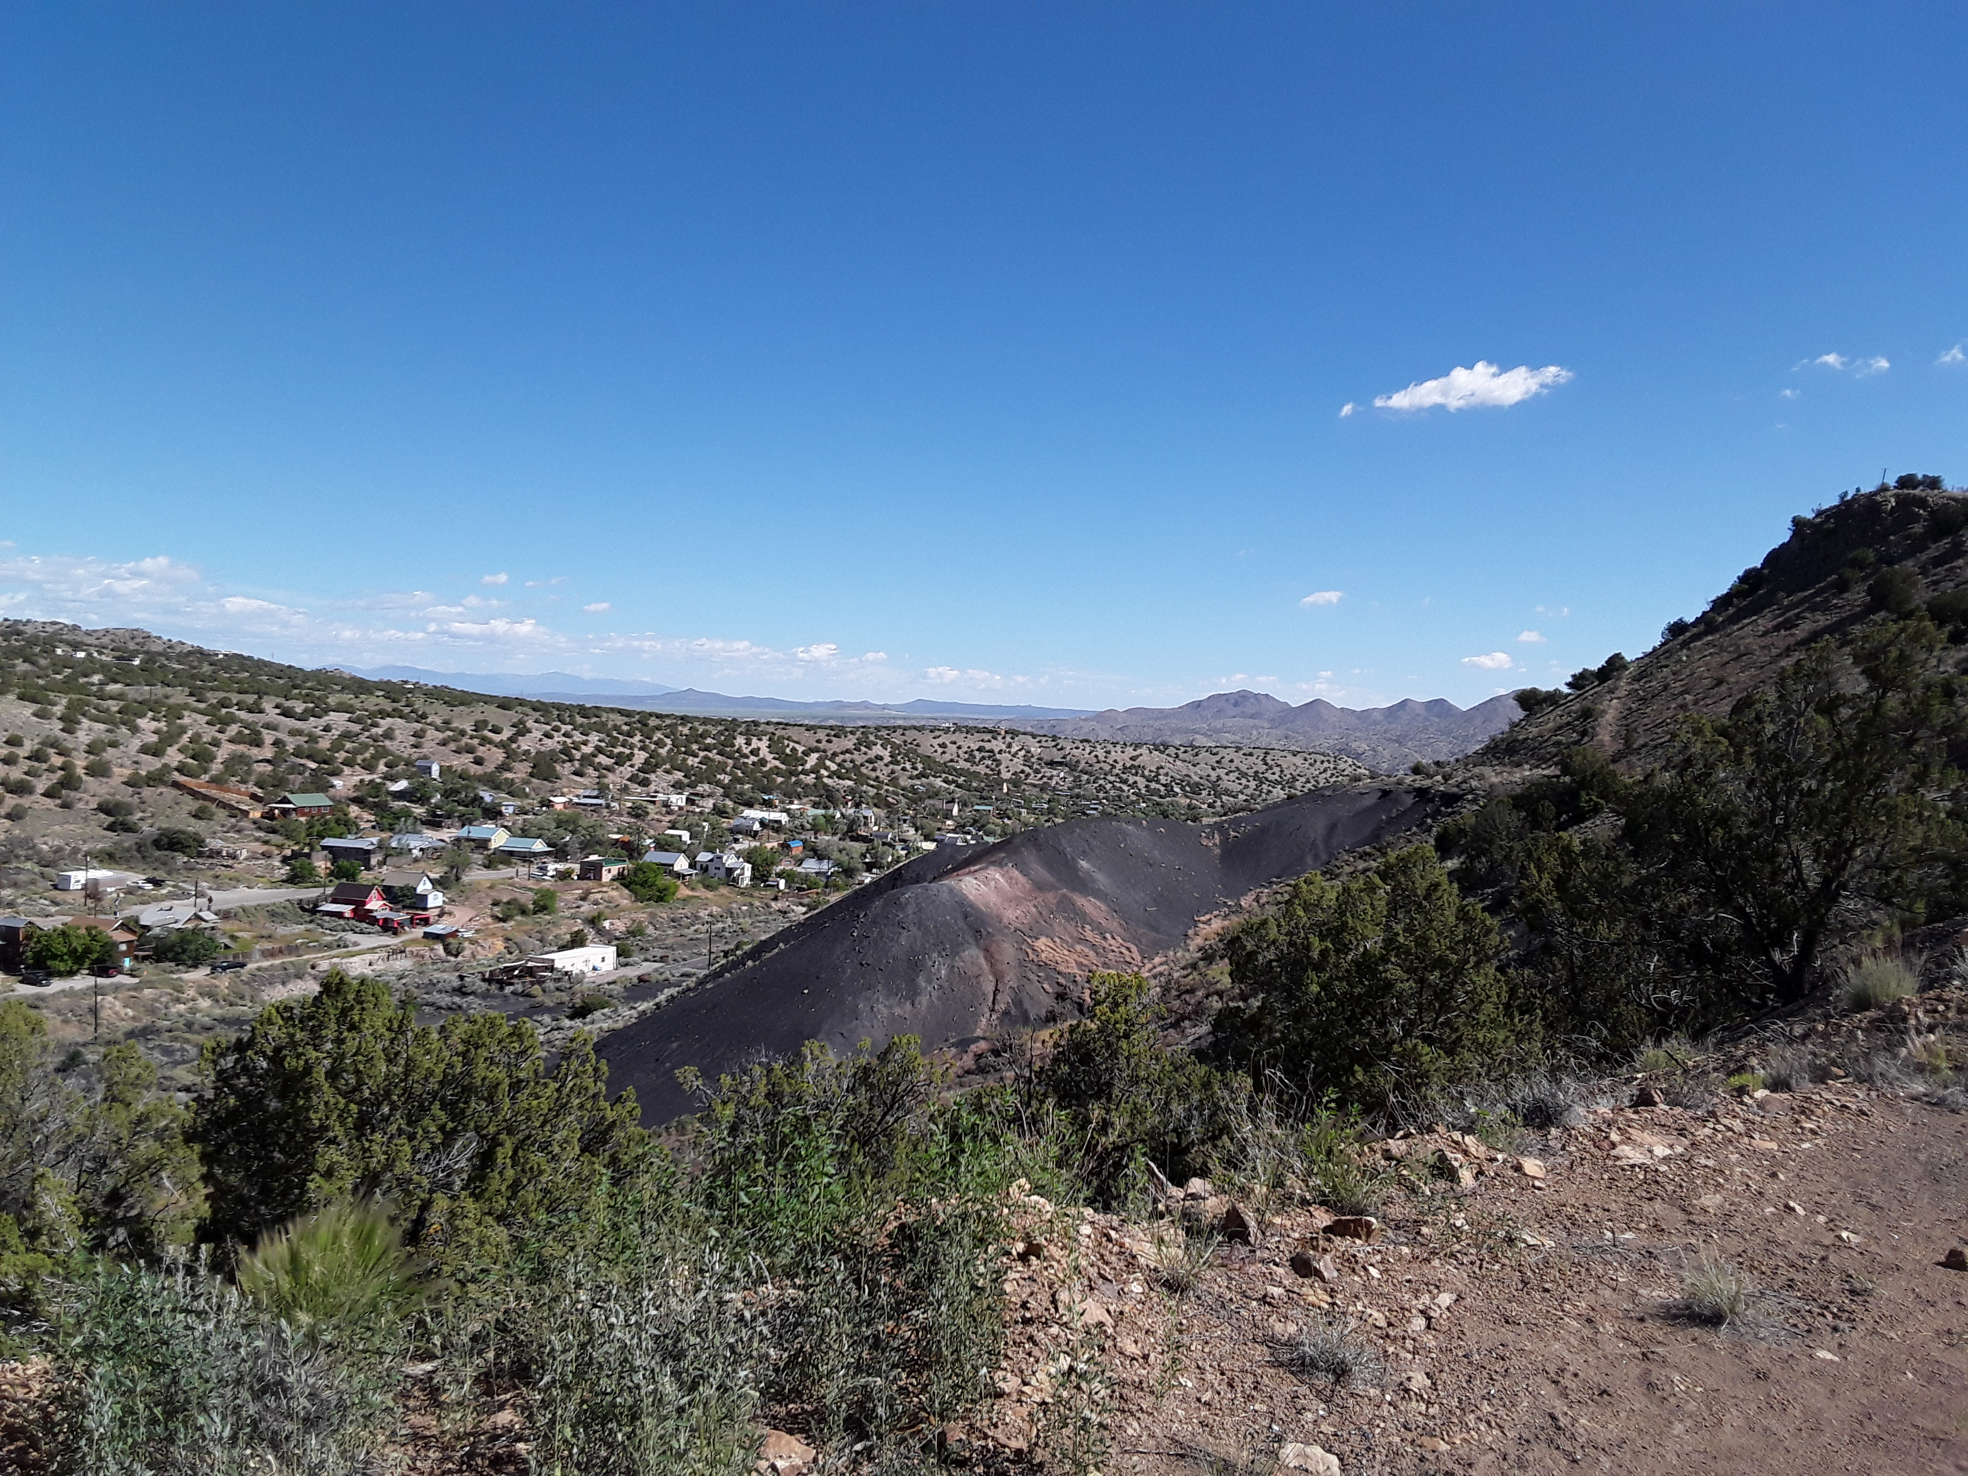
Public Information Meeting - Purpose
Reintroduce team members from agencies and contractors
Provide project update and what has happened since the last meeting
Discuss the updated engineering designs and revegetation plans, with a Q&A session
Gob pile above Madrid, NM
– Photo courtesy of AML
Notes:
Quick discussion of the layout for the meeting-
Quick overview of our team members;
Quick overview of previous public meeting results and project updates based off feedback from that meeting
Then we’ll open it to a panel discussion- all Q&A will be recorded

Slide 3

Project Team & Responsibilities
New Mexico abandoned mine Land (AML) program – Project Lead; project development, coordination, management, & construction oversight
OFFICE of SURFACE MINING RECLAMATION & ENFORCEMENT (OSMRE) – project funding source
SANTA FE COUNTY- water tank engineering design, assistance with permit acquisition on county property, landowner

Slide 4




Project Team & Responsibilities
GROUSE MOUNTAIN ENVIRONMENTAL CONSULTANTS– National Environmental Policy Act (NEPA) compliance; public outreach facilitation
WESTON SOLUTIONS– oversight of Madrid stormwater designs for the project; lead engineering
RIVERBEND ENGINEERING– oversight of Madrid Arroyo engineering designs
DANIEL B. STEVENS AND ASSOCIATES– prepared revegetation plan for Madrid Arroyo

Slide 5
Team Members
Abandoned Mine Lands Program (AML):
Oversight of Entire Madrid Stormwater Project & Funding Source
  Leeland Murray: AML Project Manager
  Andrew Zink: AML Cultural Resource Manager
  James Hollen: AML NEPA Coordinator
Weston Solutions:
Oversight of all Madrid Stormwater Designs
Rob Ederer, P.E.: Lead Engineer
Riverbend Engineering:
Oversight of Madrid Arroyo Engineering Designs
Chris Philips, P.E.
Grouse Mountain Environmental Consultants:
Public Meeting Facilitation and Environmental Compliance
Hillary Robbie: NEPA Coordinator
Cristina Marciales: Project Assistant
Daniel B. Stevens and Associates:
Prepared Revegetation Plan for Madrid Arroyo
Julie Kutz: Biologist

Slide 6
Previous Public Meeting (Jan 25) Results
Comment Period: Jan 8 – Feb 7
Limited comments regarding water tank and mine feature safeguarding
Plans for stormwater control generally accepted
Substantial concern over plans in the Madrid Arroyo
Response:
Engineering designs have been updated to provide more detail
Some arroyo work has been modified in response to comments
Revegetation Plan created to describe the planting, species, and monitoring efforts
Environmental Assessment [IN PROGRESS] to incorporate the updated engineering designs, revegetation plans, and other comments
Notes:
Public meeting held in January to discuss the proposed action and the Draft Environmental Assessment. During the meeting and the month-long associated comment period we received quite a bit of feedback. We reviewed ALL comments and provided responses individually for each comment/subject. A comment/response summary followed which is available online. For those that submitted comments via email, the comment response was sent back to the same email.
In general, comments were positive or neutral regarding the water tank, mine feature safeguarding, and stormwater controls throughout town. However, we got significant feedback about Madrid Arroyo. Comments regarding the arroyo ranged from blanket statements against, many comments requesting more detailed information, and comments requested lesser impacts.
In response to the comments-
Engineering designs have been updated to provide more detail, with some modifications in response to comments. Some arroyo work has been modified. We now have a Revegetation Plan to better describe plans for the Arroyo vegetation work, including the plant species, reclamation areas, and monitoring work.
The Environmental Assessment is being updated to reflect these changes and other comments made during the comment period.

Slide 7
Madrid Stormwater and Erosion Control
Project Schedule
August 15: Public Meeting
August/September: Finalize Environmental Assessment
September: Submit EA to OSMRE
October-November: OSMRE provides NM AML with Authorization to Proceed (ATP)
Begin Work –
January/February Water Tank Installation
2025: Hillside And Arroyo Work Following Bid Procurement

Slide 8
Q&A Session
For electronic copies of the Revegetation Plan, updated Engineering Designs, and future posting of the Environmental Assessment, please visit:
www.emnrd.nm.gov/mmd/public-notices/
Thank you for participating!

Slide 9
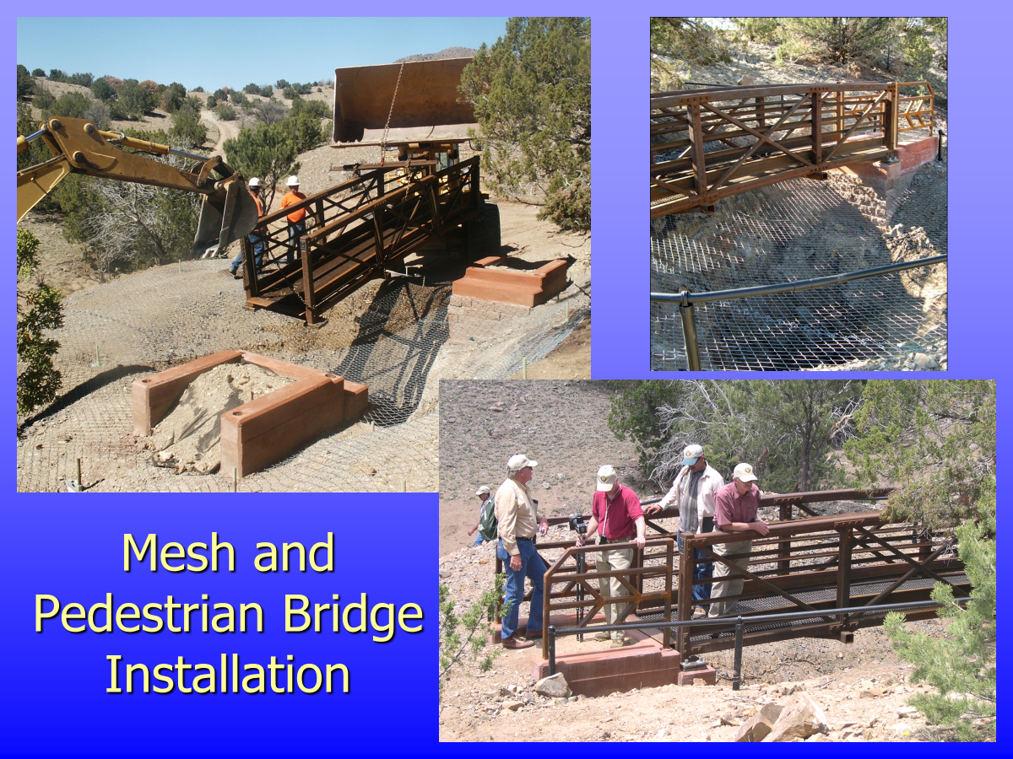
Bridge Example

Slide 10
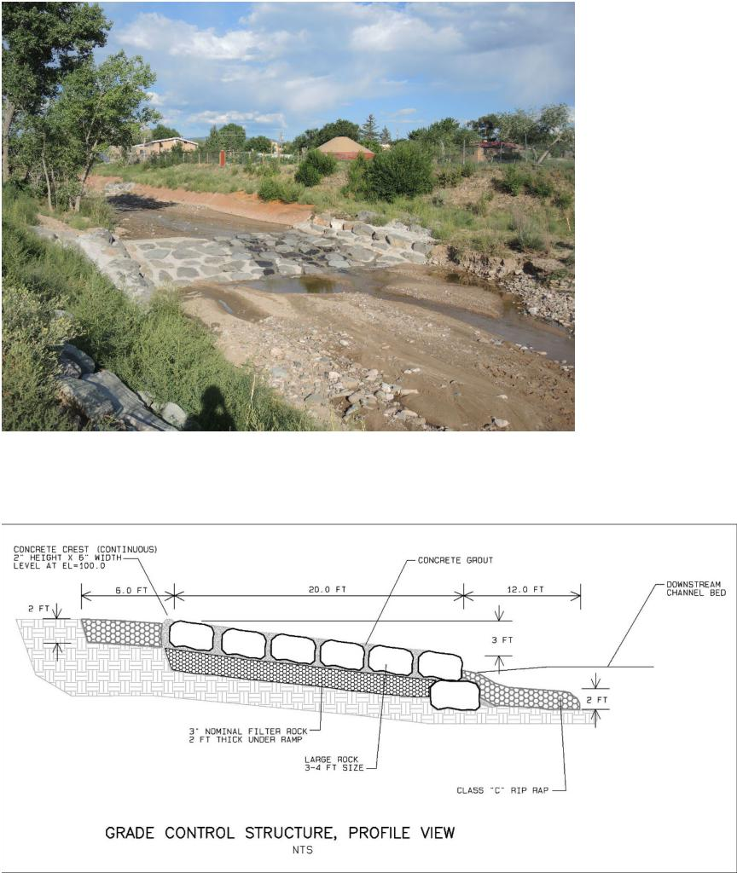
MADRID ARROYO
RESTORATION:
Examples of proposed
restoration elements
Grouted boulder grade control structure, Type 1

Slide 11
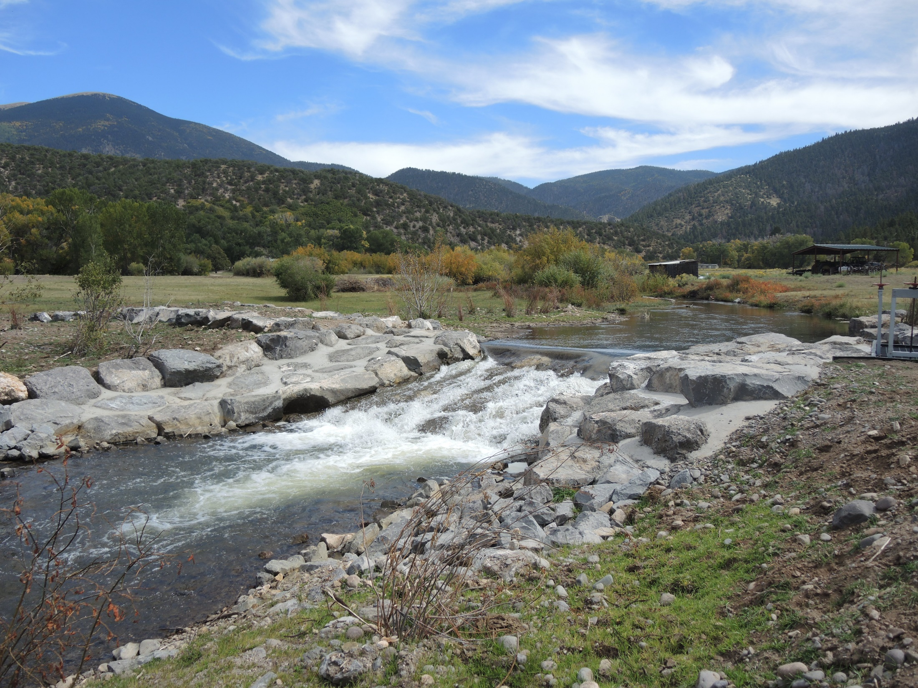
Grouted Boulder Grade Control Structure, Type 2

Slide 12
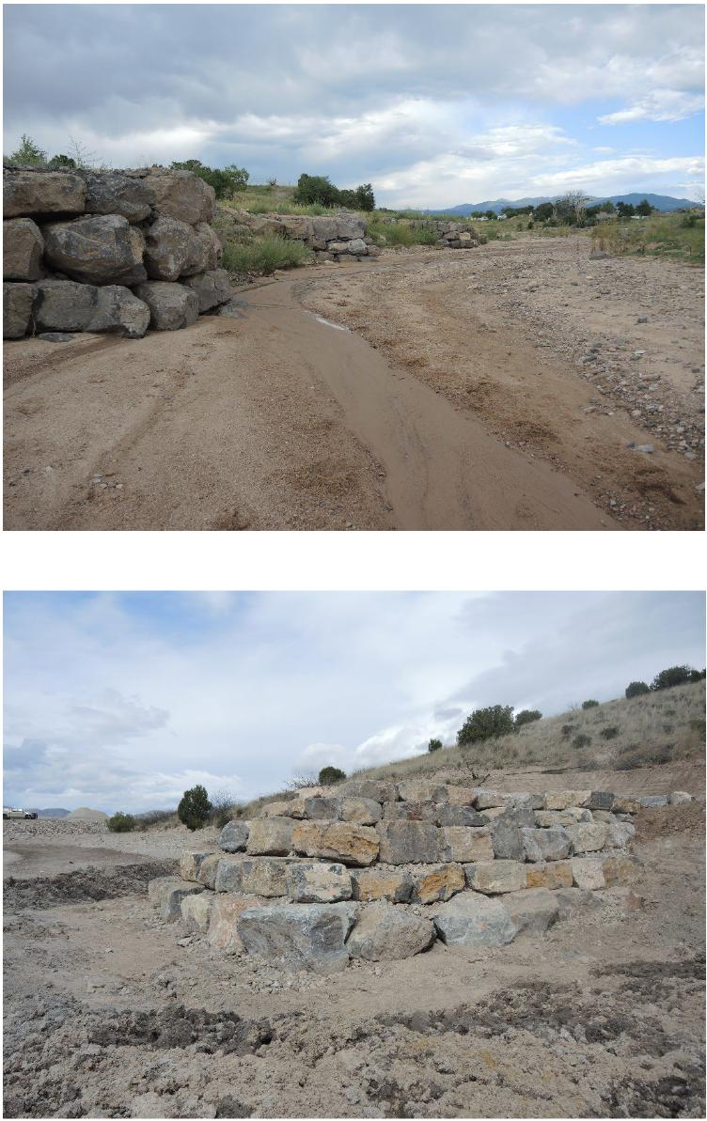
Stacked boulder deflectors, control lateral channel migration and erosion.
Stacked boulder wall, or rock and soil deflector.

Slide 13
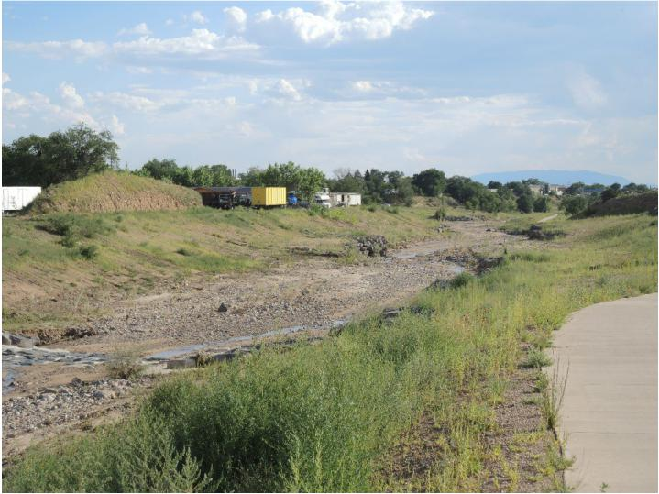
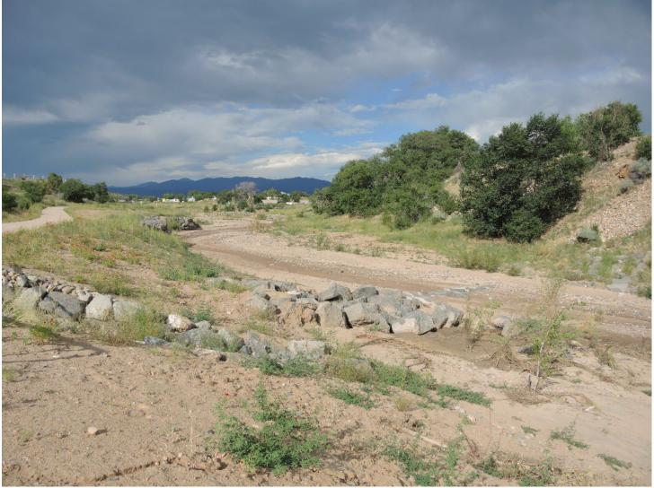
Arroyo and floodplain grading: meandering low-flow channel with adjacent floodplain, infrequent stacked boulder deflectors to manage channel migration and grouted boulder grade control structures to control channel bed elevations.
Arroyo and floodplain grading: meandering low-flow channel with adjacent floodplain, emergent willows at bankfull elevation.

Slide 14
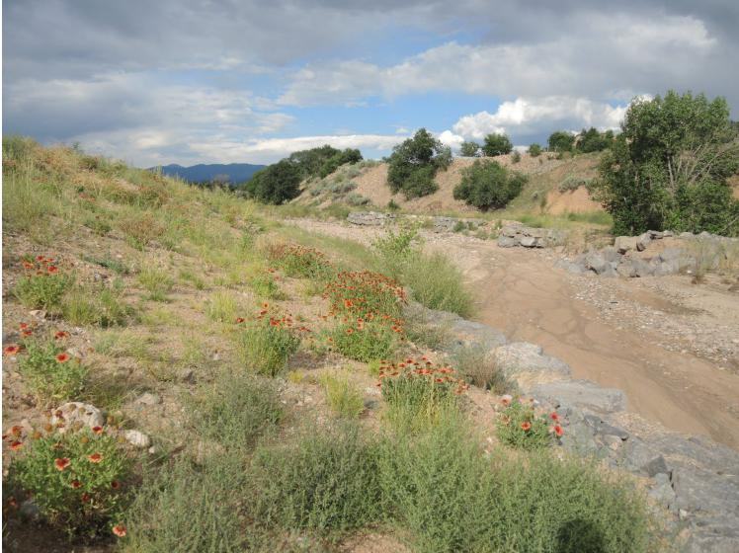
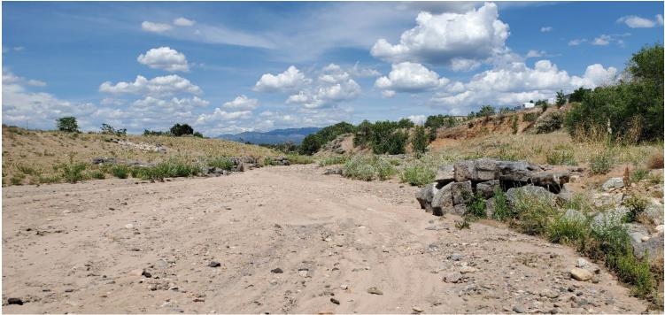
Sideslope grading at 3:1 or 4:1 allows for grasses/forbs/weeds to establish. Plant palette for Madrid will lean towards more drought tolerant species including chamisa shrubs and bunch grasses.
Arroyo morphology is laterally managed with rock structures and riparian vegetation.

Slide 15
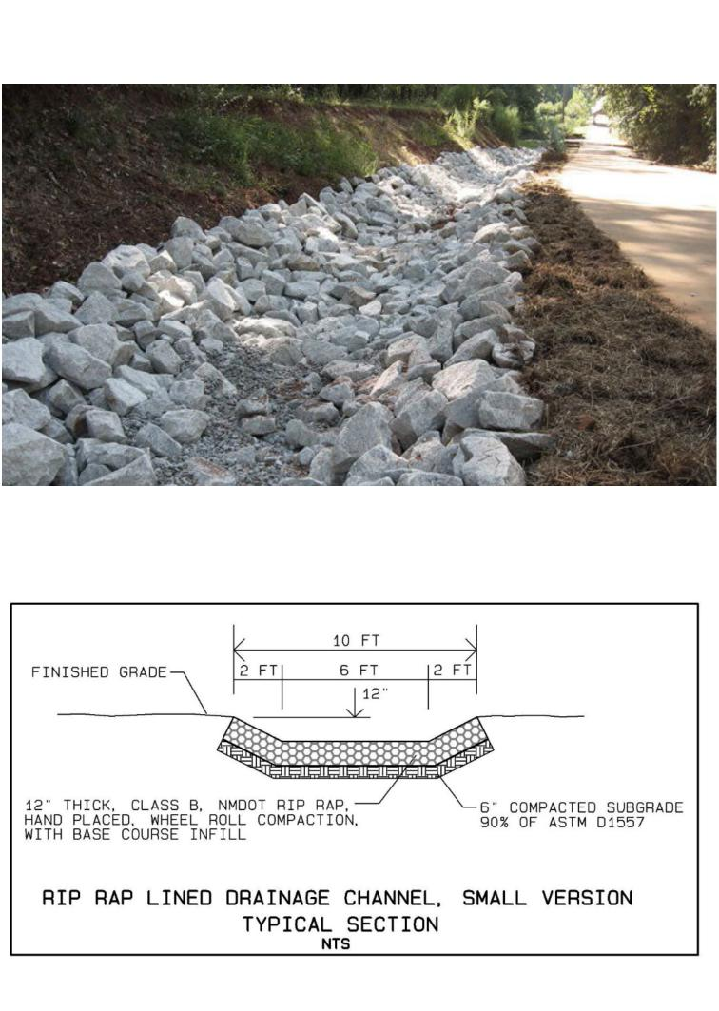
Rock lined drainage channel.

Slide 16
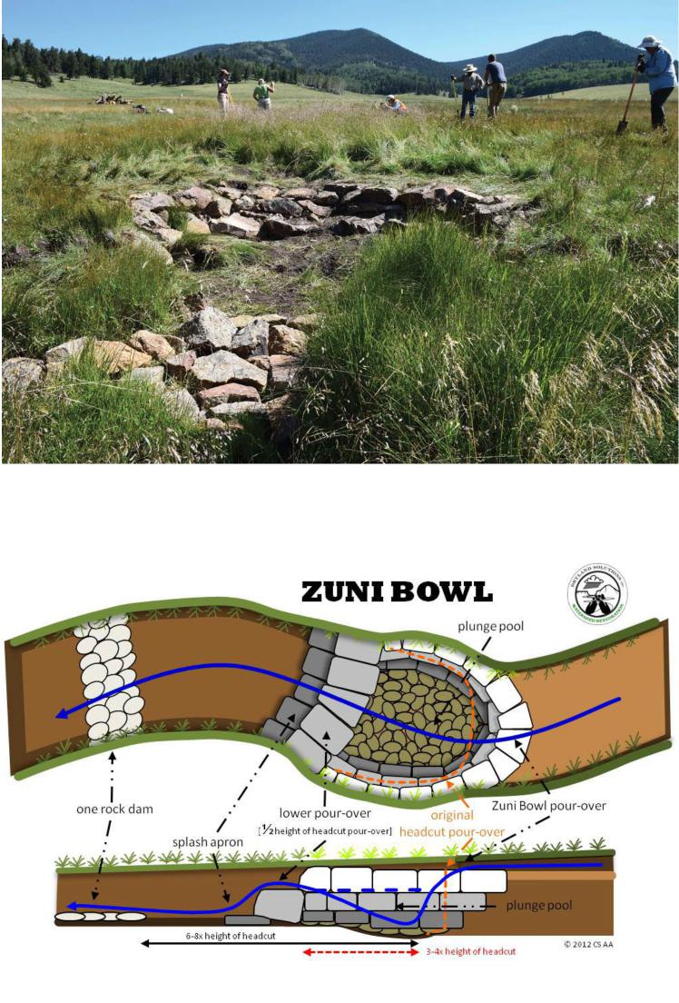
Zuni bowl grade control structure.

Slide 17
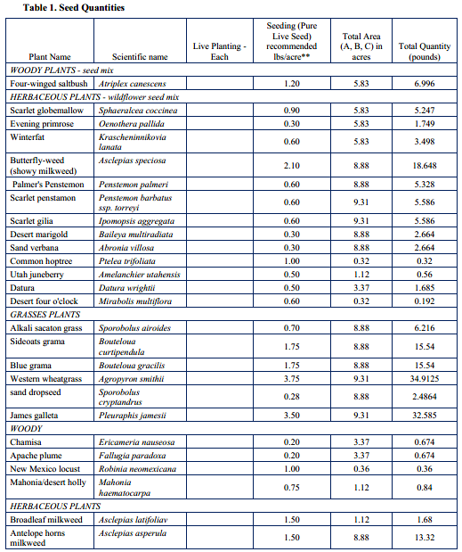
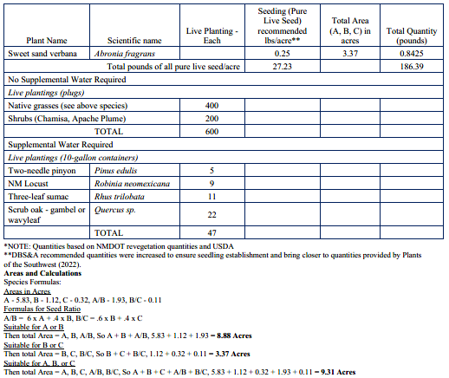
Revegetation Plan – Species
to be Hydroseeded & Live Planted

Slide 18
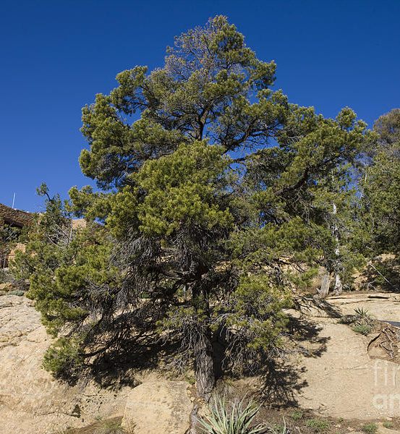
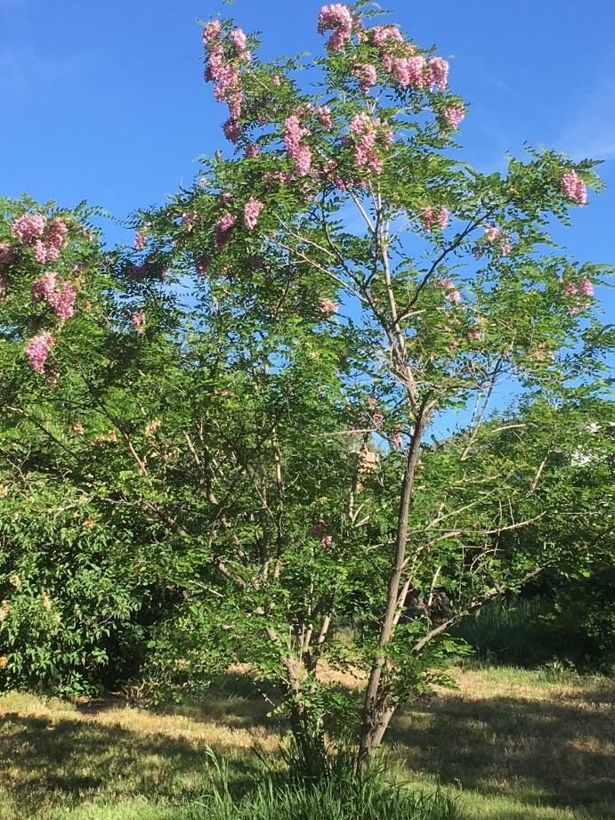
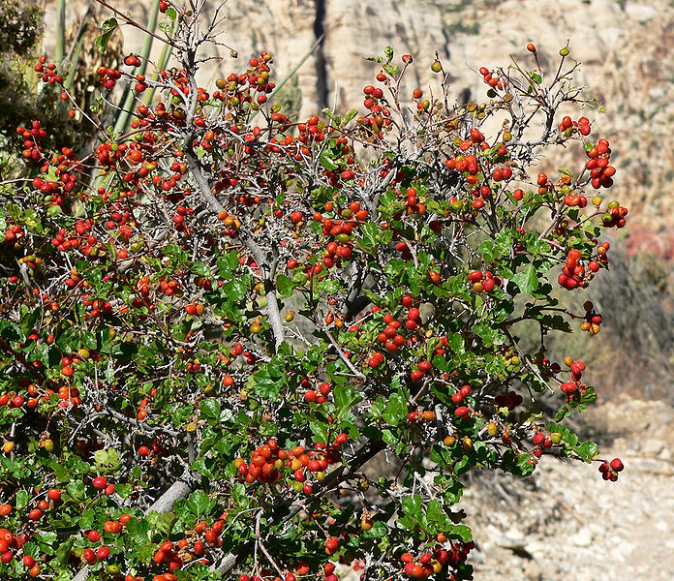
Revegetation Plan Continued
Photos of live planted species to be given supplemental water:
Threeleaf Sumac
Rhus trilobata
Two-needle pinyon
Pinus edulis
New Mexico Locust
Robinia newmexicana

Slide 19
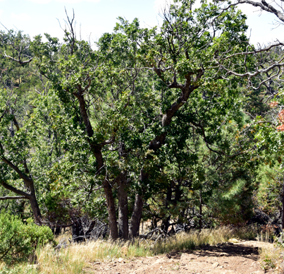
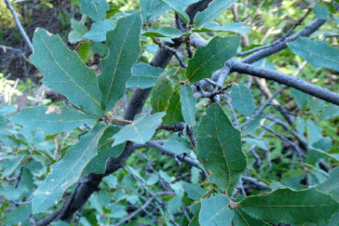
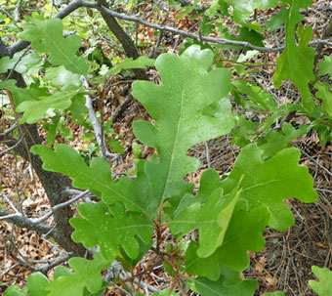
Revegetation Plan Continued
[These species will also be live planted and given supplemental
water.]
Also, a 3,000 gallon water tank
will be implemented.
Wavyleaf oak
Quercus undulata
Gambel oak
Quercus gambelii
Scrub oak
Quercus sp.
This plan incorporates input and collaboration with Madrid representative Amanda Bramble, as well as Santa Fe County staff.

Slide 20
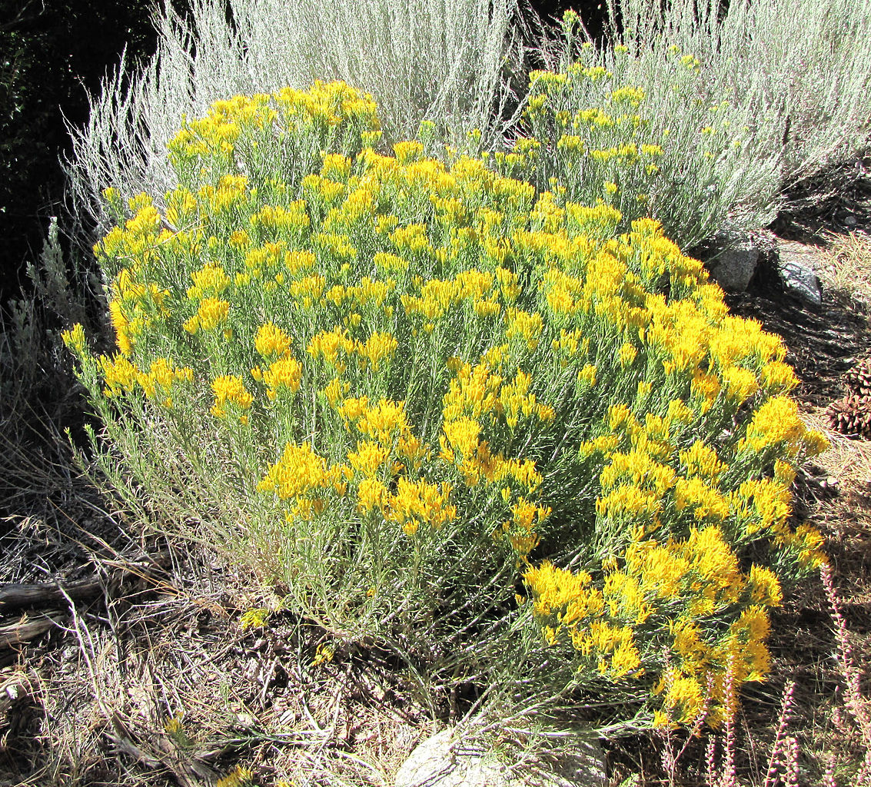
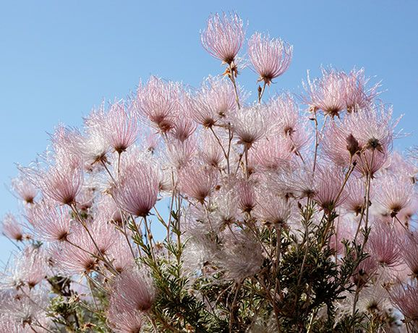
Chamisa
Ericameria nauseosa
Apache Plume
Fallugia paradoxa
200 plugs of these two species will be planted

Slide 21
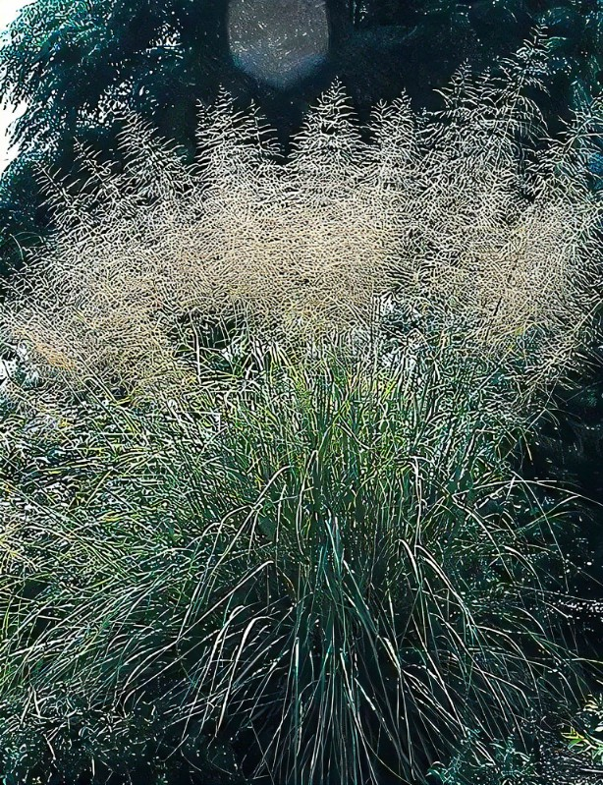
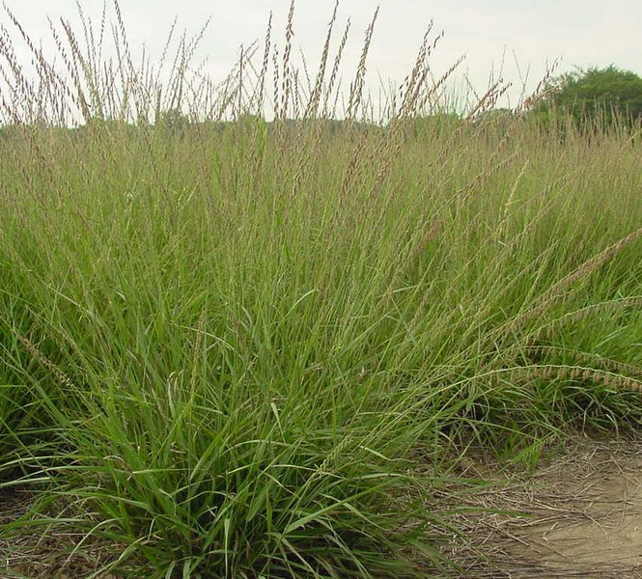
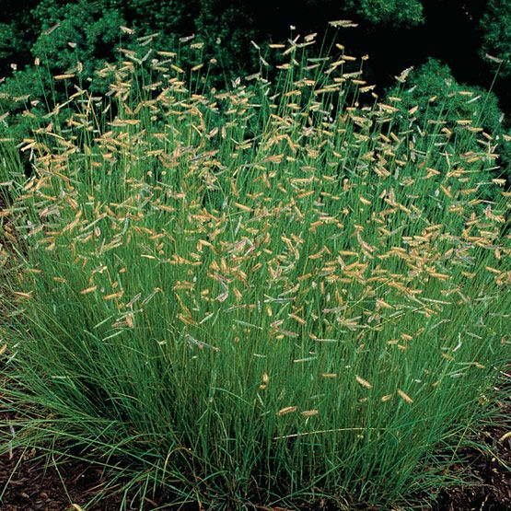
Sideoats Grama
Bouteloua curtipendula
Blue Grama
Bouteloua gracilis
Alkali Sacaton Grass
Sporobolus airoides
400 plugs of the 6 native grasses on this slide and the following slide will be planted

Slide 22
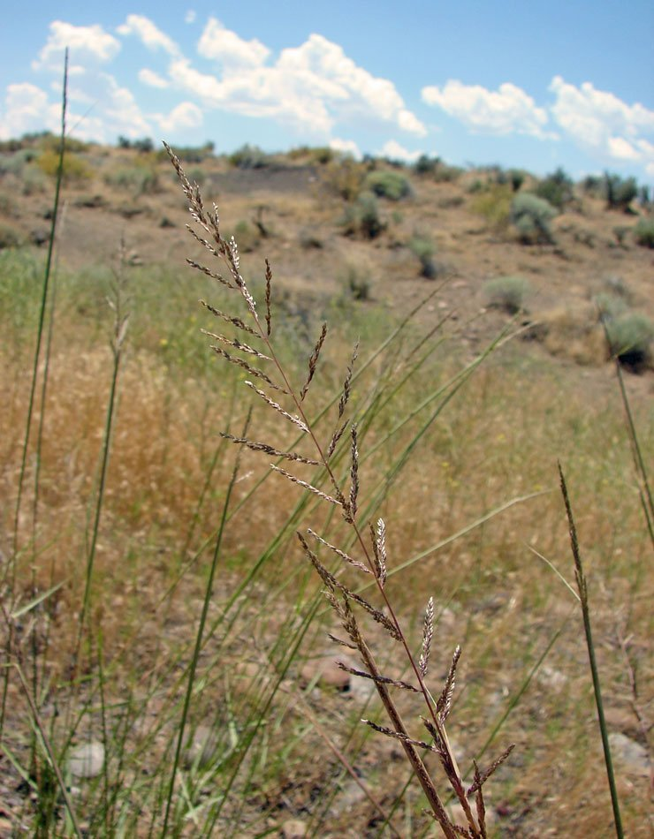
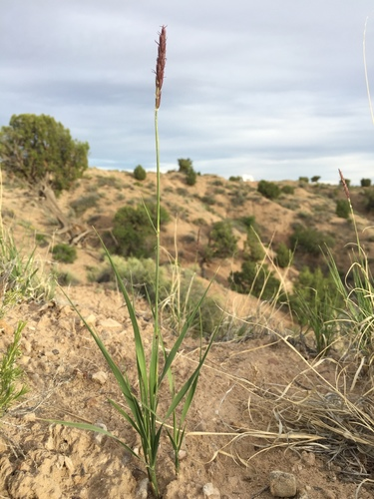
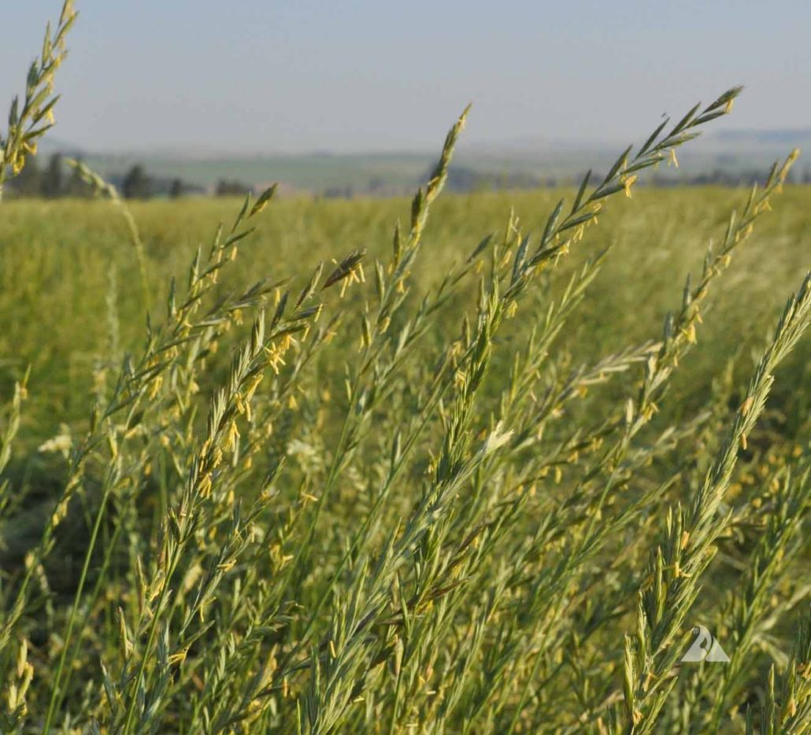
Western Wheatgrass
Agropyron smithii
Sand Dropseed
Sporobolus cryptandrus
James’ Galleta
Pleuraphis jamesii
The other 3 of the 6 native grass species that will be planted as grass plugs (400)

Slide 23
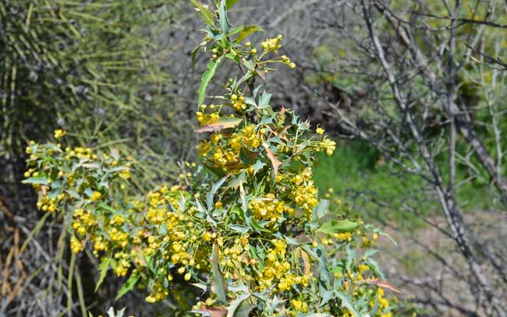
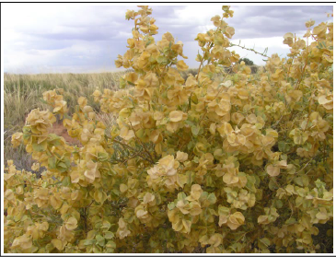
Mahonia/ Desert Holly
Mahonia haematocarpa
Four-wing Saltbush
Atriplex canescens
0.84 total pounds of seed mix
6.996 total pounds of seed mix

