Slide 1
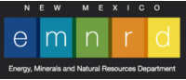

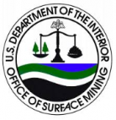
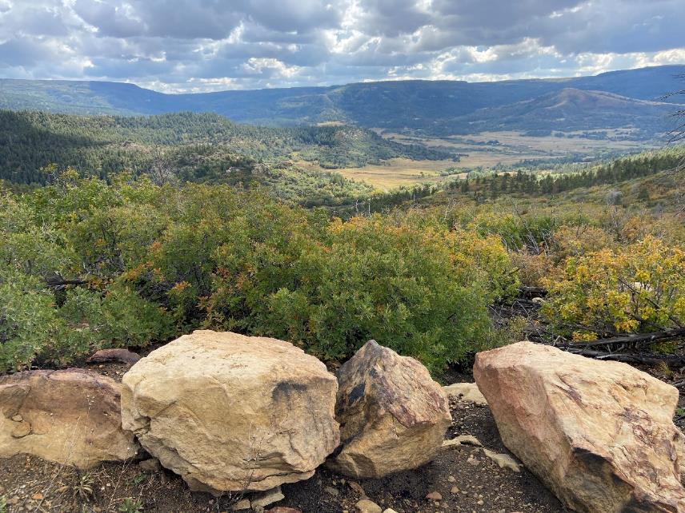
Yankee Canyon Mine Safeguarding Project
Public Meeting
03/09/2023

Slide 2
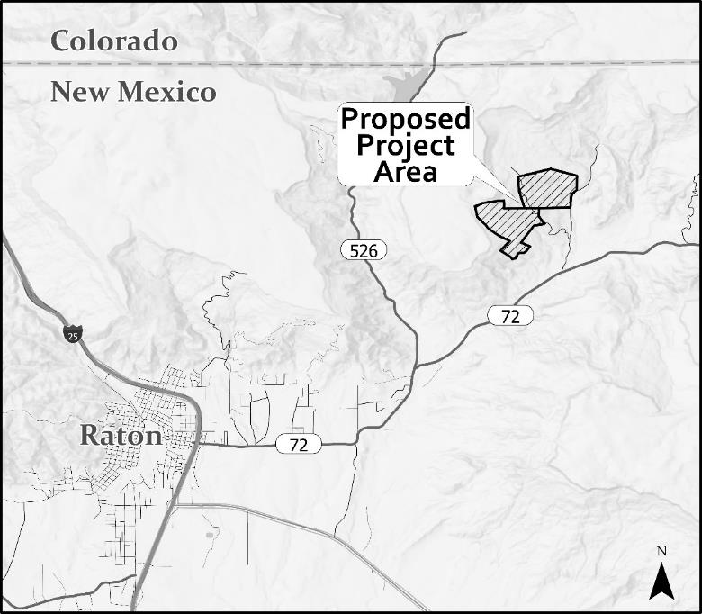
Project Location

Slide 3
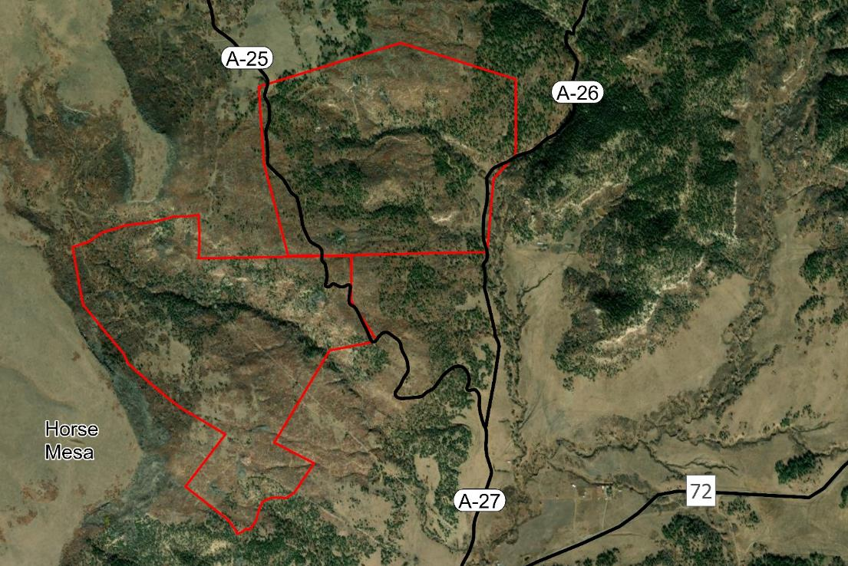
Project Area

Slide 4
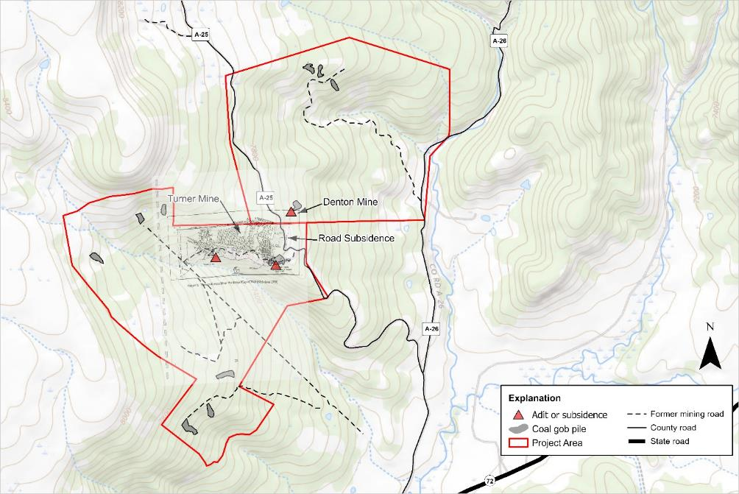
Mine Features of Project Area
Notes:
The Yankee Mine is comprised of about 3 mines in area. Turner and Denton Mines are shown with a historic map overlay

Slide 5
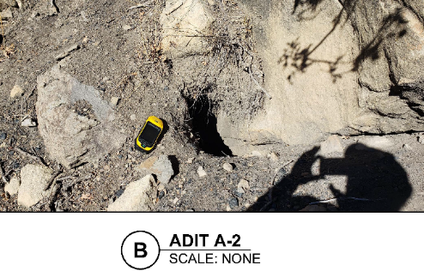
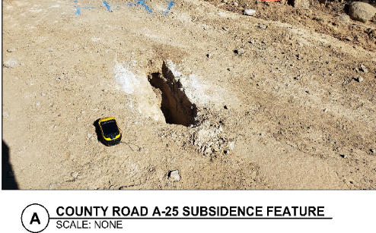
Project Purpose and Need
Many of Yankee Mine’s mine features are accessible to the public, yet many of them represent safety hazards.
County Road A-25 shows evidence of subsidence likely caused by underground mining. For safety reasons, the road has been closed. There is a need to stabilize it before it can be reopened.
Exposed gob piles can threaten water quality.
The purpose of the project is to mitigate risks to public safety and environmental issues in the project area.
Photos from Trihydro, 2023

Slide 6
Project Team
Abandoned Mine Land Program: Mike Tompson, AML Program Manager, Lloyd Moiola, Environmental Manager; James Hollen, NEPA Coordinator.
Daniel B. Stephens & Associates: Jean-Luc Cartron,
Project Manager/NEPA and Natural Resources Lead.
Okun Consulting Solutions: Adam Okun, Cultural Resources Expert.

Slide 7
Supporting Studies
Trihydro. 2023. County Road A-25 Subsidence, Colfax County, New Mexico, Site Characterization and Mitigation Recommendations Report.
Okun Consulting Solutions. 2023. Cultural Resources Report, Yankee Canyon.
Daniel B. Stephens & Associates. 2022. Biological Assessment/Biological Evaluation, Yankee Canyon Coal Mine.
Bat Conservation International. 2021. Report on Yankee Canyon Abandoned Mine Bat Surveys
Notes:
Each of these reports are discussed in this presentation

Slide 8
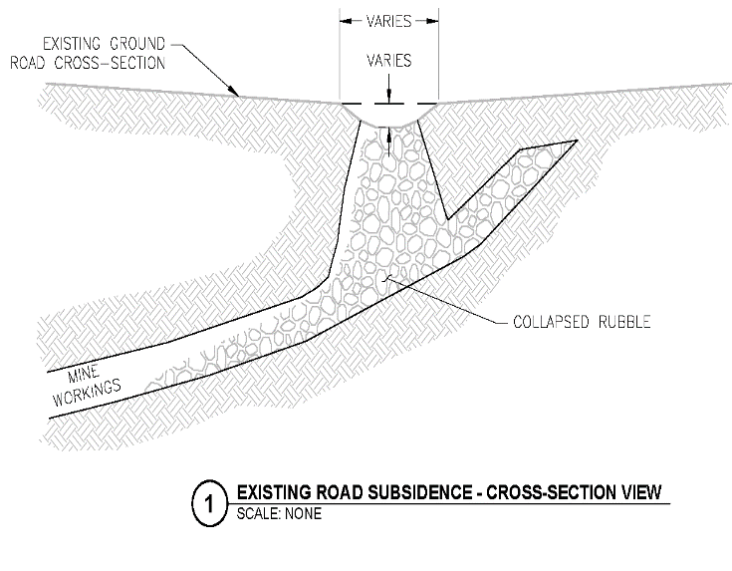
County Road A-25
Trihydro Corporation conducted site characterization of CR A-25 for the AMLP (Trihydro 2023).
By utilizing historical records and conducting visual inspections, Trihydro located 3 distinct subsidence features likely related to historic mining.
Through a ground penetrating radar (GPR) and electromagnetic induction (EMI) geophysical investigation voids were mapped along a 600 ft section of the A-25 roadway.
Following the subsurface investigation Trihydro determined that there may be other subsidence locations along A-25 and recommended further investigation and monthly monitoring until the road can be stabilized.
Reclamation recommendations were made leading to the proposed project.

Slide 9
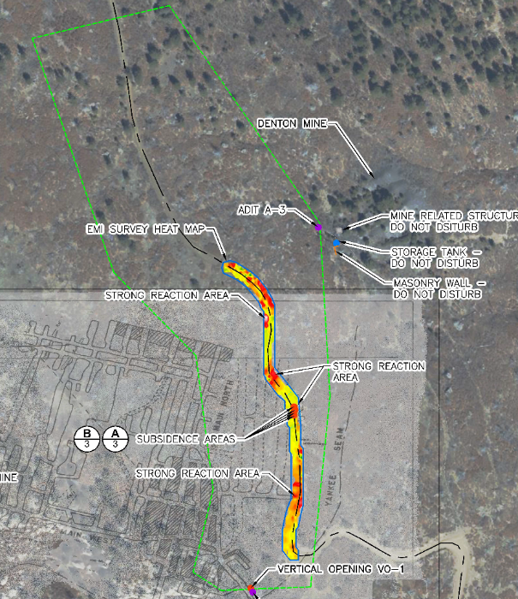
Safeguarding Project
County Road A-25. The project would further investigate then repair areas on road where subsidence features are identified.
    Investigation by Geotechnical Drilling Performed to characterize subsurface conditions. Drill holes placed every 20 to 30 feet.
    Repair through Backfilling conducted through drilling and injection of a water, sand and cement grout mixture. Grout would be injected into voids beneath and adjacent to the road.
CR A-25 Subsidence (Trihydro, 2023)

Slide 10
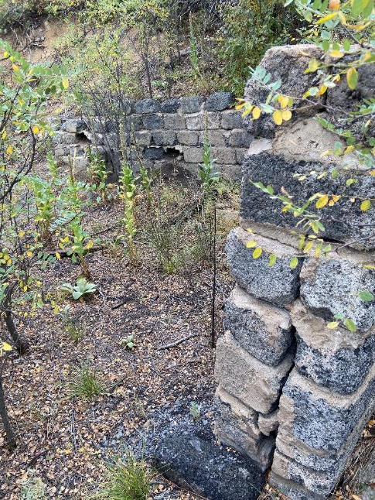
Safeguarding Project, Cont.
Gates. Gates may be installed in mine entryways safeguarding mine openings. The gates would be designed according to the latest industry standards, and wildlife compatible, following recommendations by Bat Conservation International.
Cupolas. Bat cupolas may be an option to cover vertical shafts.
Backfill. Mine openings may be backfilled with adjacent waste rock piles.

Slide 11
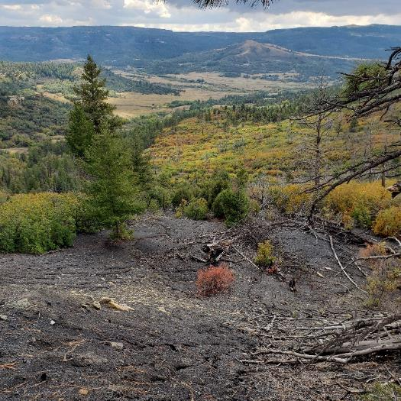
Safeguarding Project, Cont.
Other Structural Closures. Polyurethane Foam (PUF) plugs, gated culverts, and other structures may be used to safeguard mine openings.
Coal Gob Pile Reclamation. Stabilization of steep slopes on coal gob piles needed to prevent mine waste from entering adjacent ephemeral channels.

Slide 12
National Environmental Policy Act
Federal agencies and their representatives are required to provide meaningful opportunities for public participation. A primary goal of public involvement is to ensure that all interested and affected parties are aware of the proposed action.
An analysis of all the potential impacts is being conducted.
Notes:
May want to mention that the Topics we cover in the next slides are not the only ones we are covering in the EA. The ones we are highlighting in the presentation are the likely most important issues.

Slide 13
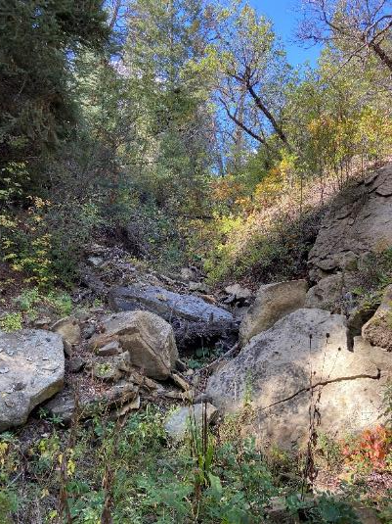
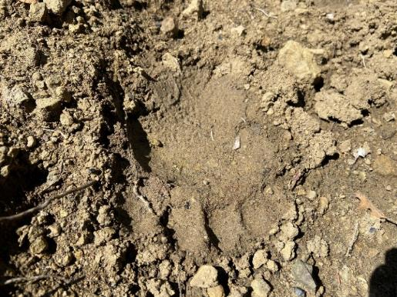
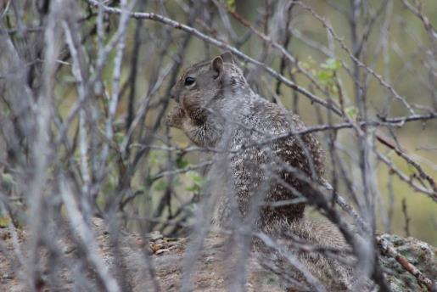
Biological Surveys
Plants and wildlife species were documented during a biological survey conducted in 2022 by Daniel B. Stephens & Assoc.
During the survey, an evaluation of potential impacts to special-status species and their habitat was conducted.
A separate survey of bats and bat habitat was conducted by Bat Conservation International.

Slide 14
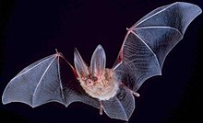

Bats and Bat Habitat
Bat Conservation International (BCI) evaluated bat occupancy and potential habitat associated with the mine features in 2021.
BCI’s 2021 survey of two distinct mine features found suitable habitat for Townsend’s big-eared bat.
BCI provided closure recommendations (BCI 2021).

Slide 15
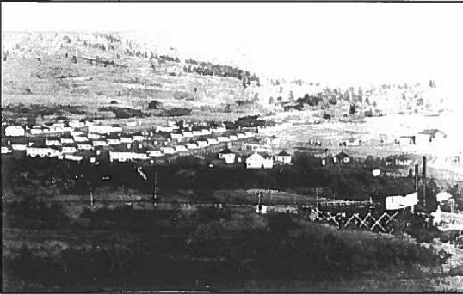
History of Yankee Canyon Coal Mining
Coal was discovered in the region by the 1840s
First major mining area was west of Raton
From 1910 to 1920, Colfax County produced 75 percent of coal in New Mexico
Town of Yankee in 1907
Yankee formed as a boomtown after the construction of the SFR&E Railroad from Raton to Yankee Mines on Johnson Mesa
Town went into decline around 1910; Yankee Mines were closed in 1921
Railroad line was abandoned in 1930s
Small-scale family mining began around 1901 and continued all the way to the 1960s
Notes:
Coal was discovered in the region by the 1840s; Raton became the center of a coal-mining region after arrival of the RR in 1879
First major mining area was west of Raton in Dillon Canyon (Blossburg and Gardiner)
From 1910 to 1920, Colfax County produced 75 percent of coal in New Mexico
Yankee formed as a boomtown after the construction of the SFR&E Railroad from Raton to Yankee Mines on Johnson Mesa; town had as many as 2,000 residents by 1907-1908
Town went into decline around 1910; Yankee Mines were closed in 1921
Railroad line was abandoned in 1930s
Small-scale family mining began around 1901 and continued all the way to the 1960s

Slide 16
Cultural Resource Survey
Cultural resources survey was conducted in Oct-Nov 2022 to document historic mining features and help the project comply with the National Historic Preservation Act and other historic preservation laws.
582 acres were surveyed
138 separate mining features and hundreds of historic artifacts were documented
Coal waste (gob) pile is the most common feature type, but many other types are present
Features are related to assaying, extraction, processing, transport, and supporting activities
FEATURE TYPE | COUNT | FEATURE TYPE | COUNT
Coal Gob Pile | 35 | Ore Cart | 2
Structure Foundation | 19 | Road-Related Feature | 2
Adit | 10 | RR Grade | 2
Open Cut/Pit | 8 | Structure (Extant) | 2
Fence | 7 | Tramway Feature | 2
Car Body | 4 | Prospect Pit | 2
Waste Rock Platform | 4 | Machine Platform | 2
Landform Modification | 4 | Privy/Depression | 2
Wall | 4 | Ramp | 2
Midden | 3 | Bridge | 1
Tramway Segment | 3 | Corral | 1
Entrance (Shaft/Vent) | 3 | Graffiti Panel | 1
Reservoir/Tank | 3 | Well | 1
Concrete Bin | 2 | Tipple Foundation | 1
Developed Spring | 2 | Utility Pole | 1
Trail/Road | 2 | Wood Concentration | 1
TOTAL |  | 138
Documented Mining Feature By Type
Notes:
Other common feature types included open pits, platforms, mine shafts, adits, and roads
Provide mention that survey included private property located within the APE

Slide 17
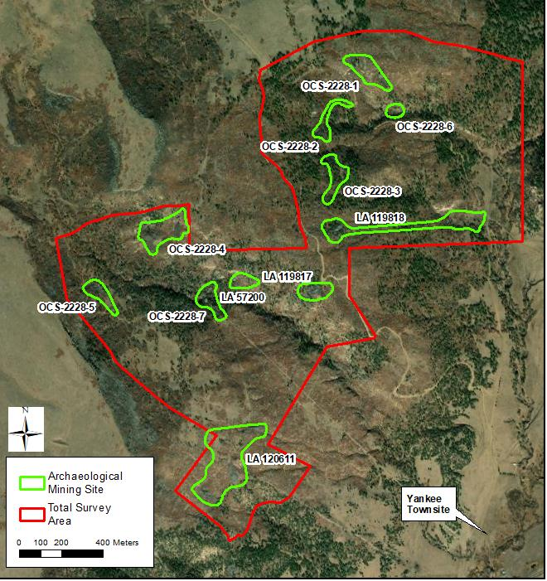
Survey Results
11 different clusters defined as archaeological sites
Yankee Mines and small family operations are represented
Sites date from 1905 to 1960s
Four of the mines had been documented in the past

Slide 18
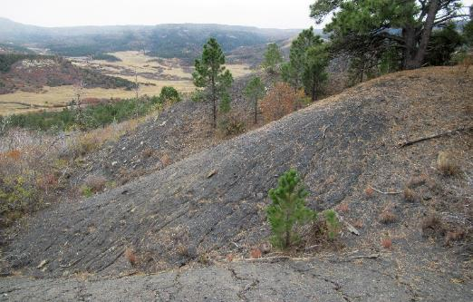
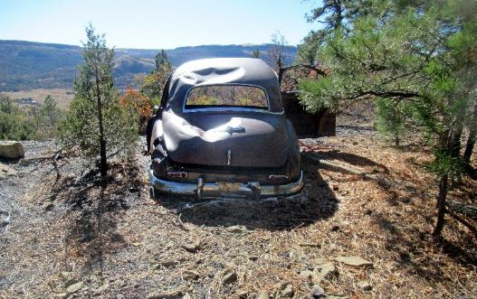
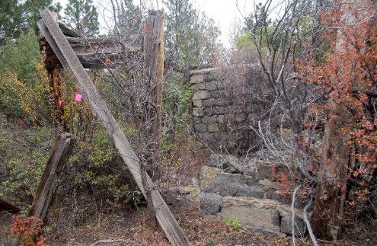
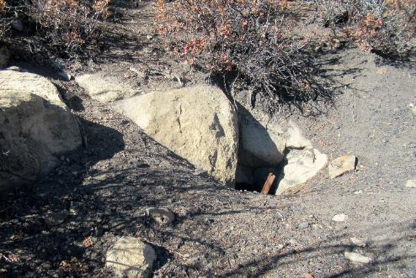
Historic Mining Features
Below are examples of historic mining features
AML will work to preserve significant features where feasible
Coal Gob Piles on Steep Slope
Car Body
Tipple Structure Remains
Mine Opening

Slide 19
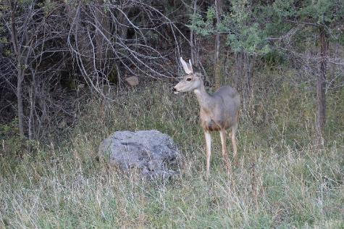
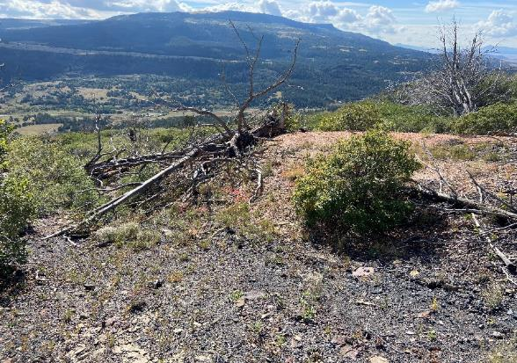
Land Use
The area is rich in natural resources, with abundant wildlife including game species such as elk and deer. County Road A-25 is utilized by hunters and provides access to private ranches and hunting lodges in the region.
Lands are also utilized for livestock grazing.

Slide 20
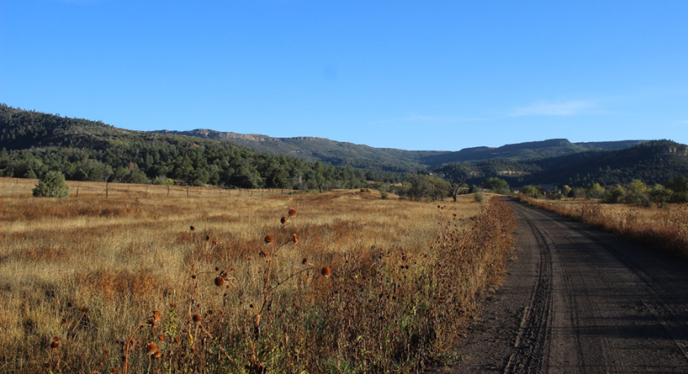
Land Use, cont.
Safeguarding measures would be on county-maintained roads, private property and state land. Access agreements would be in place prior to construction.
The project would change land use by allowing for CR A-25 to reopen following road stabilization. No other land use would change as a result of the project.

Slide 21
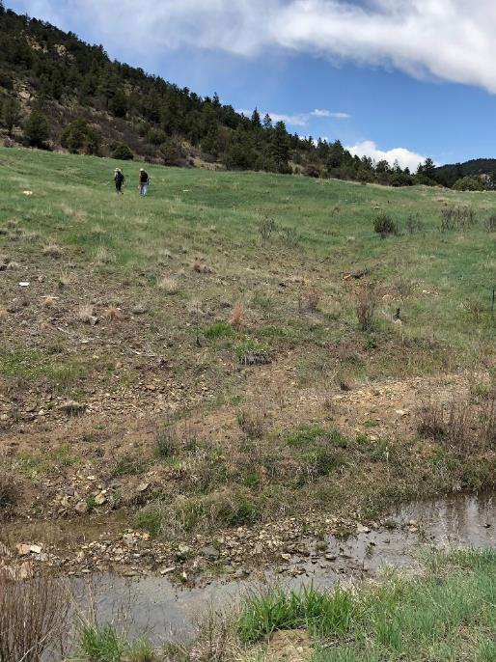
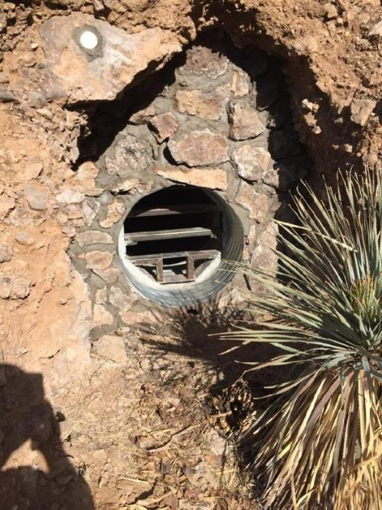
Typical AML Reclamation/Closures
Revegetated gob pile (Dillon Canyon).
Rock bulk-headed culvert with bat-friendly gate. Cemented rocks assist with blending into landscape

Slide 22
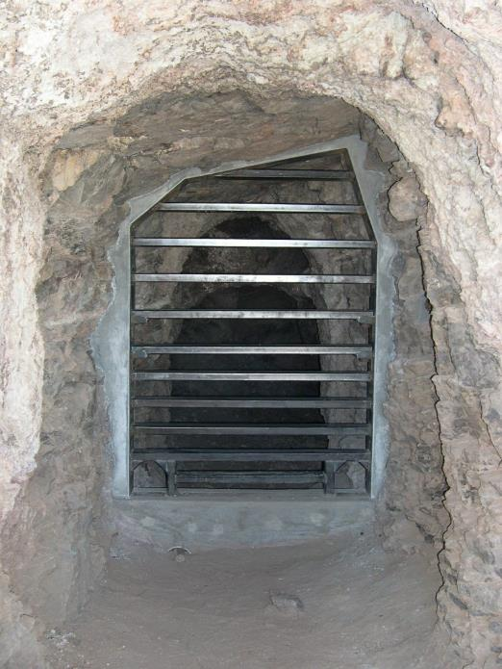
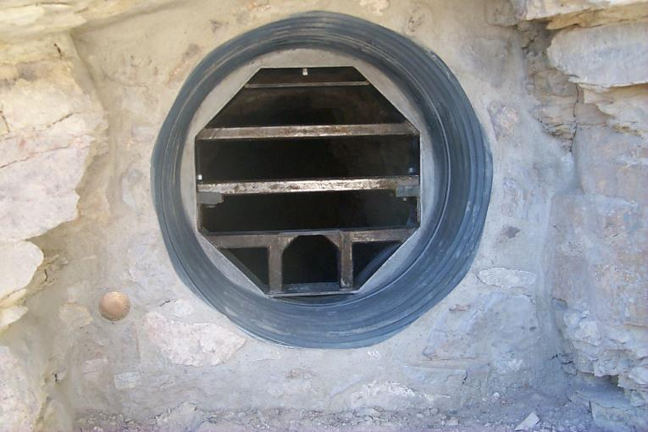
Typical AML Closures
Culvert with bat and wildlife-friendly gate
Bat and wildlife friendly gate enclosure

Slide 23
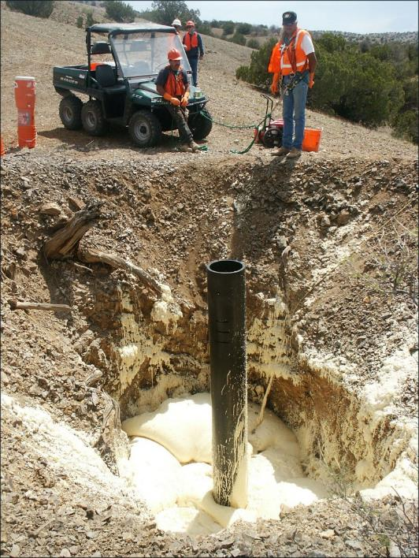
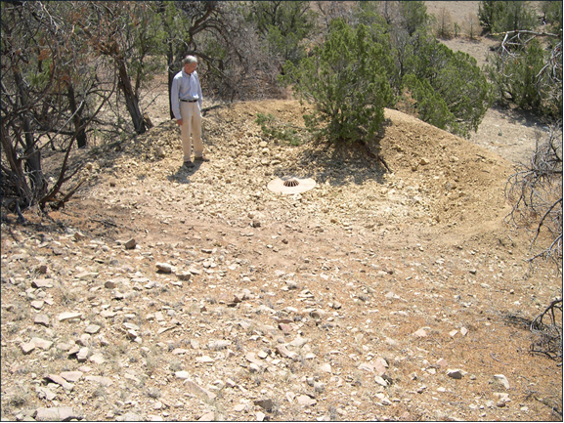
Typical AML Closures
A complete polyurethane foam closure with beehive grate and concrete collar
Polyurethane foam plug with a drain pipe (Cerrillos Hills State Park)

Slide 24
Any Questions?
For questions or additional information, please contact:
  Lloyd Moiola, <lloyd.moiola@state.nm.us>, 505-629-3757
  James Hollen,<James.Hollen@state.nm.us>, 505-231-8332 OR
  Mike Tompson P.E., <Mike.Tompson@state.nm.us>, 505-690-8063
To submit comments, please email:
  jcartron@geo-logic.com, call 505-353-9190, or mail to:
    DBS&A, c/o Jean-Luc Cartron
    6020 Academy NE, Suite 100
    Albuquerque, NM 87109
Please provide comments by April 9, 2023
Thank you!
Notes:
Review comments: Add Chris’ number and contact information.

