Slide 1
Developing New Mexico’s
Oil and Natural Gas Methane Strategy:
Methane Advisory Panel Public Outreach Meeting
New Mexico environment department
New Mexico energy, Minerals and natural resources department
Spring 2020

Slide 2
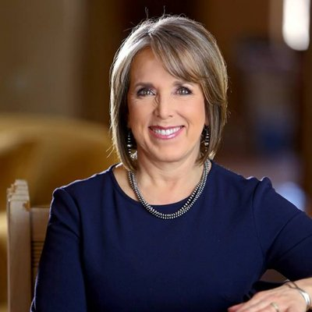
Developing New Mexico’s Methane Strategy
“EMNRD and NMED shall jointly develop a statewide, enforceable regulatory framework to secure reductions in oil and gas sector methane emissions and to prevent waste from new and existing sources and enact such rules as soon as practicable.”
- Governor Michelle Lujan Grisham
Executive Order 2019-003: “Executive Order On Addressing Climate Change And Energy Waste Prevention”
and
New Mexico Climate Strategy, Initial Recommendations and Status Update, 2019 of the New Mexico Interagency Climate Change Task Force, pages 13-15

Slide 3




Developing New Mexico’s Methane Strategy
Science: Using the best available science to inform our decision-making in protecting public health, the environment and minimizing waste.
Innovation: Employing creative engineering and technological solutions to address the public health, environmental and waste challenges.
Collaboration: Engaging communities and interested stakeholders in our methane strategy decision-making.
Compliance: Ensuring meaningful compliance with state regulations and permits.

Slide 4
Developing New Mexico’s Methane Strategy
Methane Advisory Panel (MAP) formed, consisting of technical stakeholders focusing on processes and equipment associated with exploration, production, gathering and processing.
Members included local and national eNGOs, major and independent upstream/midstream industry.
Technical guests included academia and technology companies
Notes:
Sandra/Liz

Slide 5
Developing New Mexico’s Methane Strategy
Charge to the MAP:
  Develop emission and waste-based standards for equipment and operations
  Propose monitoring, recordkeeping and reporting structures
  Provide detailed information on equipment and processes used in the industry that could relate to methane gas release.
MAP members were NOT asked:
  To draft regulations – The Departments are drafting the regulations
  To comment on policy – The MAP provided technical information
  To come to consensus – The MAP provided a wide-range of perspectives
Notes:
Sandra/Liz

Slide 6
Developing New Mexico’s Methane Strategy
Methane Strategy Development
Stakeholder Engagement
Pre-Rule Development
(Through October 2019)
Community Impacts Meeting
(March
2020)
MAP Public Outreach Meeting
(May
2020)
EMNRD Rule Development
(In process now)
NMED Rule Development
(In process now)
Methane Advisory Panel
(Through December 2019)

Slide 7
Developing New Mexico’s Methane Strategy
Report Topics:
      Completions and Simulations
      Workovers
      Heater Treaters
      Venting and Flaring
      Infrastructure Planning
      Pneumatic Controllers and Pumps
    Leak Detection
Compressors and Engines
Workovers Liquids Unloading
Separators/Heaters/ Storage Vessels
Completions/Recompletions and Stimulations
Dehydration Units

Slide 8
MAP meetings
Key Elements:
      Collaborative process
      Consensus not required – diversity of ideas sought
      No single entity discussed by name
      MAP members agreed to disagree where necessary and also worked to bridge gaps if possible
      Departments taking information to see possible rule making options based on technical information provided

Slide 9
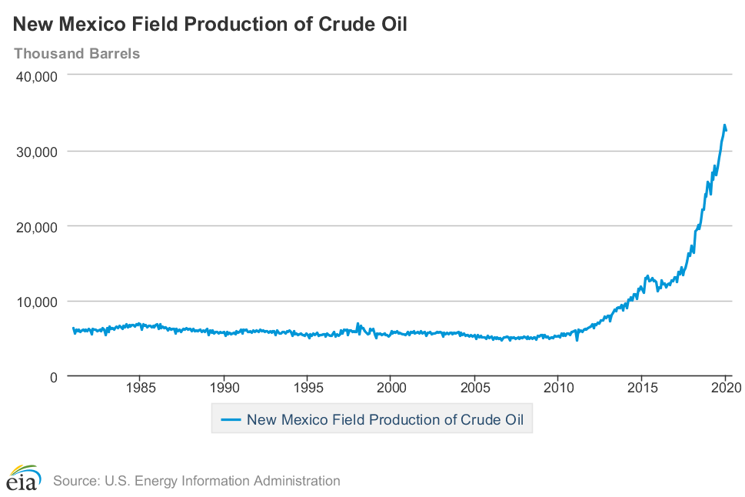
Developing New Mexico’s Methane Strategy
Includes data up to January 2020

Slide 10
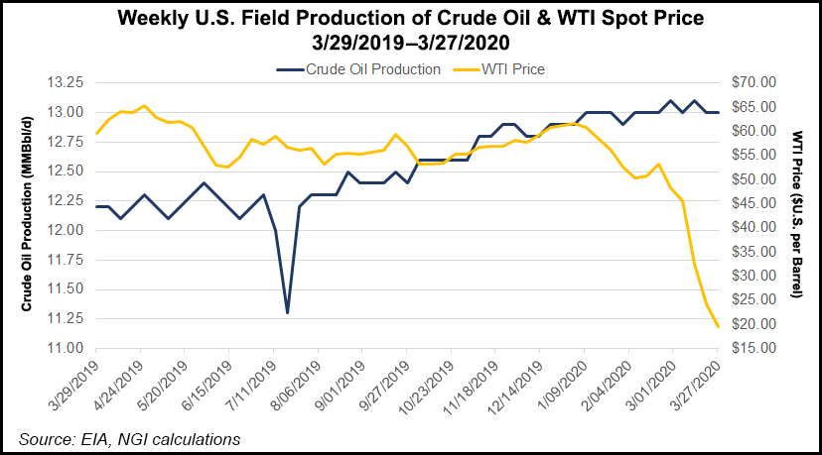
Impact of international events affecting oil prices world-wide and
Coronavirus

Slide 11


Developing New Mexico’s Methane Strategy
  Goals of Oil and Natural Gas
  Methane Rules:
  Achieve measurable, durable reductions
  Create regulatory certainty
  Promote technology innovation
  Ensure compliance mechanisms
Ozone
Rule
Waste
Rule

Slide 12
Methane Advisory Panel Meeting Overview
4:00 to 4:50 NMED and EMNRD: MAP process and how it is being
used by the Departments
  4:50 to 5:30 MAP members: San Juan and Permian basin
  updates
  5:30 to 6:00 Questions and Answers
Notes:
Questio

Slide 13
Developing New Mexico’s Methane Strategy https://www.env.nm.gov/new-mexico-methane-strategy/
  Sandra Ely, Director
  Environmental Protection Division
  PO Box 5469
  Santa Fe, NM 87502- 5469
  sandra.ely@state.nm.us
  (505) 827-2820
Adrienne Sandoval, Director
Oil Conservation Division
1220 South Francis Drive
Santa Fe, NM 87505
adrienne.sandoval@state.nm.us
(505) 476-3441

