Slide 1
Road Map to Utilize MPFM for Allocation in New Mexico
New Mexico energy, Minerals and natural resources department
Presented by Justin Wrinkle & Dean McClure
Notes:
\

Slide 2
Why we care
  70-2-11. Power of commission and division to prevent waste and protect correlative rights.
    The division is hereby empowered, and it is its duty, to prevent waste prohibited by this act and to protect correlative rights, as in this act provided. To that end, the division is empowered to make and enforce rules, regulations and orders, and to do whatever may be reasonably necessary to carry out the purpose of this act, whether or not indicated or specified in any section hereof.
  19.15.2.7(C)(16) NMAC
    “Correlative rights” means the opportunity afforded, as far as it is practicable to do so, to the owner of each property in a pool to produce without waste the owner’s just and equitable share of the oil or gas in the pool, being an amount, so far as can be practically determined, and so far as can be practicably obtained without waste, substantially in the proportion that the quantity of recoverable oil or gas under the property bears to the total recoverable oil or gas in the pool, and for the purpose to use the owner’s just and equitable share of the reservoir energy.

Slide 3
Data Gathering
  The Division will require the Operator to gather data comparing allocations derived from MPFM to allocations determined by normal allocation methods. Provided that the Operator is using an already approved method to determine the actual allocation, it does not need approval from the Division to install MPFM into its facilities for the purpose of data collection only.
  When gathering data, the Operator should aim to produce as robust of a data set as possible to increase the likelihood of approval from the Division and decrease the likelihood of limiting the scope of that approval. An ideal data set will:
    be derived from wells and operational practices that are representative of most operations found within the Permian Basin; and
    demonstrate that utilization of MPFM has an allocation error of less than 5%.

Slide 4
Well Selection
  An Operator should seek to include as wide a range of wells as possible which are representative of wells typically encountered in the Permian Basin. At minimum, the following variables should be considered when selecting wells:
    Gas-Oil-Ratio (GOR)
    Water Cut
    Flow Rates
    Oil Composition (gravity)

Slide 5
Allocation Method used for Comparison
  Two primary methods of comparison are commonly considered. However, an Operator should feel free to propose another methodology for consideration by the Division.
  All Comparisons
    Volumes will be totaled at minimum every 12-hour period and at maximum every 72-hour period.
    If a malfunction or outside influence causes a test period to be non-representative of a typical test, then that period may be excluded from consideration to determine the error associated with the MFPM for that well, but the Operator should provide the results and include the reason for its exclusion of that test in the computation.
  Direct In-line Comparison
    This is done by installing a MFPM in-line upstream of a separator at which the phases are separated and measured.
    It is presumed that the conditions (temperature, pressure, etc.) is similar at both the MFPM and separator.
    If the MFPM utilizes a form of separation such as separating most of the gas off prior to then measuring the liquid, it is presumed that the gas will be added back into the line and sent to the separator.
    If the well is not continuously in test, then a test should at minimum be a 12-hour period after the vessel is stabilized.
    It is presumed that the separator is of sufficient size to accurately measure each separated phase.
    - continued -

Slide 6
Allocation Method used for Comparison
  Sales Volume Comparison
    This is done by isolating a single well to its own facility or segregated portion of a facility and comparing the measurements from the MFPM to the sales totals from that well.
    Volumes will still need to be totaled at maximum every 72-hour period, but ideally will be totaled every 24-hour period.
    Stock on hand will need to be considered each time volumes are totaled. For instance, if a tank has 10 more STB on hand at the end of a period than at the beginning, then that 10 STB should be added to the total sold via a LACT, etc.
    A shrinkage factor will need to be considered between the MFPM measurements and the sales totals, but this factor should be consistent across all tests for a well and facility.

Slide 7
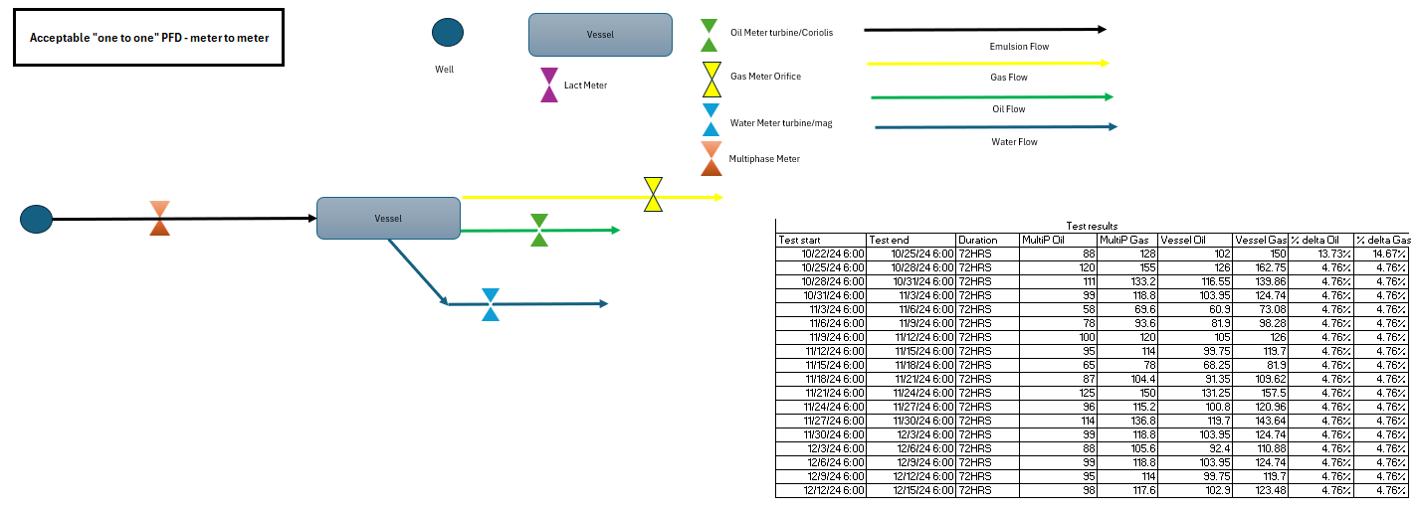
Examples
Do’s

Slide 8
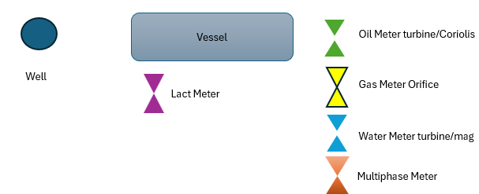
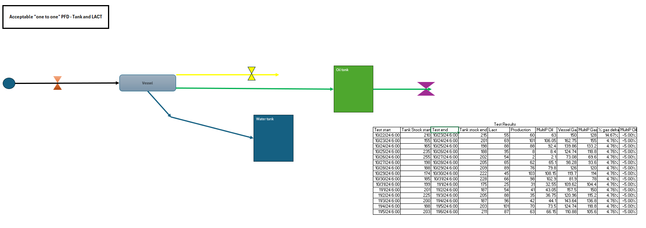
Examples
Do’s

Slide 9
Documents and Materials
  Documentation from the MPFM manufacturer that includes:
    A summary of the series of meter including a list of its components.
    A tabulation of the manufacturer's recommended maintenance and calibration schedule.
  Materials from the Operator that includes:
    A description of how the MPFM shall be utilized including a list of any installed optional components and a process flow diagram.
      Will the MPFM be installed at a facility and used in lieu of a test separator?
      Will the MPFM be installed on the well pad to measure production prior to commingling the production from the pad into a trunkline?
      Will there be optional component(s) installed to assist in measuring production with a higher GOR?
    A description of operational practices that the Operator will follow to ensure that allocation error does not exceed 5%.
    Results and data obtained from in field testing in excel and PDF formats.

Slide 10
Operational Practices
  SCADA:
    The Operator shall maintain a SCADA system that allows it to monitor the MPFM and to conduct checks meant to identify if the MPFM needs maintenance or calibration.
  Methodology to ensure that allocation error does not exceed 5%.
    The Operator shall at a minimum follow the MPFM manufacturer’s recommended maintenance and calibration schedule.
    The Operator shall propose and follow additional checks meant to identify when the MPFM needs additional maintenance. These checks may include such things as:
      methods to identify equipment failure; and
      comparisons of live flow data to historic data to identify changes to GOR, water cut, etc.
  Equipment:
    The MPFM shall be appropriately sized and configured for the expected production. If the production or its makeup changes, then the MPFM shall be updated, as necessary.
    All necessary optional components shall be installed and maintained, as necessary.

Slide 11
Example Conditions of Approval
  Maintenance and Calibration Schedule:
    The Operator will be provided a maintenance and calibration schedule that it must at a minimum meet. If the manufacturer recommends a schedule more stringent than the Operator’s current schedule, then the Operator shall update its schedule to at a minimum match it. The Operator may propose other amendments to the schedule, but it shall await review and approval of them before implementing them.
  Operational Practices:
    The Operator will be provided a list of practices that it must at a minimum meet. The Operator may propose amendments to the practices as necessary, but it shall await review and approval of the amendment before implementing it.
  Data Retention:
    The Operator shall maintain and provide to the Division upon its request:
      Individual test data for each production test for at least 1 year; and
      All calibration and maintenance details for at least 3 years.
  Certification:
    The Operator shall certify that it will maintain, in reasonable probability, an allocation error less than 5%.

Slide 12
Incorporating MPFM into Surface Commingling Approvals
  Alternative Allocation Methods:
    The Division will approve utilization of MPFM for allocation as an alternative allocation method under 19.15.12.10(B)(1)(e) NMAC and 19.15.12.10(C)(1) NMAC. Each approval will be designated with a SCM number.
  Surface Commingling Application:
    The Operator will include within its application:
      reference to the appropriate SCM number;
      a detailed description of the MPFM and its purpose such that a layman will understand;
      a list of wells for which the operator intends to use MPFM for allocation; and
      parameters for any additional wells that the operator may use MPFM for allocation in the future.

