Slide 1


OCD – Orphan Program
Stakeholder Meeting for
Plugging Opportunities
Gerasimos “Gerry” Razatos, Deputy Director
September 8, 2026

Slide 2
OCD Plugging Program Overview
There are estimated to be thousands of orphan wells statewide
  LFC analysts in their Policy Spotlight: Orphaned Wells report estimated over 2,000 just state and private wells are currently orphaned. With another 3,000 on the horizon.
  There are likely a similar number of federal wells in the same condition as roughly 50% of the wells in the state are on federal lands.
  Currently OCD has >1,600 wells with plugging orders that are not plugged and/or remediated. There are various statuses to the wells currently, with the main two below.
    ~700 state or private wells currently needing plugging and remediation.
    682 state or private wells which are plugged but are still waiting on surface cleanup and reclamation.
    Financial liability for currently authorized wells and facilities will cost an estimated ~$200 million.
Current potential orphan wells and liability in the state
  181 operators haven’t filed production reports in over a year. These operators own 2,730 total wells, of those 1,609 are state or private wells, of which OCD would be the regulator responsible for plugging.
  LFC estimates $700 million to $1.6 billion in potential plugging and cleanup liability to the state currently and in the near future due to wells either having zero production or extremely low production volumes.

Slide 3
OCD Plugging Program Overview (Continued)
Historically prior to 2022 because of funding availability OCD historically was plugging 25-50 wells per year and spending ~$2 million a year. This drastically changed with the new Bipartisan Infrastructure Law (BIL) grants which were fully encumbered the end of 2022
  In FY26 OCD set a record plugging 114 wells at a cost of $28.4 million
How does OCD decide which wells to plug?
  Highest priority are those which threaten human health/environment or that have integrity issues.
  Other criteria considered: proximity to occupied structures, being within a municipal boundary or agricultural area, history of integrity issues or non-compliance, lack of water protection casing, abnormally high well pressure, well age, H₂S presence, and proximity to other orphan wells.

Slide 4
OCD Plugging Program Overview - Funding Sources
OCD has multiple funding sources to support the plugging of abandoned wells.
1) The Oil and Gas Reclamation Fund (this is the longest-standing funding source)
  Funded by proceeds from the Oil and Gas Conservation Tax, which increases depending on the price of West Texas Intermediate Crude (when prices are above $70/barrel the tax rate increases)
  Fund balance is $75.906 million (as of June 30, 2025 – Projected to be $81.583 million for June 30, 2026).
  During FY27, OCD is authorized to spend $21.650 million from this fund, which OCD will use to plug/remediate facilities not clearly eligible for plugging with BIL funding.
2) The 2021 BIL created an unprecedented source of funds for state plugging work
  New Mexico is eligible for $97.26 million under the initial and formula grant programs combined + Performance and Regulatory Improvement Grants
    Currently OCD has received $90.5 million and have spent $40 million since 2022
3) BLM Plugging Grant
  Currently this fund has been exhausted, and OCD is working with the BLM for future funding. The prior grant period was from 2020-2025 and was for $4 million.

Slide 5
Invitation to Bid (ITB)
To accomplish our plugging goals The Oil Conservation Division (OCD) issues Invitations to Bid to support orphan well plugging activities. The ITB allows for individual services to be tailored to each dependent on sites needs ranging from plugging needs to site reclamation. The ITB essentially allows for a menu of options. Our current ITB accepted all applicants. The intent was to keep as many options open as we could to be able to tailor our needs dependent on the situation. However, over the years with the grants and additional funding our needs are currently growing which is why we are looking for a new ITB.

Slide 6
Invitation to Bid (ITB)
The Oil Conservation Division (OCD) previously issued an Invitation to Bid (ITB) to modernize the Statewide Price Agreement (SWPA) used to support orphan well activities. After reviewing all submissions, OCD determined that none of the bids met the administrative requirements necessary to move forward in the ITB process. The main issues OCD observed were incomplete bids on required items and widespread use of incorrect units. These are critical as most items cannot be changed or added after the bid is submitted.
June 4, SWPA ITB Released
July 6, Deadline to bid on ITB
July 20, OCD begins review of bids
August 20, ITB Cancelled
September 8, Stakeholder Meeting
Future; SWPA ITB released for bidding
Future; Begin plugging under the new SWPA
All dates are for 2026, except those which list “Future” which are TBD.

Slide 7
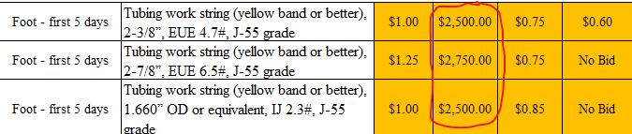
Unit Errors
Unit Errors were our number 1 issue

Slide 8
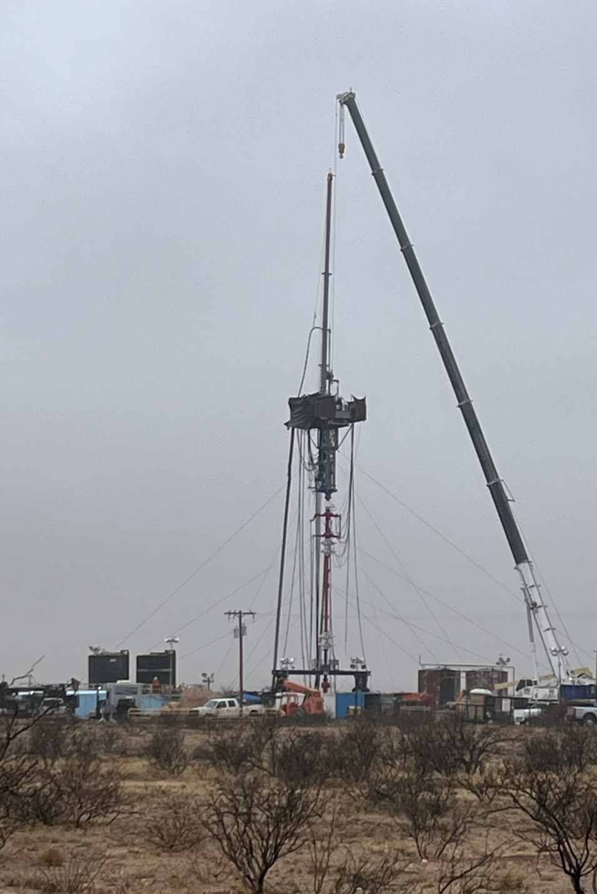
Administrative Errors Related to Engineering

Slide 9
Engineering - Administrative Errors
Common Incomplete Bid Items:
Item 1 – Single derrick rig package
Item 3 – Rig Crew Travel
Item 4/5 – rig mobilization
Item 6 – Single derrick rig standby
Items 18–19 – Class A and B or ASTM equivalent cement
Item 27 – Shallow tubing cement spot

Slide 10
Administrative Errors Related to Engineering
Common Incorrect Units:
Item 7 – Double derrick rig standby
Item 17 – Fresh or Brine water tank for storage
Item 22 – Drayage for delivering cement to location
Item 23 – Calcium Chloride used
Items 71, 73, 75 – Tubing work string (various sizes)

Slide 11
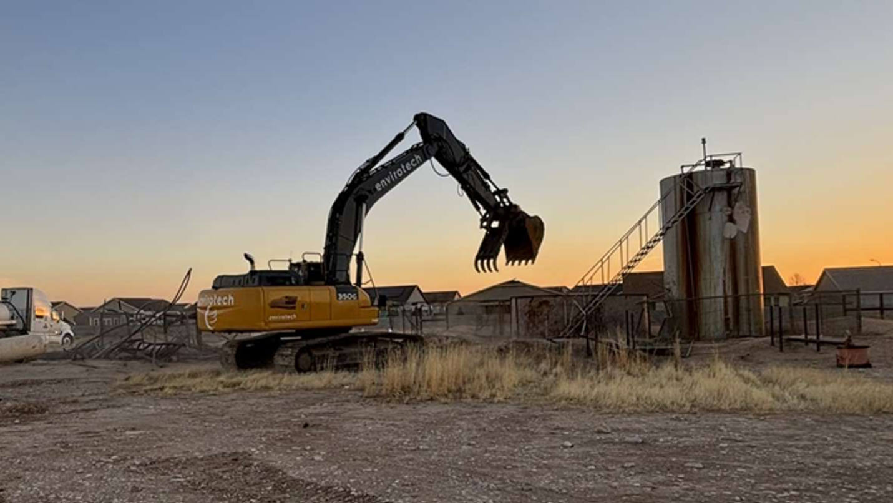
Administrative Errors Related to Environmental

Slide 12
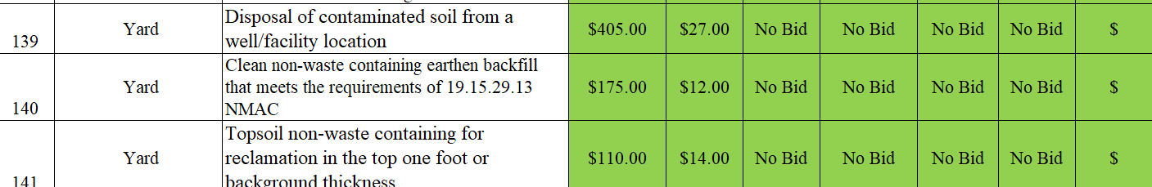
Environmental - Administrative Errors
Common Incomplete Bid Items and Wrong Units:
Item 132 – Hand auger
Item 133 Compactor
Item 134 – Interface probe
Item 139 – Disposal of contaminated soil from a well/facility location
Item 140 – Clean non-waste containing earthen backfill
Item 141 – Topsoil non-waste containing for reclamation in the top one foot or background thickness

Slide 13
Common Questions and Answers Received

Slide 14
Common Questions & Answers
Question: How are the C103/C103Q's submitted after the site is complete?
Answer: These forms will be submitted electronically by vendors through the OCD Permitting website.
Question: How will invoices and cost addendums be submitted for awarded bids?
Answer: Invoices and cost addendums will be submitted electronically to the OCD through the OCD Permitting website. Vendors will be trained by the OCD on its use.
Question: Is bonding requirements set at 100% for federal wells and 50% for all others?
Answer: Bonding is 100% for all.

Slide 15
Common Questions & Answers
Question: How will per diem be tracked and submitted?
Answer: Per diem is addressed on Page 13 of the ITB where it states the following:
Per Diem—
        A set daily fee for lodging, meals, and incidentals—may be claimed for each worker engaging in an overnight stay. Per diem will be paid pursuant to published GSA rates (https://www.gsa.gov/travel/plan-book/per-diem-rates). In areas where the standard GSA rates are not sufficient, Per Diem costs will need to be pre-approved by the agency in direct relationship to the area and be billed under the item code “Materials or Supplies Provided by Vendor but not Within Price Agreement”.

