Slide 1


Slide 2
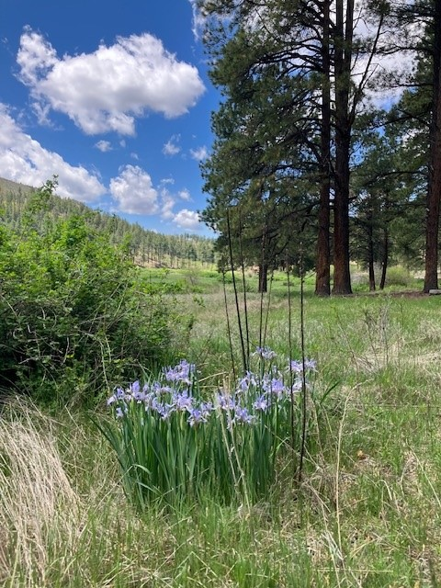
18
Fee Revision Process
Completed State Parks Fees Study July 2023
Developed proposed changes to our fee structure and associated revisions to State Parks Administrative Rules
Held public information sessions around the state from January through March
Collected and reviewed over 900 public comments between February 14, 2024, and March 29, 2024
Notes:
.

Slide 3
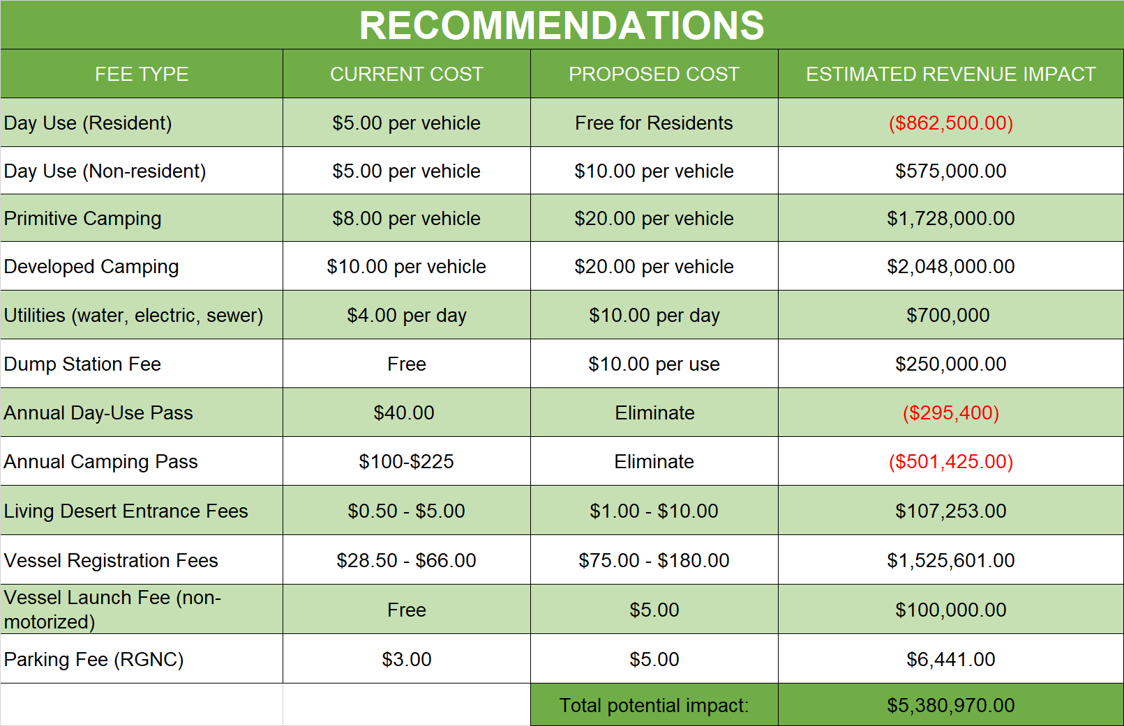
In addition to the fee changes proposed above for the current cycle, we are recommending adding
into rule a 5-year review of fees and adjustment for inflation.

Slide 4
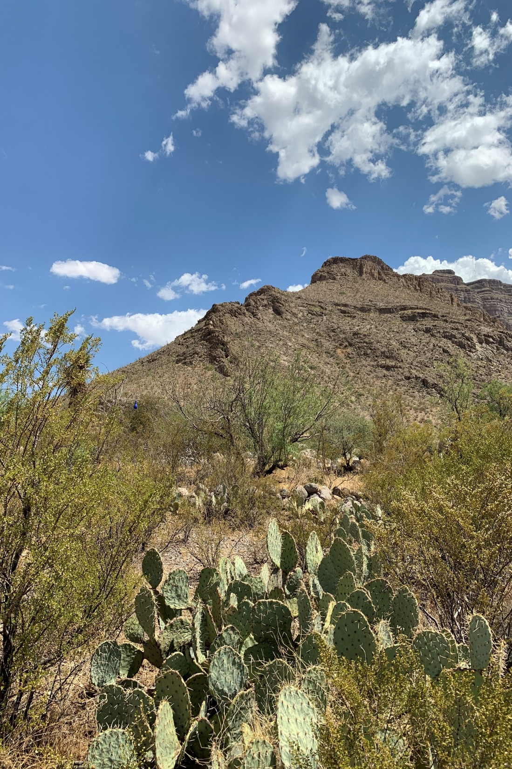
18
Public Input Process
Held meetings around the state and virtually listening to questions and comments from the public
  Mesilla Valley Bosque SP
  Elephant Butte Lake SP
  Living Desert Z&G SP
  Virtual
  Tucumcari
  Las Vegas
  Navajo Lake SP
  Rio Grande Nature Center
  RGNC Friends Group
  Virtual meeting with NGOs
  Parks Advisory Board
  Park Management Staff
Over 400 people attended public meetings both virtually and in person.
Received over 900 written comments through traditional mail, e-mail, and hand delivered at public meetings
Reviewed and consolidated all comments based on opposition to recommendations

Slide 5
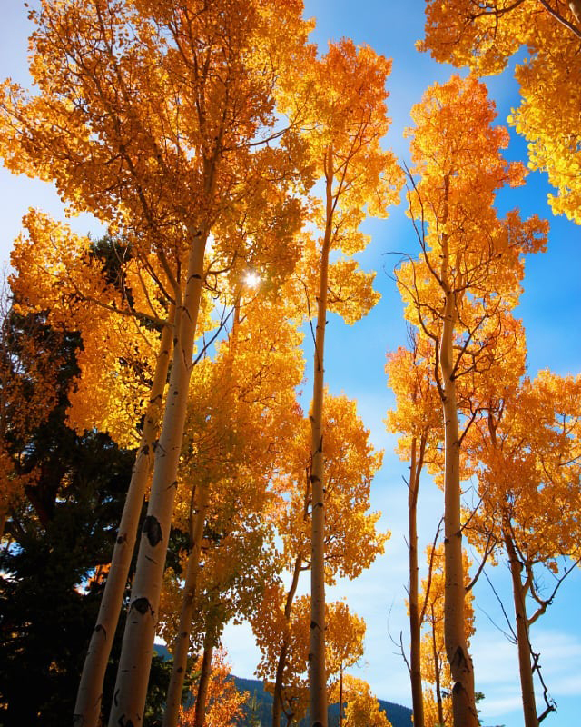
18
Comment Evaluation
Added categories including “For All” “Against All” and “Neutral”
Annual Pass comment evaluation process
Removed duplicate responses and compiled duplicate responses from the same e-mail address
Not 100% accurate as some interpretation is required
Most comments included a statement indicating that it is understandable that fees must be increased

Slide 7
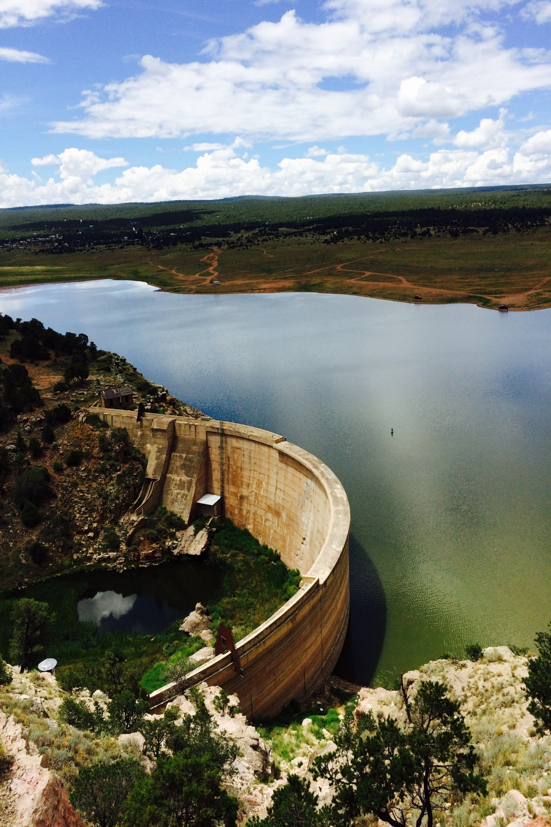
18
Senior/Disabled ACP
Most comments referenced the need to consider senior, disabled, and veteran populations.
Suggestions included:
  Keep the current ACP for Senior/Disabled as is
  Keep the current ACP for Senior/Disabled but increase the fee
  Implement a discount pass that allows for a certain percentage off park fees
  Implement free access for senior, disabled, and veteran populations

Slide 8
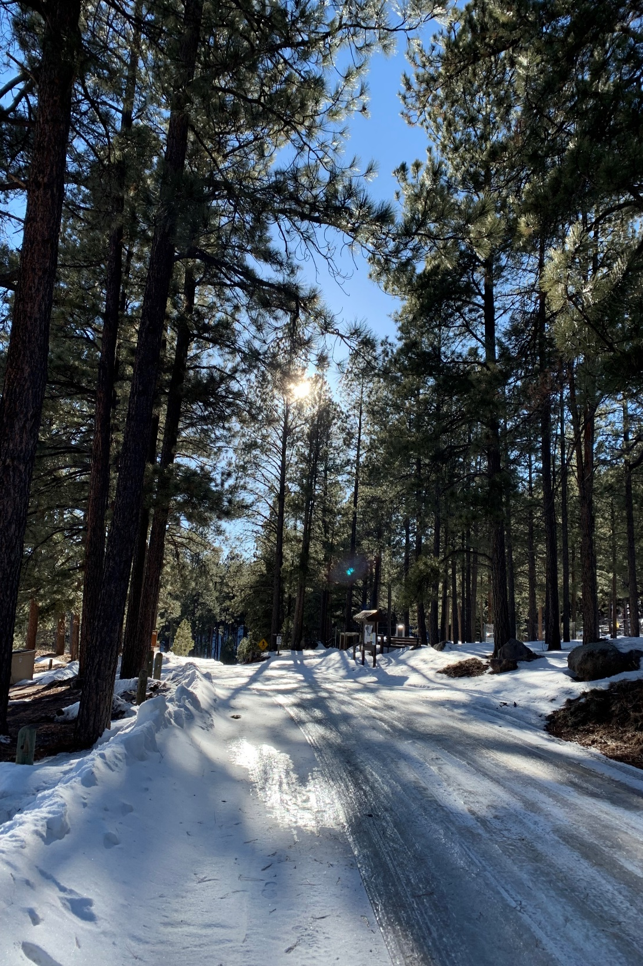
18
Annual Camping Pass
There was significant interest in keeping an ACP with suggestions for addressing concerns.
Suggestions included:
  Keep ACP as is
  Keep ACP with increased fees
  Keep only resident ACP and eliminate NR-ACP
  Create a discount pass that allows for a percentage off sites
  Create a multiple stay punch card
  Create park specific ACPs
  Reduce the stay limit
  Create seasonal camping passes for off season use

Slide 9
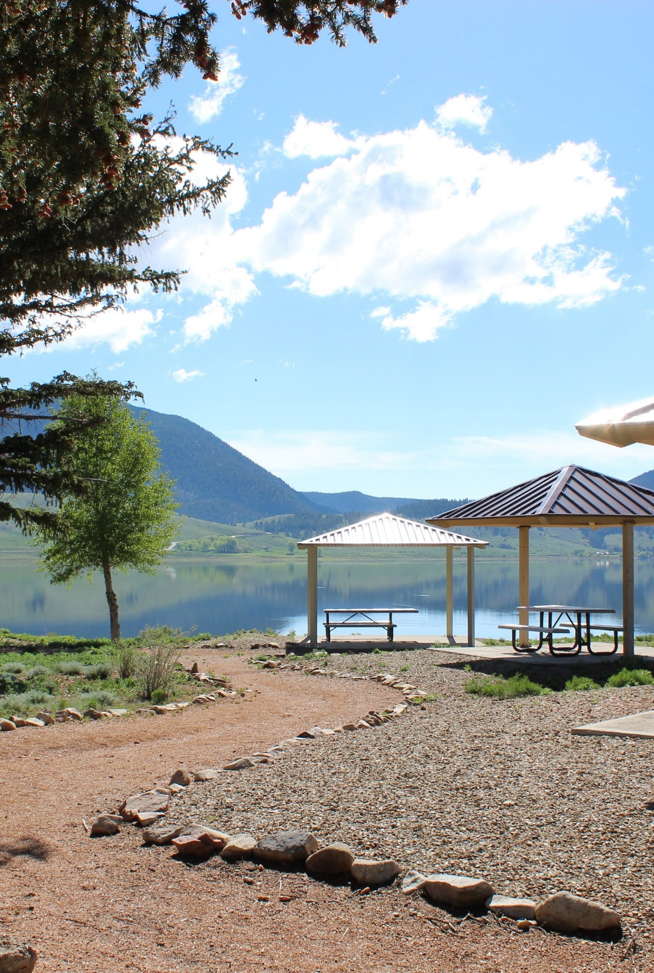
18
Free Day Use / ADU
Most comments opposing free day use had to do with concerns for overcrowding, resource abuse, crime, and inability to manage for increased use.
Suggestions included:
  Increasing the ADU fee
  Creating resident/non-resident ADU fees
  Reducing Day Use fee but not eliminating it
  Providing free or cheaper access to less busy parks

Slide 10
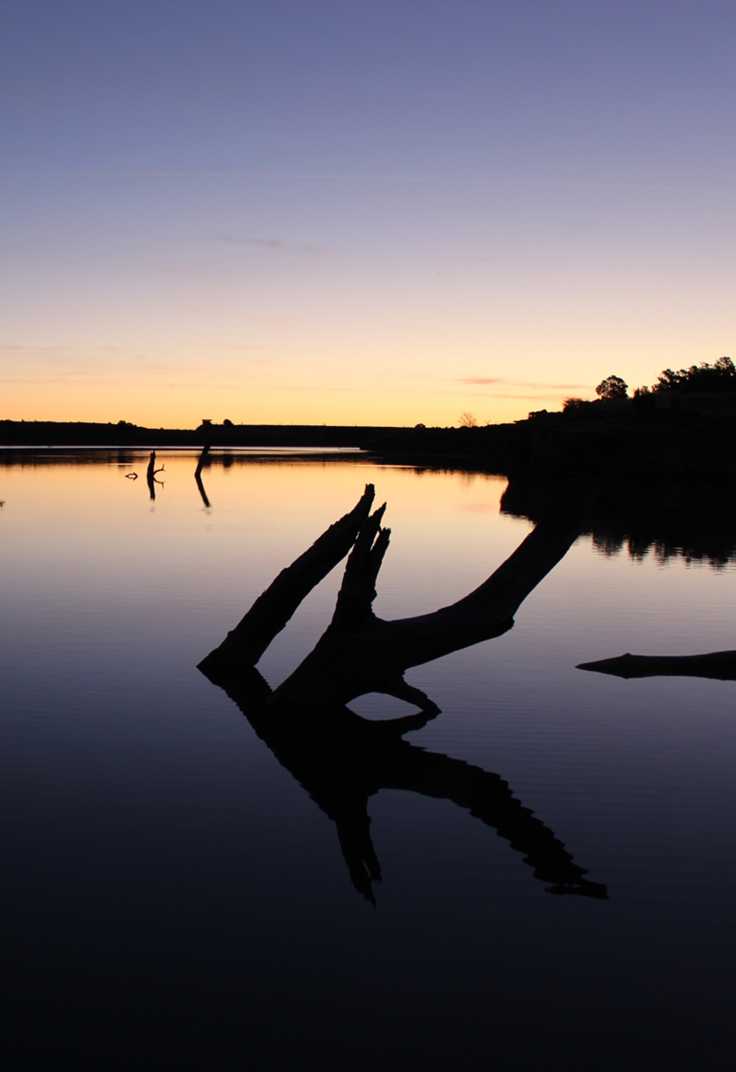
18
Overall Concerns
New Mexico is a poor state
Increasing fees hurts people on fixed/limited incomes
Need for improved maintenance/staffing
Concerns related to management of fees and inconvenience
Consider dynamic pricing

Slide 11
NMSP Fees Compared to
Other Economically Disadvantaged States
State | Median Income | Poverty Rate | Day Use | Developed Camping | Full Hookup Camping | Primitive Camping
New Mexico | $56,420 | 17.7% | $5.00 | $10.00 | $18.00 | $8.00
Mississippi | $48,610 | 19.2% | $0.00 | $15.00 | $17.00-32.00 | $17.00
West Virginia | $52,460 | 16.8% | $0.00 | $20.00-35.00 | $40.00-45.00 | N/A
Arkansas | $53,980 | 16% | $0.00 | $14.00 | $32.00 | $14.00
Kentucky | $55,880 | 16.3% | $0.00 | $18.00-45.00 | N/A | $15.00-22.00
Louisiana | $58,330 | 19.5% | $3.00 per person | $18.00 | $25.00-33.00 | $9.00-18.00
Median income information from: Federal Reserve Economic Data https://fred.stlouisfed.org/release/tables?rid=249&eid=259515#snid=259516
Poverty information from: USDA Economic Research Service https://data.ers.usda.gov/reports.aspx?ID=17826
Fee information from: NASPD AIX 2020-2021 and various state park system websites

Slide 13
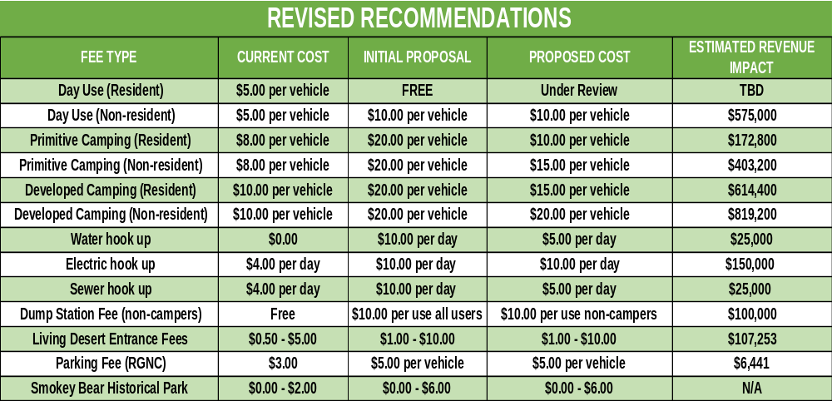
Revised Entrance/Camping Fee Proposal

Slide 14
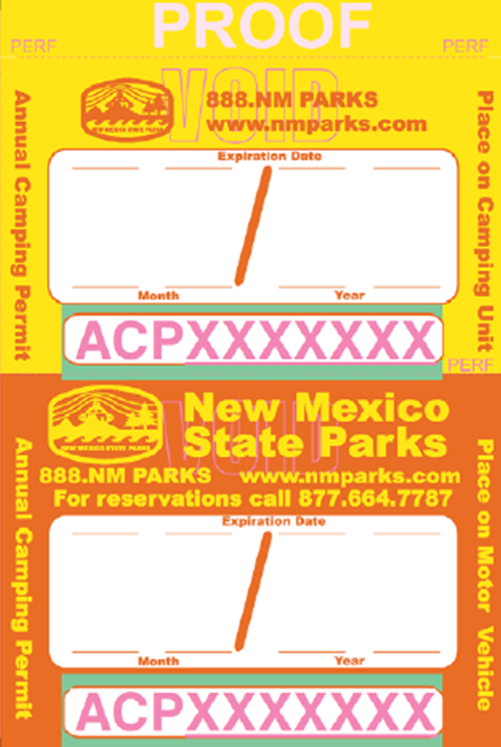
18
Annual Pass Adjustments
Work with reservation contractor to eliminate double-booking and fraudulent pass numbers.
Amend stay limits during busy season to reduce living in parks.
  7 out of 20 day stay limit from April 1 – Sept 30
  14 out of 20 day stay limit from Oct. 1 – Mar. 31
Increased enforcement verifying appropriate ACP use.

Slide 15
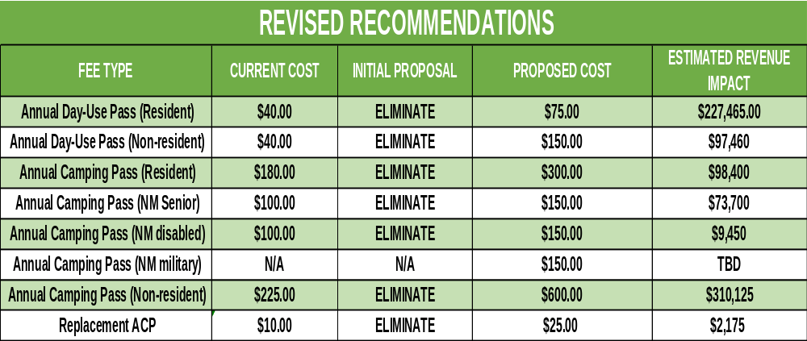
Revised Annual Pass Proposal

Slide 16
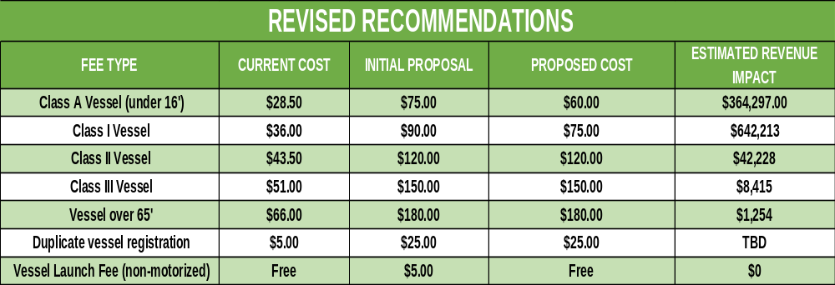
Revised Boat Registration Proposal

Slide 17
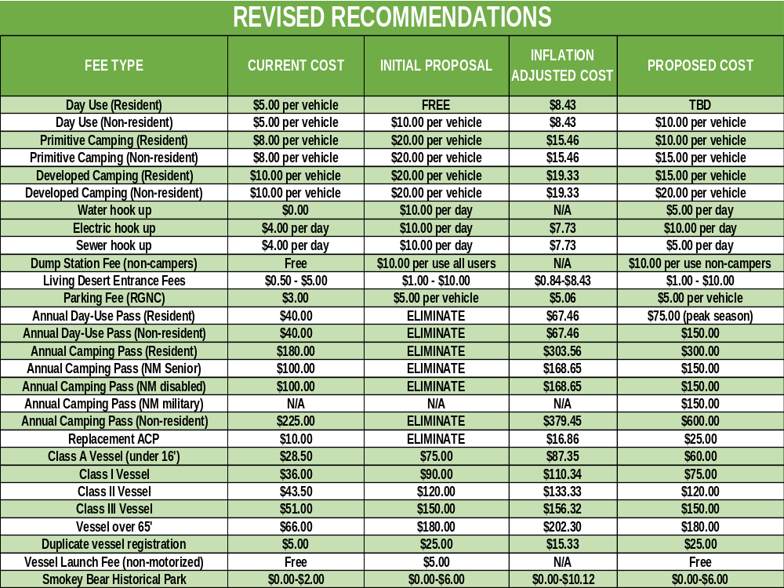

Slide 18
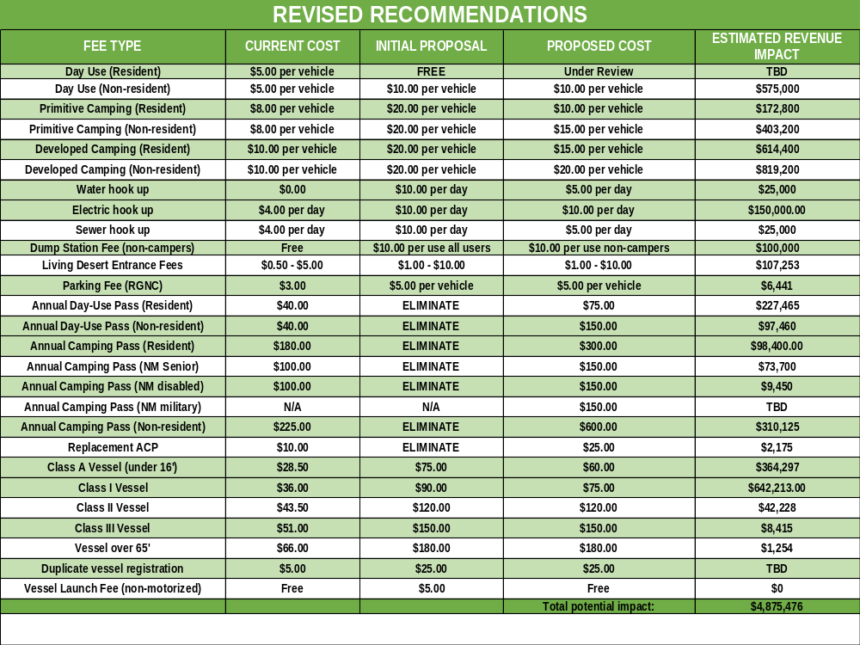

Slide 19
18
Example of Current vs. Proposed Fees
Based on a 3-night stay
CAMPING FEES BASED ON A 3 NIGHT STAY
Service | Current Fee | Proposed Resident Fee | Proposed Non-Resident Fee
Primitive Camping | $24.00 | $30.00 | $45.00
Developed site no utilities | $30.00 | $45.00 | $60.00
Developed site with water | $30.00 | $60.00 | $75.00
Developed site with Electric and water | $42.00 | $90.00 | $105.00
Full hookup site (water, sewer and electric) | $54.00 | $105.00 | $120.00

Slide 20
Proposed Fees Compared to Other States
18
STATE | FEE
Utah | $188.00
Texas | $150.00
Colorado | $133.46
Arkansas | $131.70
Arizona | $123.20
New Mexico Non-Resident | $120.00
West Virginia | $105.98
Kentucky | $105.00
New Mexico Resident | $105.00
Mississippi | $102.00
Louisiana | $99.00*
We compared the cost of a full hookup campsite for 9 other states, including states that have similar economic situations to New Mexico.
Actual campsite costs from online reservation systems for a 3-night stay
  UT – Escalante Petrified Forest SP
  TX – Cedar Hill SP
  CO – Crawford SP
  AR – Bull Shoals – White River SP
  AZ – Lake Havasu SP
  WV – Beech Fork SP
  KY – Columbus Belmont SP
  MS – George P Cossar SP
  LA – Sam Houston Jones SP (*no sewer)

Slide 21
Tentative Timeline for Implementation
January 2023 Begin Fee Study
Complete Fee Study
Dec. 2023 – Mar. 2024
Conduct Informational Meetings
February 27, 2024
March 29, 2024
End Public Comment
April 2024
Review Public Comment / Revise Recommendations
July 2023
Publish Rule Change
June 2024
Conduct Informational Meetings
July 2024
Publish Revised Rule Change
July - August 2024
Hold Final Rule Hearing
January 2025
Adopt Rule Changes

Slide 22
Additional Rule Change Recommendations
Maintain 5-year review of Park Fees and adjustment
Amend stay limits to reflect peak seasons for camping
Clarify check out times for campsites
Include Cerrillos Hills as a park that does not allow camping
Clarify official use of OHVs
Allow for use of OHVs by concessionaires in some areas
Remove the allowance for OHVs on ice fishing lakes
Remove exception to fees for the Conchas Concession
Amend Language for Foster Family Free access
Eliminate reference to Wildlife Blind Fees
Addition of a short-term concession permit
Clean up spelling and grammatical errors

Slide 23
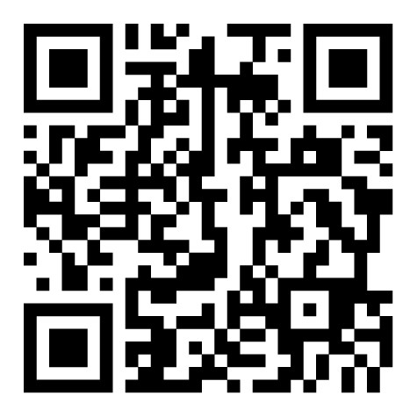

Questions?
Comments may be sent to:
A full copy of the Fees Study can be found online at:
New Mexico State Parks Division
Fee Amendments Comments
1220 S. St. Francis Dr.
Santa Fe, NM 87505
1-888-NMPARKS (667-2757)
www.emnrd.nm.gov
EMNRD-ParksComments@emnrd.nm.gov
Jared Langenegger, Bureau Chief
(575)420-1733

