Slide 1



Legal Update: Carlsbad Brine Well Remediation Authority
June 2, 2022
Dylan Fuge
General Counsel
New Mexico Energy Minerals and natural resources Department

Slide 2

OCD Rule Requirements
Agenda
  Change Order No. 5 Overview
  Management of Oil and Gas Development Activities Proximal to Brine Well Cavity
  Questions

Slide 3
OCD Rule Requirements
Change Order No. 5
  Remedial phase successfully concluded significantly under budget and ahead of anticipated schedule.
  EMNRD determined, based on feedback from the authority, the legislature, and its own experience, that some of those savings be redeployed to:
    Implement a managed depressurization of the cavity;
    Develop and implement an at least 2-year post remediation monitoring plan; and
    Have the contractor prepare an interim report providing guidance on the potential risks of induced seismic activity in and around the cavity
  Change Order 5 was a NO COST amendment to the contract that merely expanded the scope and performance timeframe within the bounds of the existing budget.
  Even after expansion in scope, at least $1.4M remains available for unforeseen contingencies

Slide 4
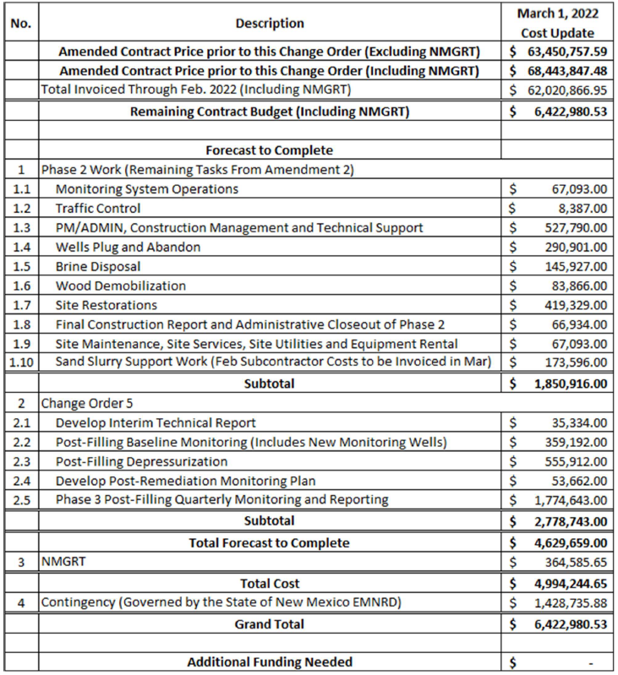
OCD Rule Requirements
Change Order No. 5 – Budget Update
Overall Spend to Date:
$65,248,067.74
incl. Wood Contract,
Use Agreements,
& Other Related Expenses

Slide 5
OCD Rule Requirements
Management of Drilling & Development Activities Proximal to Brine Well Cavity
  In connection with the resumption of cavity remediation and sand back-filling, the OCD imposed conditions on certain oil and gas development activities within 1-5 miles of the cavity.
  The restrictions applied to those activities with the potential to cause induced seismicity (i.e., drilling and completion) and were put in place in order to ensure that there were no potential negative impacts to the cavern or our remedial plan due to such seismicity.
  The restrictions paused activity under existing and any new permits and required OCD approval prior to resumption.

Slide 6
OCD Rule Requirements
Management of Drilling & Development Activities Proximal to Brine Well Cavity
  As part of Contract Amendment 2, OCD required Wood to prepare a report to analyze the risks to the cavern post implementation of the remedial plan.
    Given the additional time required for cavity depressurization, Change Order 5 required preparation of an interim plan.
  That interim plan indicates that the risk to the cavern from oil and gas activities beyond 1 mile of the cavern have been sufficiently decreased, such that such activities can safely resume.
  Additional guidance within 1 mile of the cavern will be provided following completion of the site depressurization and the receipt of a final report from the contractor.

