Slide 1
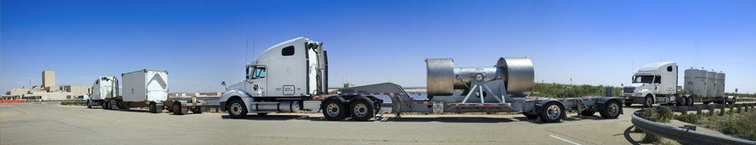
Energy, Minerals and Natural Resources
Eletha J. Trujillo, Bureau Chief
Energy Minerals & Natural Resources Department
5200 Oakland Ave NE Suite A
Albuquerque, NM 87113
Eletha.Trujillo1@emnrd.nm.gov

Slide 2
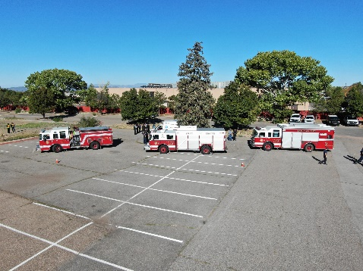
WIPP Working Group
Working in year three of five (7/1/22 – 6/30/27)
Four Funded State Agencies:
  Energy Minerals & Natural Resources Department (EMNRD)
    Bureau Chief, Fire Service Support Coordinator, and Training and Development Specialist with Law Enforcement focus
  Environment Department –
    One full time staff – Radiation Control Bureau and trainer
  Department of Health
    One full time staff – Hospital and clinic training
  Department of Public Safety
    30% finance management, and 100% ERO and inspector training for hazmat and inspections
City of Santa Fe exercise

Slide 3
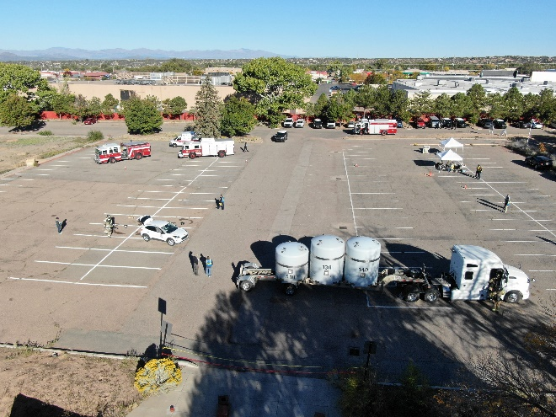
FY25 WIPP Funding and Activities
$1.3 million dollars
WIPPTREX 2023 – City of Santa Fe
  Closeout and support follow up
WIPPTREX 2025 – City of Raton/Colfax County
  Currently planning and designing
  Scheduled for October 2025
Deploying Law Enforcement Course for local communities
Continue training, and certifications of inspectors

Slide 4
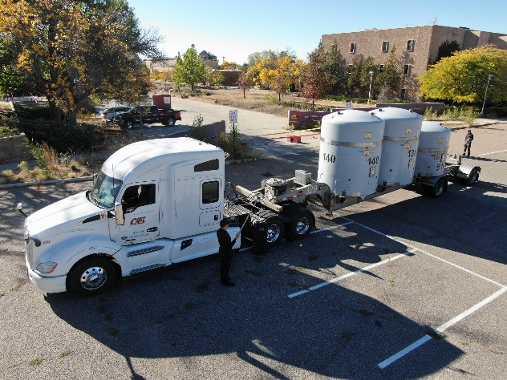
Shipments: January 1 - October 17, 2024
Shipper Site | Shipments Sent to WIPP
ANL-E | 4
INL | 289
LANL | 39
LLNL | 1
ORNL | 10
SRS | 54
Total | 397
Empty TRUPACT for City Exercise

Slide 5
Other Items of Interest
Under congressional direction, DOE is looking for sites to store and dispose of the spent nuclear fuel.
DOE is working to build trust and confidence with the public and stakeholders.
Potential outcomes from the consent-based siting process could include
  either a negotiated consent agreement or
  a determination that after exploring the option in good faith, the community is not, in fact, interested in serving as a host.
DOE is conducting webinars and speaking engagements.
RFI Comment Summary and Analysis found at https://www.energy.gov/sites/default/files/2022-09/Consent-Based%20Siting%20RFI%20Summary%20Report%200915.pdf

Slide 6
Questions?

