Slide 1
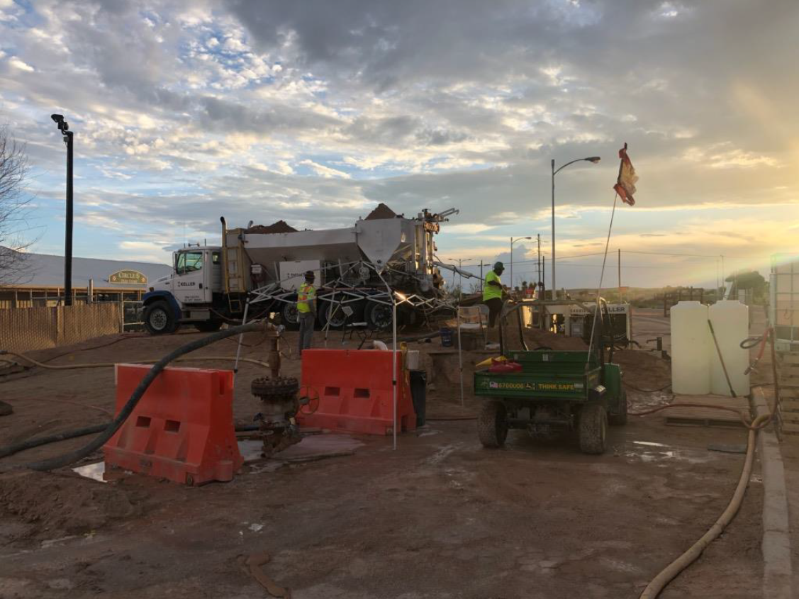



Carlsbad Brine Well Authority Meeting
June 02, 2022

Slide 2

Introductions
Jim Griswold - OCD
Dan Kwiecinski – Wood Project Manager
Peter Guerra – Wood Deputy PM

Slide 3
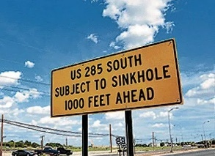
Agenda
Project Background
Work Completed
  Remediation Design
  Filling the Cavity
Work Remaining
  Cavity Depressurization
  Site Surface Restoration Activities
  Post-remediation Monitoring
  Project Closeout
Meeting the Project Objectives
Discussion

Slide 4
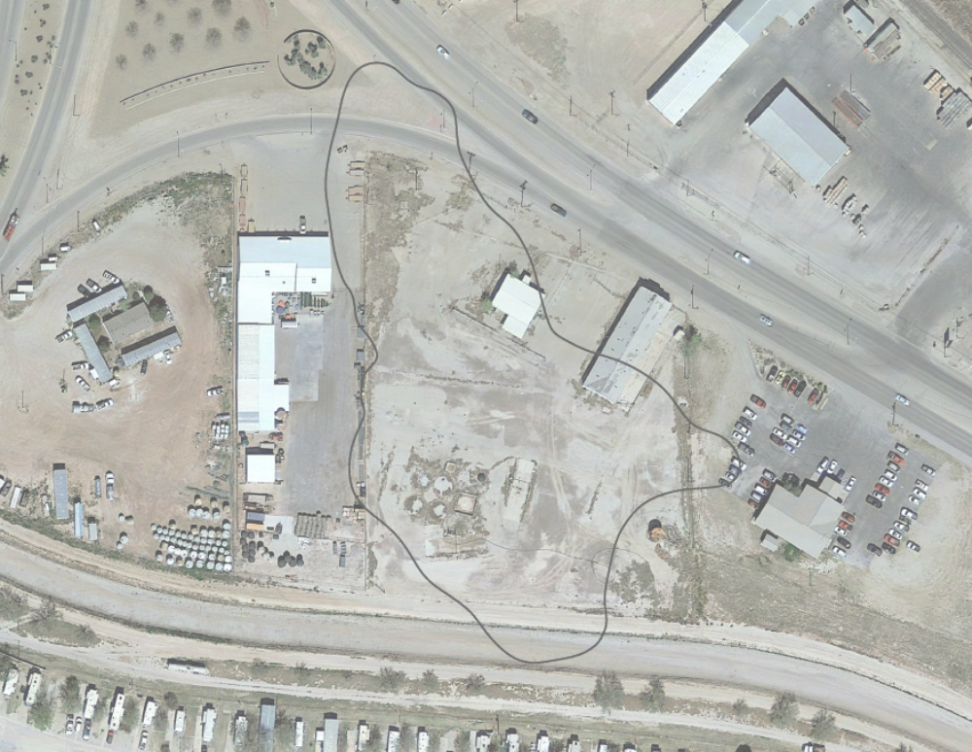


Remediation Implementation Work Completed
2018-2019 – Remediation Plan Design
Sep 2019 - Mobilization
  Grouting Campaign
    Stabilize Southern Cavity
    Injected 5,600 CY of Grout
  Discovered Northern Void
    December 2019 Encountered During Drilling
    February 2020 Sonar Survey
  Required adjustment to remediation approach
  Sand Slurry Campaign
    Stabilize Northern Void
    Injected 170,000 CY of Sand
    Completed Feb 2022
  Brine removed and disposed of from cavity equal to the volume of solids added.
Apr 2022 - Demobilization
SAND STABILIZED
NORTHERN VOID
ORIGINAL
BOUNDARY
GROUT STABILIZED
SOUTHERN VOID

Slide 5
Filling the Northern Void Work Completed
FEBRUARY 2020
SAND FILLED CAVITY
MAY 2020
SEPTEMBER 2021
SAND FILLED RUBBLE
(CONCEPTUAL)
JANUARY 2022
300’
GW3
GW5
400’
500’
100’
0’
100’

Slide 6
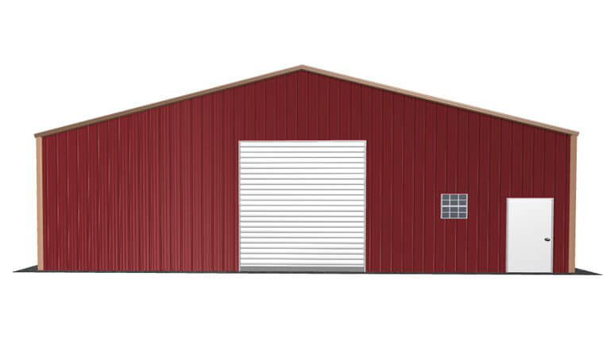
Cavity Depressurization Work Remaining
CURRENT BRINE LEVEL
(~60-ft or 32 psi above ground)
Objectives
  Decrease pressure of brine in cavity
  Protect freshwater aquifer
Stepwise Depressurization
  Decrease cavity pressure incrementally
  Monitor performance with existing instrumentation
  Ease off pressure to preserve integrity of aquitard (barrier between cavity and freshwater aquifer)
FRESH
GROUND
WATER
TARGET BRINE LEVEL
(~60-ft or 32 psi below ground)
AQUITARD
GROUT/SAND
AND BRINE
FILLED CAVITY

Slide 7
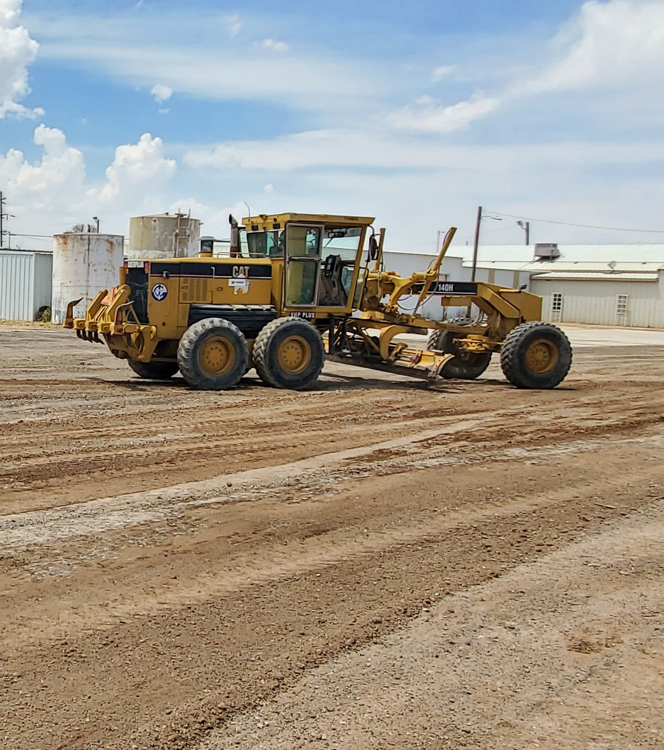
Site Surface Restoration Work Remaining
Demobilize equipment and unused materials
Restore / Replace
  Grades and pavements
  Fencing and gates
  Septic System
Remove Project Infrastructure
  Site Office
  Storage buildings
  Surface water control features
  Brine storage

Slide 8

Post-remediation Monitoring Work Remaining
Two years of monitoring following depressurization
What will be monitored?
  Existing monitoring system to measure changes subsurface
  Brine and sand level in cavity
  (gauging using water-level sounder)
  Fresh groundwater quality
  Ground surface movement (InSAR)
Why is it smart to monitor?
  Adjust level of brine if rising
  Assess condition of cavity before plugging wells
  Assure freshwater quality is maintained
Quarterly reporting

Slide 9

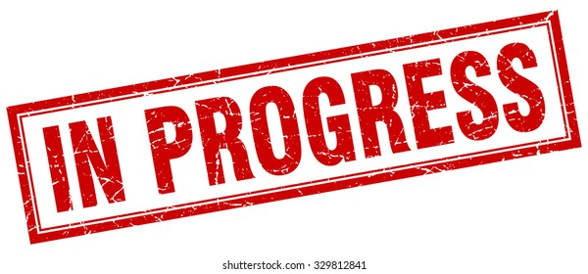

Meeting the Project Objectives
Mitigate the risk of a sinkhole forming at the project site and surrounding area.
  With the completion of sand deployment at the northern void the risk of a sinkhole forming at the surface has been mitigated to the extent possible.
Protect the freshwater aquifer above the cavity from brine impacts.
  A significant portion of the risk of brine and freshwater mixing due to a cavity roof collapse was abated by filling the cavity with grout and sand.
  Carefully lowering the brine level (stepwise depressurization) will further reduce the risk of brine from the cavity impacting the freshwater above.

Slide 10
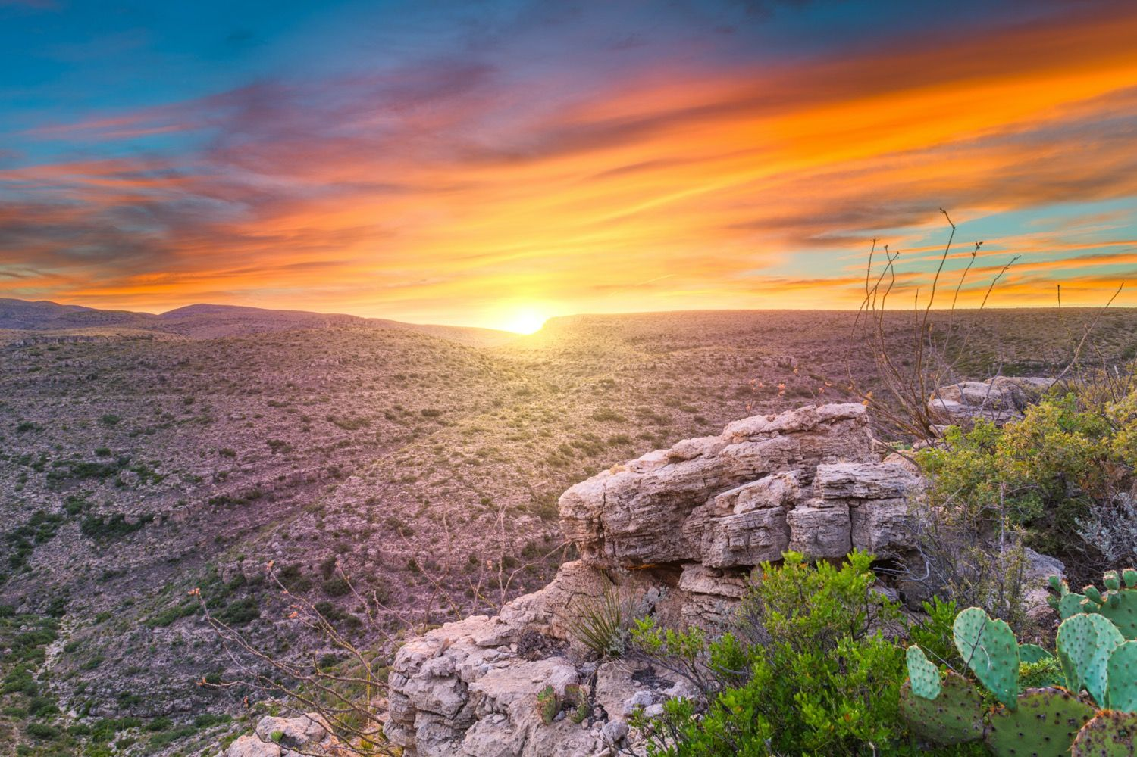
Discussion
Source: https://www.travellens.co/best-things-to-do-in-carlsbad-nm/

Slide 11
Appendix

Slide 12
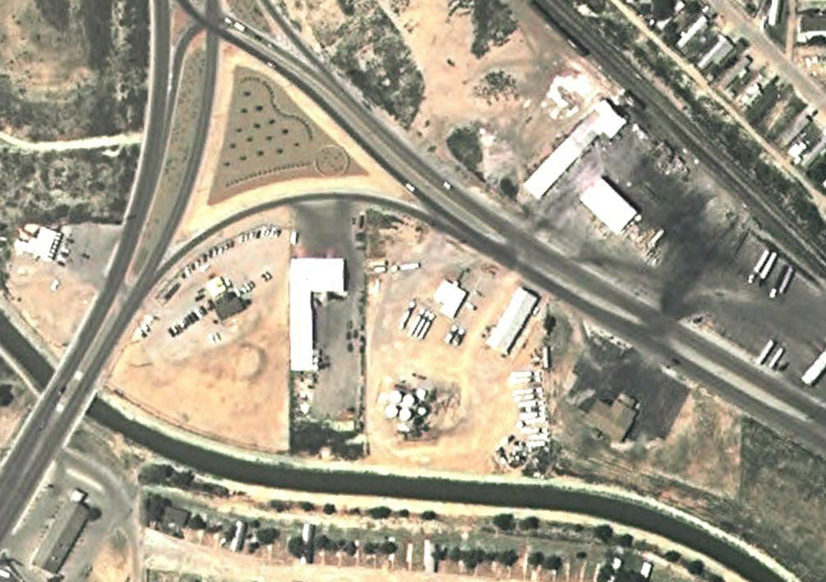
Project Background
ACTIVE SOLUTION MINING
PRELIMINARY
INVESTIGATIONS
SITE CHARACTERIZATION
& FEASIBILTY STUDY
1978
2008
2010
2012
2014
2016
2018
Operated from 1978 until July of 2008.
Dissolving and extracting the subsurface salt deposit in the form of brine (salt-laden water).
Two wells named Eugenie #1 and Eugenie #2 used in brine production.
A fracking procedure at Eugenie #2 was conducted in late 1979 to increase brine production.
Eugenie #2
Eugenie #1
2005

Slide 13
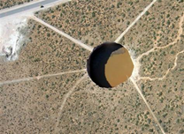
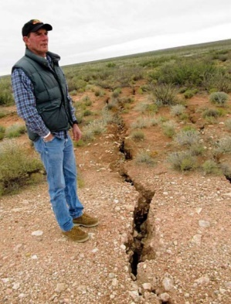
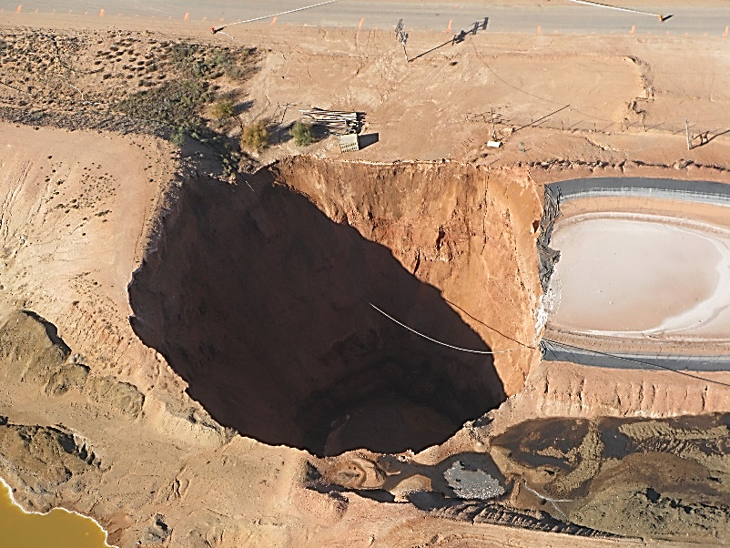
Project Background
ACTIVE SOLUTION MINING
PRELIMINARY
INVESTIGATIONS
SITE CHARACTERIZATION
& FEASIBILTY STUDY
1978
2008
2010
2012
2014
2016
2018
7/16/2008: Brine well southeast of Artesia catastrophically collapsed forming a 100-ft deep sinkhole.
7/22/2008: Brine production at the site was terminated at OCD’s direction.
11/3/2008: Second brine well collapse occurred north of Loco Hills, NM.

Slide 14
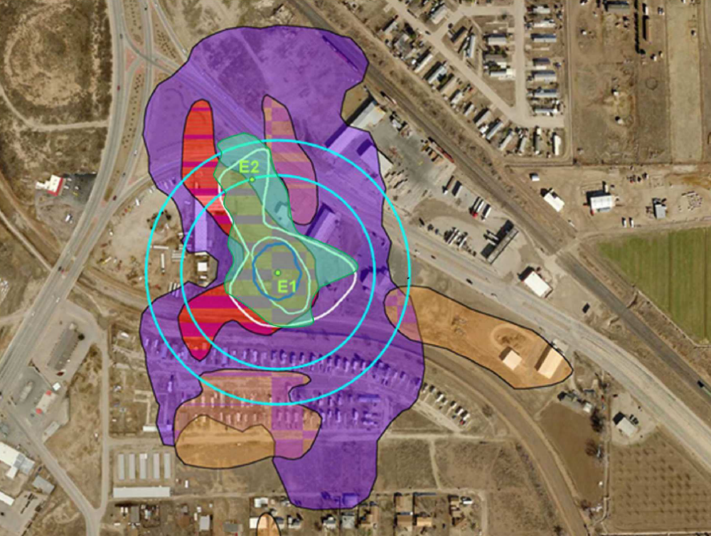
Project Background
ACTIVE SOLUTION MINING
PRELIMINARY
INVESTIGATIONS
SITE CHARACTERIZATION
& FEASIBILTY STUDY
1978
2008
2010
2012
2014
2016
2018
Geophysical surveys were performed from 2009 to 2012 to provide an initial understanding of the cavity.
Geophysical methods include:
  Seismic reflection and refraction,
  Reflection microtremor (ReMi),
  High-resolution magnetotelluric (MT) Z-Scan,
  Microgravity, and
  2-D electrical resistivity.
Compilation of results from all the geophysical methods used to characterize the
cavity.

Slide 15
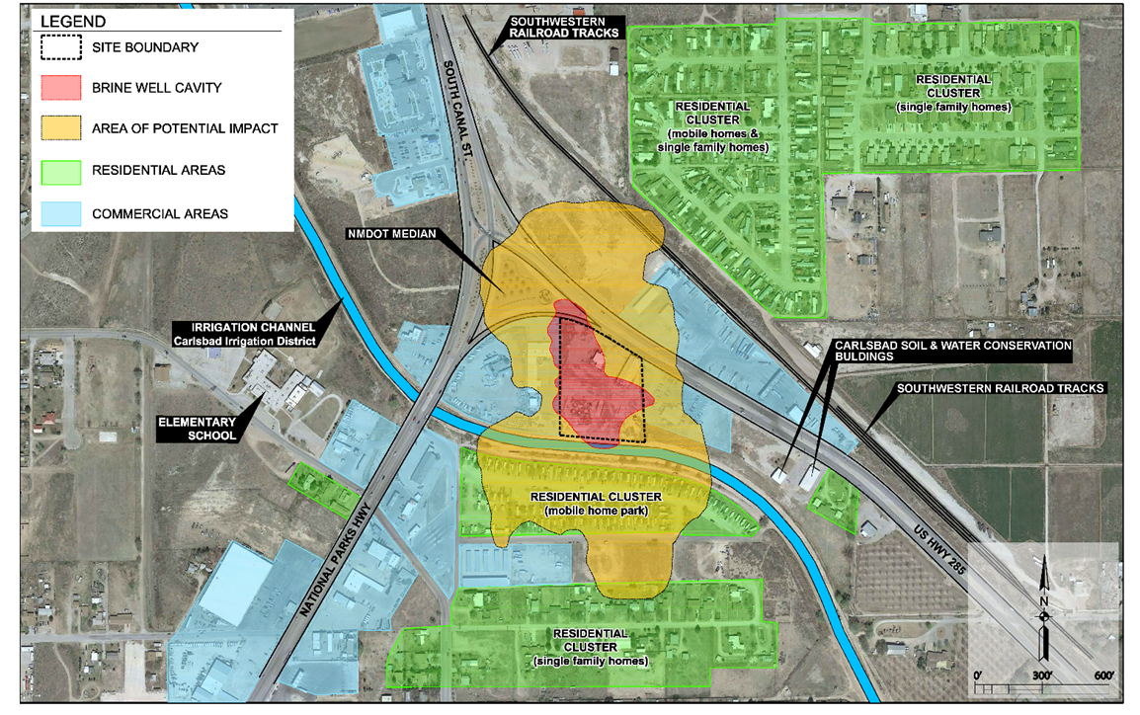
Project Background
ACTIVE SOLUTION MINING
PRELIMINARY
INVESTIGATIONS
SITE CHARACTERIZATION
& FEASIBILTY STUDY
1978
2008
2010
2012
2014
2016
2018
Coring and drilling campaigns
Cavity sonar surveys
Analysis and modeling of the cavity
InSAR to assess settlement / surface movement
Evaluate and select the remediation approach

Slide 16
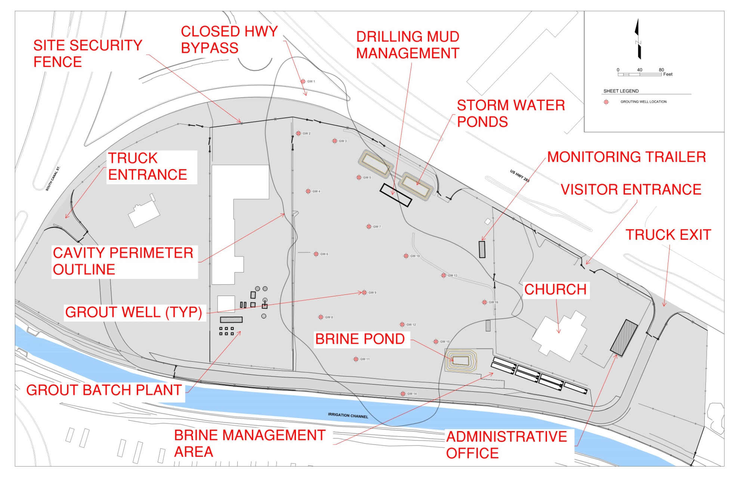
Remediation Design (2018-19) Work Completed

Slide 17
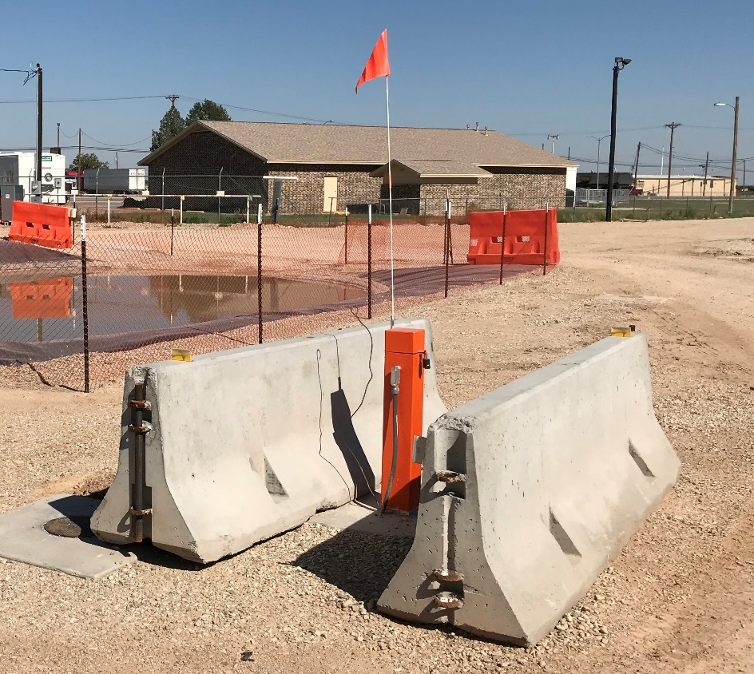
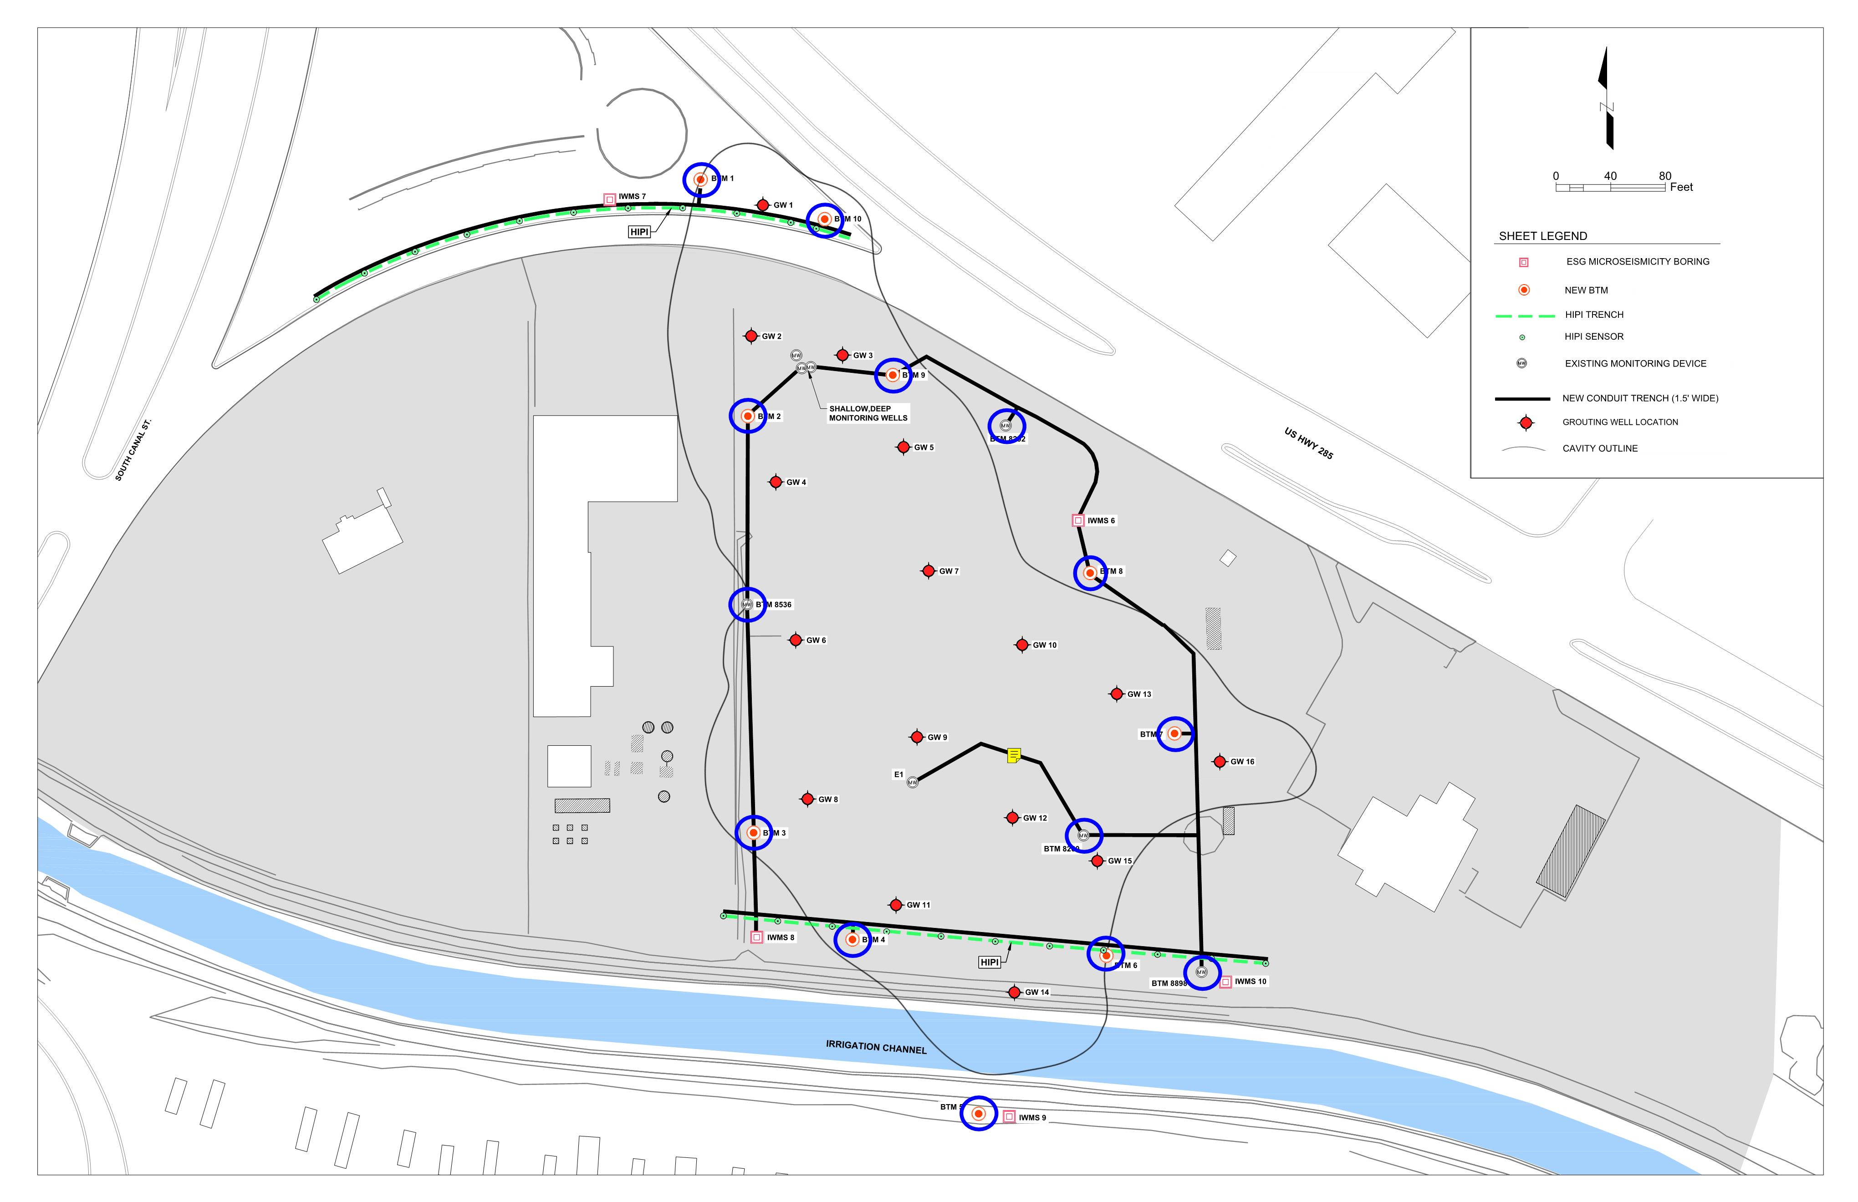
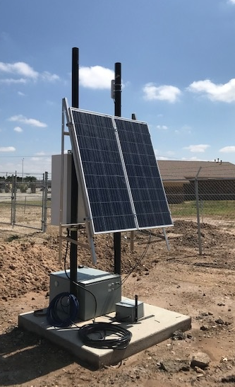
BOREHOLE TILT METER
Monitoring System Work Completed
Continuous Monitoring
Remote Access and Online Reporting
Monitored 24/7 during Operations
MICROSEISMIC STATION

Slide 18
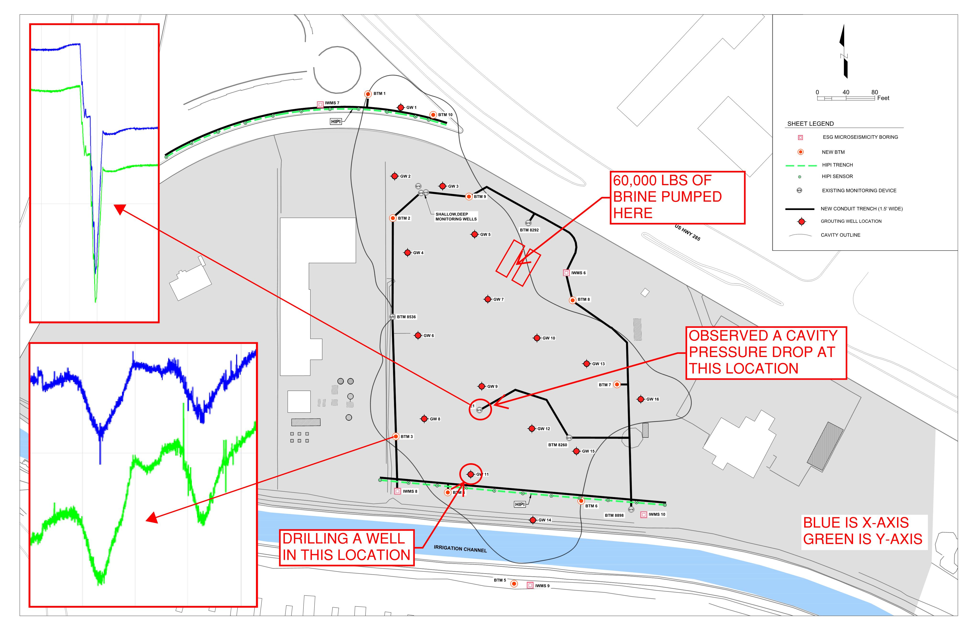
Monitoring System in Action Work Completed

